Slide 1



Qualifications and Credentials Platform component of ACQF-II project
O8/03/2024

Slide 2
01
Opening remarks

Slide 3



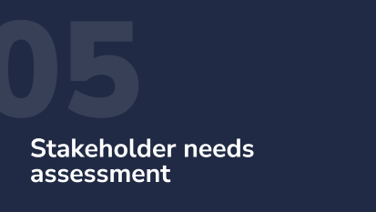

Agenda

Slide 4
Opening Remarks

Slide 5
02
Roundtable introductions of participants and the project consortium

Slide 6
Participant roundtable

Slide 7
Consortium team
Cognizone: Leader in essential data sectors, empowering organisations and governments to leverage their data effectively with Semantic Technologies and Linked Data.
Knowledge and Innovation Centre: Social enterprise of international experts working at the crossroads of education, technology and quality assurance.
PPMI: Premier research and policy analysis centre, that delivers clear, actionable evidence to global public sector and civil society leaders.

Slide 8
Consortium team
Cognizone:
  Providing overall leadership of the delivery
  Focus on IT Expertise
Knowledge and Innovation Centre:
  Providing Thematic Expertise and related deliverables
PPMI:
  Providing Research and Context-based Expertise for stakeholder-facing deliveries

Slide 9
03
Presentation of the QCP Project

Slide 10
The QCP component of ACQF-II project project in a nutshell
Over the lifetime of the project, we will deliver:
Package A: Develop a strategic concept for ACQF QCP
Package B: Baseline analysis and stakeholders' consultation
Package C (in subsequent project phases):
  Technical development of ACQF QCP
  Data collection for ACQF QCP
  Handover of ACQF QCP
  Capacity development and advocacy

Slide 11
Package A: Develop a proof of concept of the ACQF QCP
The main objectives of this activity are to:
Document the user needs and expectations; Coming from results of Package B: and analyse the requirements, preferences, and challenges of all stakeholders to ensure the platform meets their needs.
Outline the technologies and architectures of the ACQF QCP; Assess and select suitable technologies and architectural designs that support scalability, security, and interoperability.
Produce a technical blueprint for the system; Create a technical plan that outlines the system's components, data model and integration points.

Slide 12
Package B: Baseline analysis and stakeholder consultation
The main objectives of this activity are to:
Collect quantitative data from identified stakeholders via a survey. This will map existing practices, stage of development of QDBs, stakeholder needs, national capacities & resources and other issues. The primary target groups are relevant national authorities.
Explore stakeholder perspectives in greater depth, allowing nuanced interpretations of the baseline conditions via webinars. Webinars will allow us to gather additional feedback, discuss more complex questions and enrich our quantitative data.
Baseline analysis report: synthesising the findings of the survey and webinars. The report will provide an overview of existing practices, development stages of QDBs, evaluate technical viability matters and other needs of the stakeholders.

Slide 13
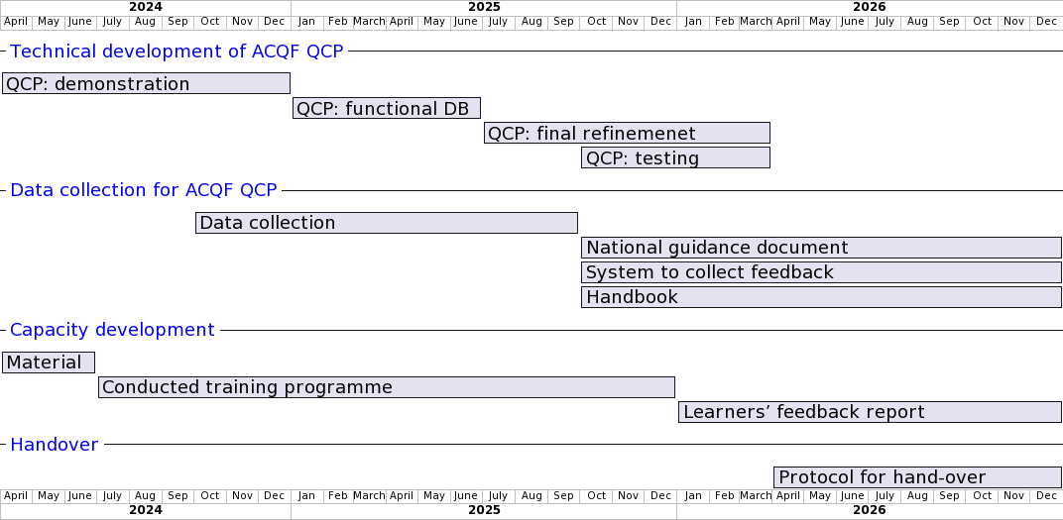
Package C: Subsequent phases
Slide 13 – Package C) - Comments ACQF-II coordinator:
The plan has some discrepancies in terms of logic, which need to be addressed. The most visible cases to be reviewed are:
Under the item 1 (Technical development of ACQF QCP): a) step 1: should be “database functional and demonstration”;
Under the item 2 (Data collection for ACQF QCP): a) The Handbook should comprehensively and fully describe the QCP for users at national and continental levels. It is not a Handbook on data collection only. B) What is the scope of “National Guidance document” – is this a chapter or module of the Handbook?
Under the item 3 (Capacity development): what is the scope of “Material”? Is this the Training Manual and pedagogic videos (as per ToRs)?
Notes:
@startgantt
<style>
ganttDiagram {
task {
FontName Helvetica
FontSize 18
}
separator {
FontColor blue
FontName Helvetica
FontSize 18
}
}
</style>
printscale monthly
Project starts the 1st of April 2024
' Define tasks with start and end dates
-- Technical development of ACQF QCP --
[QCP: demonstration] as [D11] starts at 2024-04-01 and ends at 2025-01-01
[QCP: functional DB] as [D21] starts at 2025-01-01 and ends at 2025-06-30
[QCP: final refinemenet] as [D3a1] starts at 2025-07-01 and ends at 2026-03-31
[QCP: testing] as [D3b1] starts at 2025-10-01 and ends at 2026-03-31
-- Data collection for ACQF QCP --
[Data collection] as [DCC1] starts at 2024-10-01 and ends at 2025-09-30
[National guidance document] as [NGD1] starts at 2025-10-01 and ends at 2026-12-31
[System to collect feedback] as [SCF1] starts at 2025-10-01 and ends at 2026-12-31
[Handbook] as [HB1] starts at 2025-10-01 and ends at 2026-12-31
-- Capacity development --
[Material] as [TM1] starts at 2024-04-01 and ends at 2024-06-30
[Conducted training programme] as [CTP1] starts at 2024-07-01 and ends at 2025-12-31
[Learners’ feedback report] as [LFR1] starts at 2026-01-01 and ends at 2026-12-31
-- Handover --
[Protocol for hand-over] as [PHO1] starts at 2026-04-01 and ends at 2026-12-31
@endgantt

Slide 14
Package C: Subsequent phases
Notes:
@startgantt
<style>
ganttDiagram {
task {
FontName Helvetica
FontSize 18
}
separator {
FontColor blue
FontName Helvetica
FontSize 18
}
}
</style>
printscale monthly
Project starts the 1st of April 2024
' Define tasks with start and end dates
-- Technical development of ACQF QCP --
[QCP: demonstration] as [D11] starts at 2024-04-01 and ends at 2025-01-01
[QCP: functional DB] as [D21] starts at 2025-01-01 and ends at 2025-06-30
[QCP: final refinemenet] as [D3a1] starts at 2025-07-01 and ends at 2026-03-31
[QCP: testing] as [D3b1] starts at 2025-10-01 and ends at 2026-03-31
-- Data collection for ACQF QCP --
[Data collection] as [DCC1] starts at 2024-10-01 and ends at 2025-09-30
[National guidance document] as [NGD1] starts at 2025-10-01 and ends at 2026-12-31
[System to collect feedback] as [SCF1] starts at 2025-10-01 and ends at 2026-12-31
[Handbook] as [HB1] starts at 2025-10-01 and ends at 2026-12-31
-- Capacity development --
[Material] as [TM1] starts at 2024-04-01 and ends at 2024-06-30
[Conducted training programme] as [CTP1] starts at 2024-07-01 and ends at 2025-12-31
[Learners’ feedback report] as [LFR1] starts at 2026-01-01 and ends at 2026-12-31
-- Handover --
[Protocol for hand-over] as [PHO1] starts at 2026-04-01 and ends at 2026-12-31
@endgantt

Slide 15
Package C: Subsequent phases
Notes:
@startgantt
<style>
ganttDiagram {
task {
FontName Helvetica
FontSize 18
}
separator {
FontColor blue
FontName Helvetica
FontSize 18
}
}
</style>
printscale monthly
Project starts the 1st of April 2024
' Define tasks with start and end dates
-- Technical development of ACQF QCP --
[QCP: demonstration] as [D11] starts at 2024-04-01 and ends at 2025-01-01
[QCP: functional DB] as [D21] starts at 2025-01-01 and ends at 2025-06-30
[QCP: final refinemenet] as [D3a1] starts at 2025-07-01 and ends at 2026-03-31
[QCP: testing] as [D3b1] starts at 2025-10-01 and ends at 2026-03-31
-- Data collection for ACQF QCP --
[Data collection] as [DCC1] starts at 2024-10-01 and ends at 2025-09-30
[National guidance document] as [NGD1] starts at 2025-10-01 and ends at 2026-12-31
[System to collect feedback] as [SCF1] starts at 2025-10-01 and ends at 2026-12-31
[Handbook] as [HB1] starts at 2025-10-01 and ends at 2026-12-31
-- Capacity development --
[Material] as [TM1] starts at 2024-04-01 and ends at 2024-06-30
[Conducted training programme] as [CTP1] starts at 2024-07-01 and ends at 2025-12-31
[Learners’ feedback report] as [LFR1] starts at 2026-01-01 and ends at 2026-12-31
-- Handover --
[Protocol for hand-over] as [PHO1] starts at 2026-04-01 and ends at 2026-12-31
@endgantt

Slide 16
Notes:
@startgantt
<style>
ganttDiagram {
task {
FontName Helvetica
FontSize 18
}
separator {
FontColor blue
FontName Helvetica
FontSize 18
}
}
</style>
printscale monthly
Project starts the 1st of April 2024
' Define tasks with start and end dates
-- Technical development of ACQF QCP --
[QCP: demonstration] as [D11] starts at 2024-04-01 and ends at 2025-01-01
[QCP: functional DB] as [D21] starts at 2025-01-01 and ends at 2025-06-30
[QCP: final refinemenet] as [D3a1] starts at 2025-07-01 and ends at 2026-03-31
[QCP: testing] as [D3b1] starts at 2025-10-01 and ends at 2026-03-31
-- Data collection for ACQF QCP --
[Data collection] as [DCC1] starts at 2024-10-01 and ends at 2025-09-30
[National guidance document] as [NGD1] starts at 2025-10-01 and ends at 2026-12-31
[System to collect feedback] as [SCF1] starts at 2025-10-01 and ends at 2026-12-31
[Handbook] as [HB1] starts at 2025-10-01 and ends at 2026-12-31
-- Capacity development --
[Material] as [TM1] starts at 2024-04-01 and ends at 2024-06-30
[Conducted training programme] as [CTP1] starts at 2024-07-01 and ends at 2025-12-31
[Learners’ feedback report] as [LFR1] starts at 2026-01-01 and ends at 2026-12-31
-- Handover --
[Protocol for hand-over] as [PHO1] starts at 2026-04-01 and ends at 2026-12-31
@endgantt

Slide 17
Notes:
@startgantt
<style>
ganttDiagram {
task {
FontName Helvetica
FontSize 18
}
separator {
FontColor blue
FontName Helvetica
FontSize 18
}
}
</style>
printscale monthly
Project starts the 1st of April 2024
' Define tasks with start and end dates
-- Technical development of ACQF QCP --
[QCP: demonstration] as [D11] starts at 2024-04-01 and ends at 2025-01-01
[QCP: functional DB] as [D21] starts at 2025-01-01 and ends at 2025-06-30
[QCP: final refinemenet] as [D3a1] starts at 2025-07-01 and ends at 2026-03-31
[QCP: testing] as [D3b1] starts at 2025-10-01 and ends at 2026-03-31
-- Data collection for ACQF QCP --
[Data collection] as [DCC1] starts at 2024-10-01 and ends at 2025-09-30
[National guidance document] as [NGD1] starts at 2025-10-01 and ends at 2026-12-31
[System to collect feedback] as [SCF1] starts at 2025-10-01 and ends at 2026-12-31
[Handbook] as [HB1] starts at 2025-10-01 and ends at 2026-12-31
-- Capacity development --
[Material] as [TM1] starts at 2024-04-01 and ends at 2024-06-30
[Conducted training programme] as [CTP1] starts at 2024-07-01 and ends at 2025-12-31
[Learners’ feedback report] as [LFR1] starts at 2026-01-01 and ends at 2026-12-31
-- Handover --
[Protocol for hand-over] as [PHO1] starts at 2026-04-01 and ends at 2026-12-31
@endgantt

Slide 18
Notes:
@startgantt
<style>
ganttDiagram {
task {
FontName Helvetica
FontSize 18
}
separator {
FontColor blue
FontName Helvetica
FontSize 18
}
}
</style>
printscale monthly
Project starts the 1st of April 2024
' Define tasks with start and end dates
-- Technical development of ACQF QCP --
[QCP: demonstration] as [D11] starts at 2024-04-01 and ends at 2025-01-01
[QCP: functional DB] as [D21] starts at 2025-01-01 and ends at 2025-06-30
[QCP: final refinemenet] as [D3a1] starts at 2025-07-01 and ends at 2026-03-31
[QCP: testing] as [D3b1] starts at 2025-10-01 and ends at 2026-03-31
-- Data collection for ACQF QCP --
[Data collection] as [DCC1] starts at 2024-10-01 and ends at 2025-09-30
[National guidance document] as [NGD1] starts at 2025-10-01 and ends at 2026-12-31
[System to collect feedback] as [SCF1] starts at 2025-10-01 and ends at 2026-12-31
[Handbook] as [HB1] starts at 2025-10-01 and ends at 2026-12-31
-- Capacity development --
[Material] as [TM1] starts at 2024-04-01 and ends at 2024-06-30
[Conducted training programme] as [CTP1] starts at 2024-07-01 and ends at 2025-12-31
[Learners’ feedback report] as [LFR1] starts at 2026-01-01 and ends at 2026-12-31
-- Handover --
[Protocol for hand-over] as [PHO1] starts at 2026-04-01 and ends at 2026-12-31
@endgantt

Slide 19
04
Presentation of the QCP survey

Slide 20
Timeline for the survey and webinars
Data Collection is foreseen to start next week and will last 2 weeks, until March 25. We will circulate an email to stakeholders when the survey opens. Please kindly share this with all relevant stakeholders.
Data Analysis starts after the closure of the survey
Webinar 2 is preliminarily planned for the 3rd of April, to present and validate initial results of the survey and the collected qualitative data.
Final Report is planned to be delivered by the end of April

Slide 21
Presentation of the QCP questionnaire
The survey focuses on a three main topics:
Demographic and organisational questions: these questions are used to identify the type of affiliated organization, professional roles and the stage of development of qualifications and credentials databases in the country.
Stakeholder needs and perceptions: focuses on user and administration needs, potential barriers and challenges, and potential use cases.
Current state of qualifications databases and future plans: organisational structures, current practices and future plans, technical operation (format of data storage, data entry, date versioning), public accessibility, main user groups.
In the following, we present a selection of key questions in more detail to elicit feedback from you. Please keep in mind that not all of the questions may be relevant to you.
We note that the questions will include additional explanations whenever needed.

Slide 22
Presentation of the QCP questionnaire (2)
Please consider some of these questions when we present the survey:
Are the questions clear enough for you? Did you find any of them hard to understand or confusing?
Do you think the questions are relevant to your organisation and your professional role?
Do you feel that the questions are comprehensive enough?
Are there any gaps that the questionnaire did not ask about or is something overlooked (e.g. concrete questions or more general topics)?
Are there any answer options you would modify or are not clear enough for you? Are these capturing the entire range of possible answers?

Slide 23
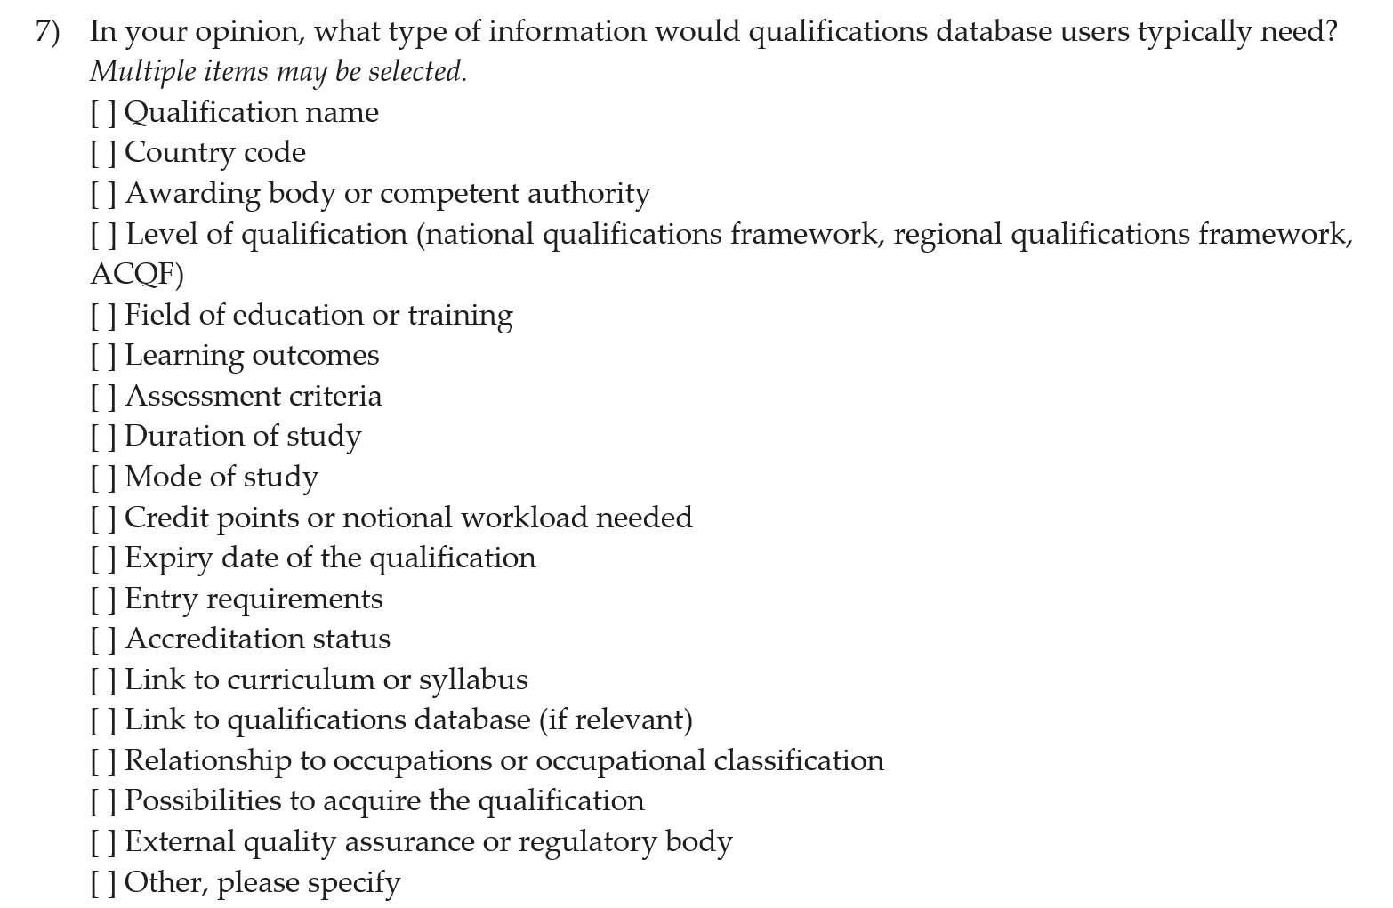
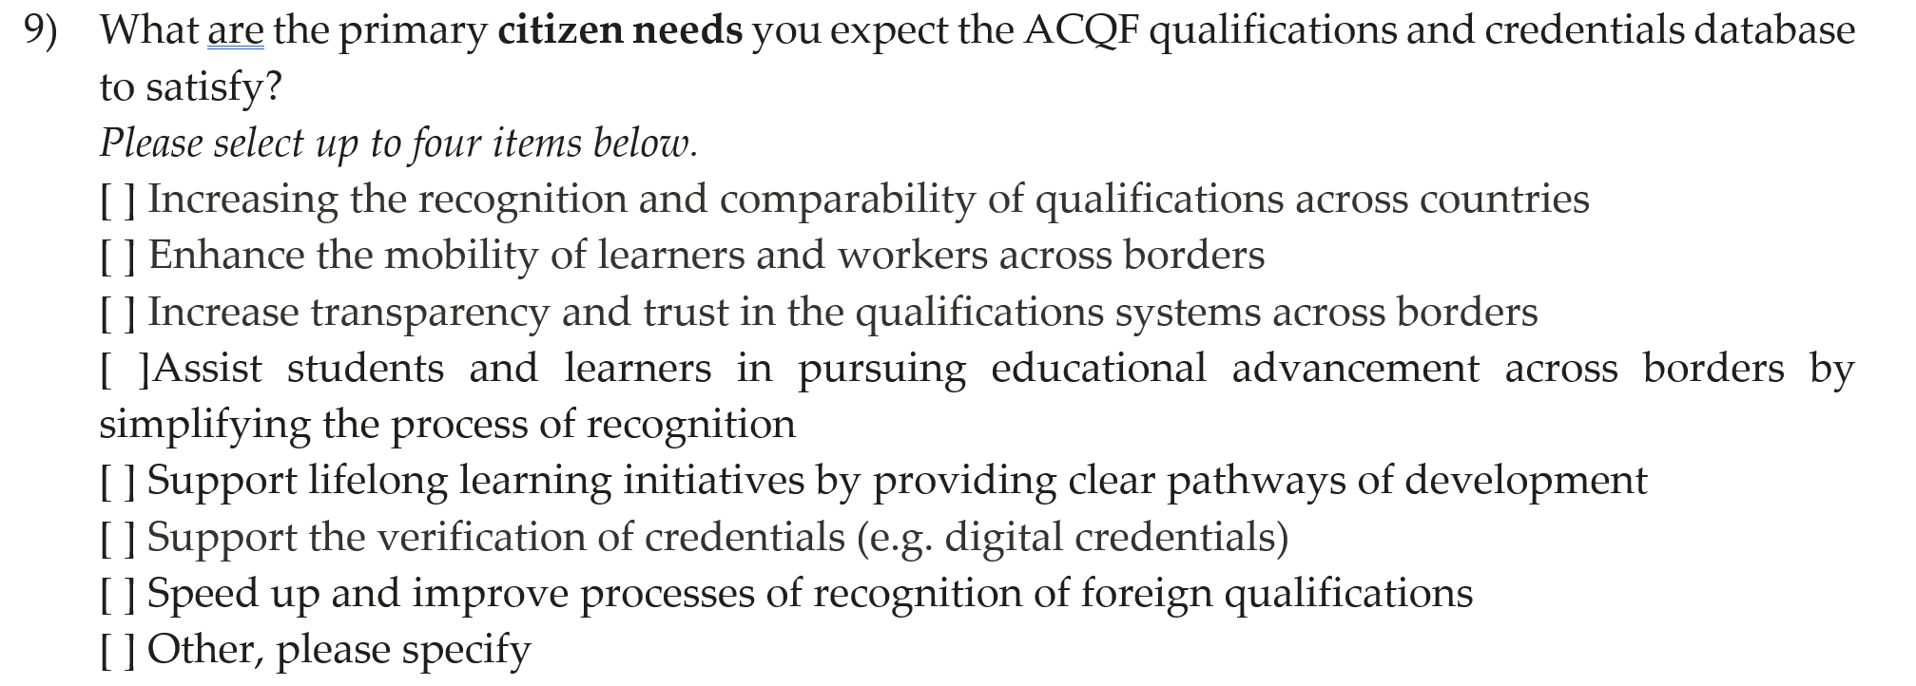
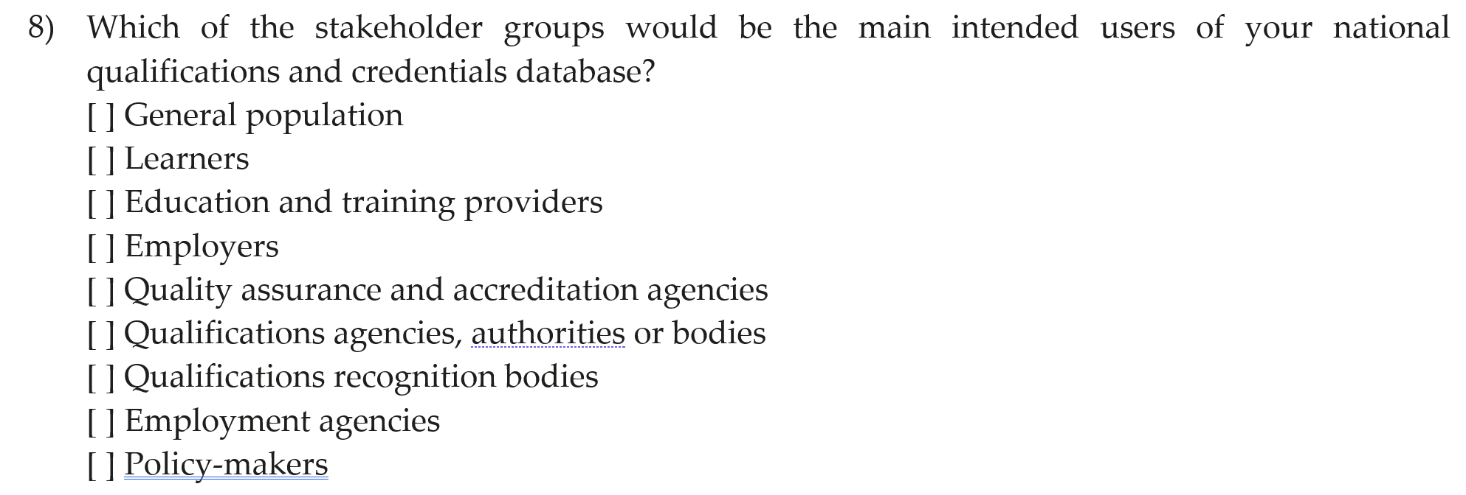
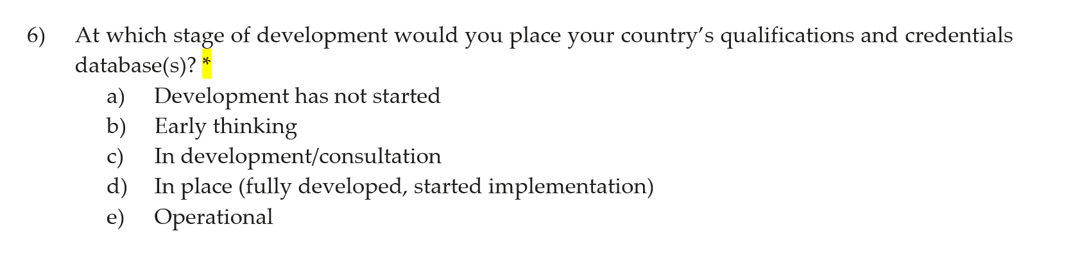
ACQF QCP Survey: Stakeholder needs and perceptions

Slide 24
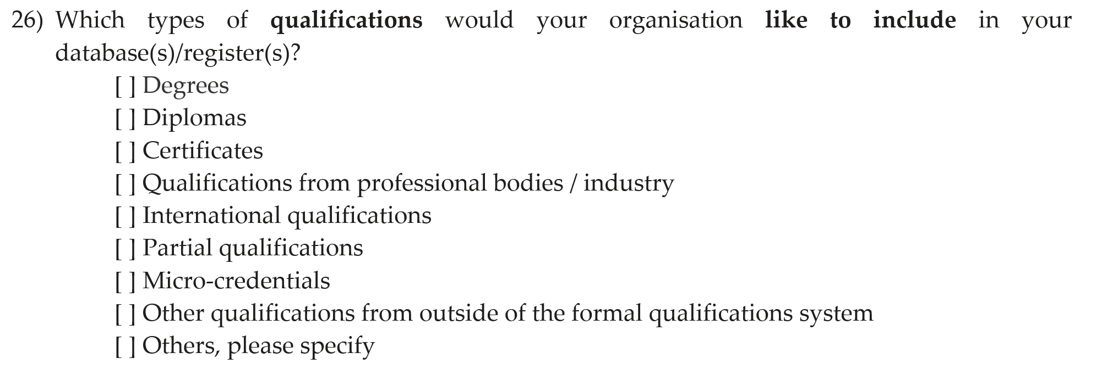
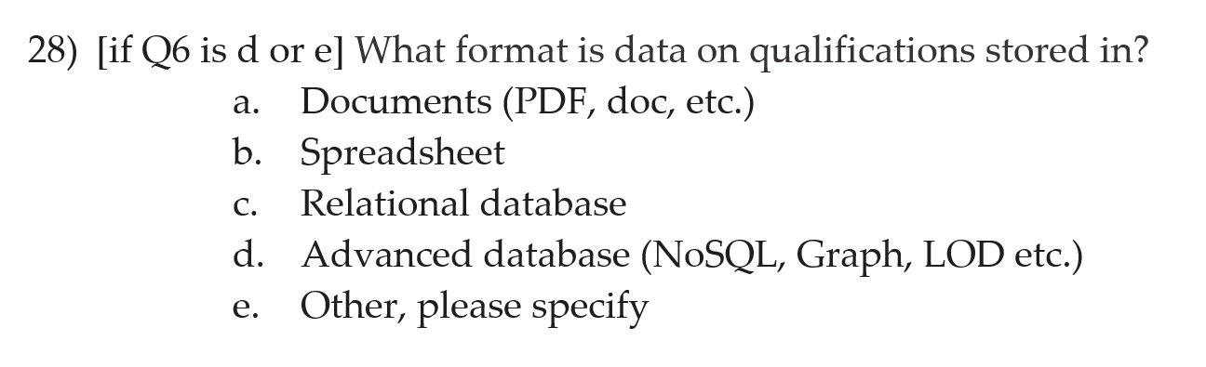
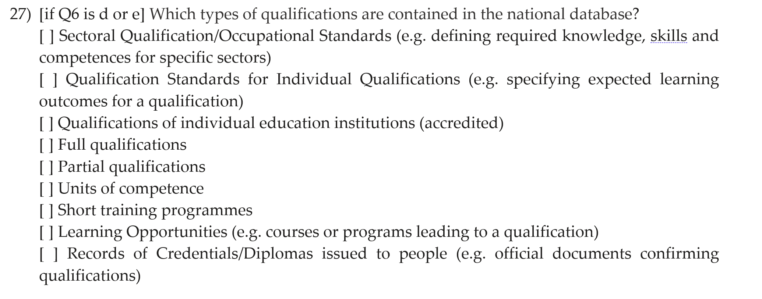
ACQF QCP Survey: current practices and future plans

Slide 25
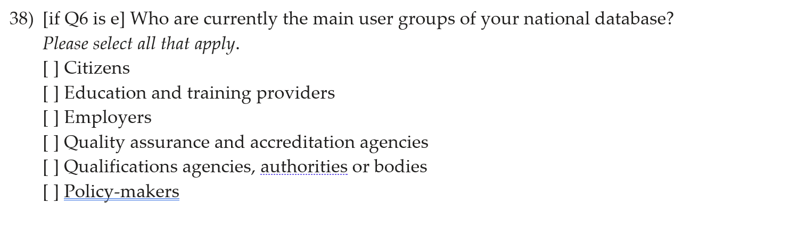
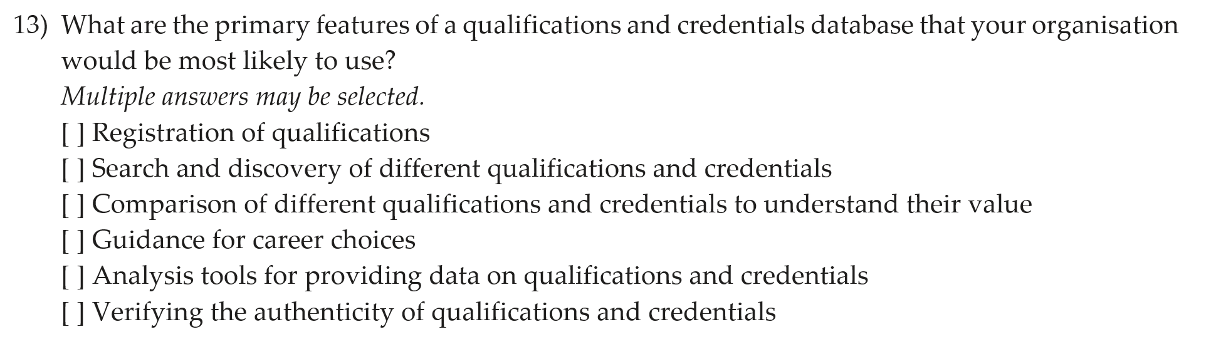
ACQF QCP Survey: user groups

Slide 26
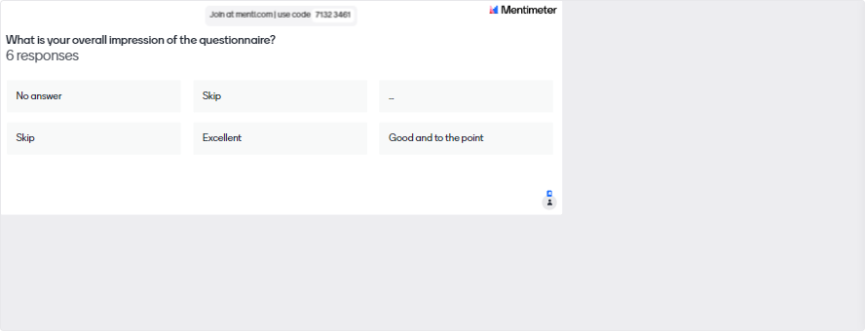
Feedback and questions

Slide 27
Feedback and questions
Do you have any suggestions or feedback on the survey process in general (e.g. in terms of dissemination of the survey, confidentiality etc.)?
Do you have any other questions with regards to the survey?

Slide 28
05
Stakeholder needs assessment

Slide 29
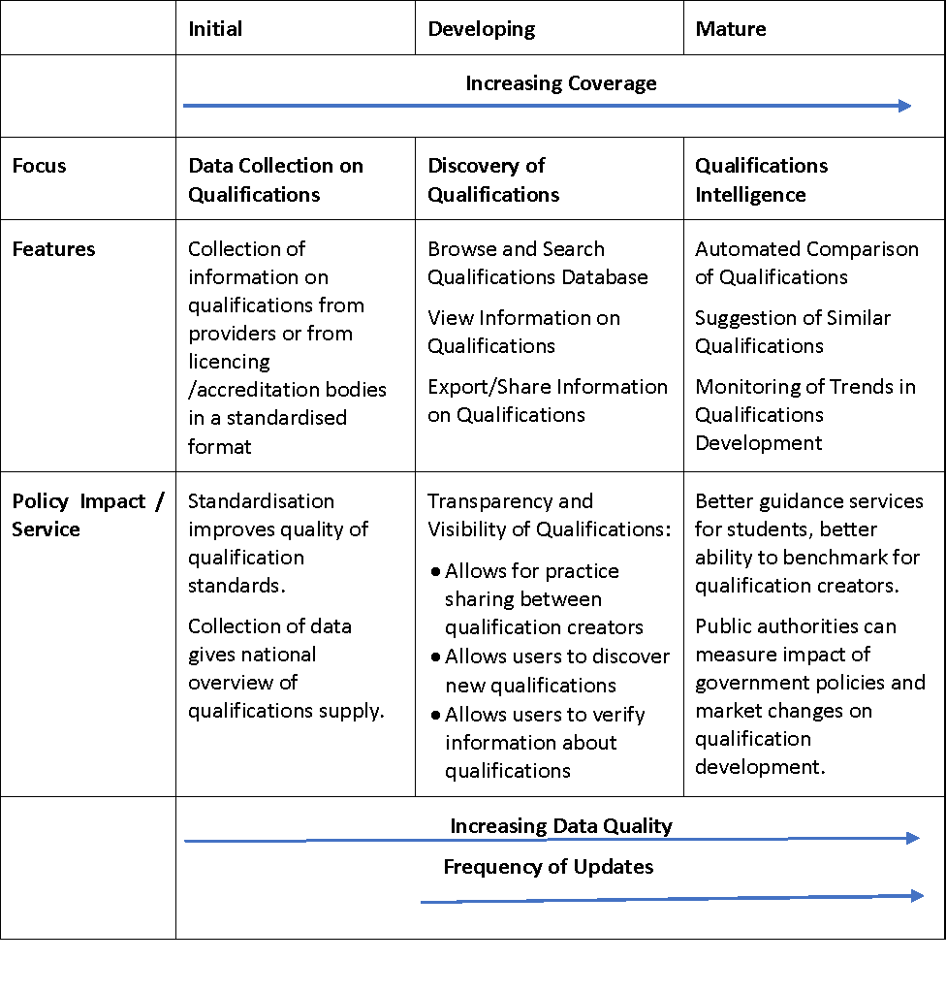
What do users typically want?
It has taken most EU countries around 10-15 years to go from initial to mature stages, and the EU database has taken 10 years to reach developing stage
Independently developed qualification databases have very similar sets of features
By creating standardising processes and technology frameworks for qualification databases for countries, we can go from initial to mature in 5 years and stop double funding effectively the same solutions in each country

Slide 30
Service benefits over time
Development
Preparatory
Future
Development synergies
Transparency and trust
Comparison
Search and Discovery
Visualisation
Guidance
Credentials
Monitoring
Analysis
Scope of the project:
Development phase and the connected 3 services

Slide 31
Our approach to user requirements
We will use surveys to:
  understand the state of play in each country
  understand the actors that need to be involved in each country
  collect the requirements of public administrations, (and business and citizens by proxy)
We will use workshops and design events to:
  prioritise requirements
  validate our development approach
We will do extensive user testing to:
  ensure the system fits the needs of stakeholders
  determine support/documentation that must be provided to aid implementation

Slide 32
Exclusive to the webinar
During the webinar, an interactive session with participants took place.
Colleagues were sharing their experience and expectations to user needs in a high-level via the Mentimeter tool.
Following three questions were asked:
  Rate the importance of target groups
  Rate the importance of functions for the national level
  Rate the importance of functions for the international (continental) level

Slide 33
06
Concluding remarks

Slide 34
Wrap-up: most immediate steps
The AQCF QCP survey will start data collection on 13 March. This will last approximately 2 weeks, until March 25.
Webinar 2: preliminarily planned for the 3rd of April, to present and validate initial results of the survey (Activity 2)
Webinar 3: present and validate the draft reports of Activity 1 and 2

Slide 35
Thank you for your attention!

