Slide 1



3rd ACQF Forum – RPL for Practitioners
4 October 2024

Slide 2


Context
In parallel to the technical development of the Qualifications and Credentials Platform (QCP), we will conduct a training programme for stakeholders involved in managing and using qualifications databases
Means
Training activities (such as during this meeting)
Training material and eLearning for self-paced learning
Aim
Addressing baseline knowledge for QCP usage
Providing hands-on support when QCP launches
Several major themes identified until the end of 2024
Notes:
Welcome, everyone, to this training session on the Qualifications and Credentials Platform (QCP). Our aim today is to address foundational knowledge and provide hands-on support to ensure successful adaptation and usage of the QCP. This training is part of a series of activities identified until the end of 2024, including self-paced learning materials that will be shared in the coming months.
More detailed information on formats, dates and opportunities, as well as the provision of the training material for self-paced learning will be shared with everyone throughout the next months, as we continue the development of the QCP and identify relevant meetings and milestones.

Slide 3






Major themes
Technical Aspects
Using the QCP, navigating UI, accessing/querying databases
Data entry, validation, and management
Interoperability Concepts
Standards and protocols (e.g., Linked Data, ISCED) for data exchange
Data Governance and Security
Data governance principles, ownership, privacy, security
Compliance with data protection regulations
Quality Assurance and Validation
Processes for validating and verifying qualifications data
Capacity Development
Building capacity for managing/updating national databases
Aligning national data with international standards.
Policy and Strategic Alignment
Policy frameworks and strategic initiatives in the African context
Notes:
The major themes we will cover throughout the 2024 training activities include:
Technical Aspects: Using the QCP, navigating the UI, accessing/querying databases, and managing data.
Interoperability Concepts: Standards and protocols like Linked Data and ISCED for data exchange.
Data Governance and Security: Principles of data governance, ownership, privacy, and compliance with data protection regulations.
Quality Assurance and Validation: Processes for validating and verifying qualifications data.
Capacity Development: Building capacity for managing and updating national databases and aligning data with international standards.
Policy and Strategic Alignment: Understanding policy frameworks and strategic initiatives in the African context.

Slide 4
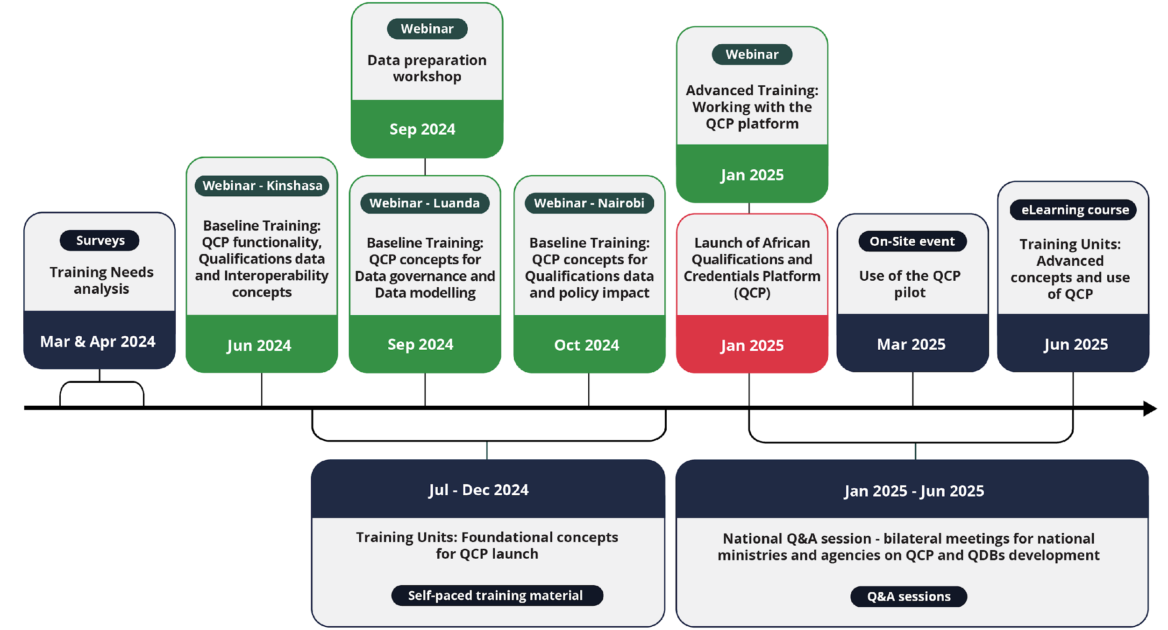


Slide 5
Qualifications and Credentials Platform (QCP) – Training on QCP concepts and tools
Objective of today’s training
Advanced understanding of Learning Outcomes, Skills and QCP requirements to take full advantage of comparable data

Slide 6
Agenda
QCP and Learning Outcomes (LOs)
  Use of Artificial Intelligence (AI) for LOs
Data Formats
  Linked and Structured Data
  QCP Data Model for Skills and LOs
QCP Curation Portal - preview
Skills Matching – ESCO & ISCED-F 2013
Data analysis for Policy Making

Slide 7

Integrating Learning Outcomes into Qualifications Databases
Importance of Learning Outcomes - RPL
Provides clear expectations and standards for learners
Facilitates recognition and comparison of qualifications
Enhances transparency and accountability
Learning Outcomes Definition: Statements describing what learners are expected to know, do and value upon completion of a programme or course

Slide 8
Integrating Learning Outcomes into Qualifications Databases
Steps to Integrate Learning Outcomes
Identify Relevant Learning Outcomes
Standardise Learning Outcomes Descriptions
Embed Learning Outcomes in Qualification Descriptions
Use Competency Frameworks
Implement Quality Assurance Mechanisms
Notes:
Identify Relevant Learning Outcomes
Collaborate with educators, industry experts, and accreditation bodies to identify key learning outcomes for each qualification
Ensure alignment with national and international standards
Standardize Learning Outcomes Descriptions
Use a consistent format and language to describe learning outcomes
Ensure clarity, specificity, and measurability of outcomes
Embed Learning Outcomes in Qualification Descriptions
Include learning outcomes in the official descriptions of qualifications
Ensure they are prominently featured in qualifications databases
Use Competency Frameworks
Align learning outcomes with established competency frameworks (e.g., ESCO, national frameworks)
Map learning outcomes to specific competencies and skills
Implement Quality Assurance Mechanisms
Establish procedures to regularly review and update learning outcomes.
Engage stakeholders in the quality assurance process.

Slide 9
Integrating Learning Outcomes into Qualifications Databases
Tools and Techniques for Integrating Learning Outcomes
Use tools designed for managing qualifications and learning outcomes to ensure effective integration and retrieval
Create and distribute templates and guidelines for documenting learning outcomes consistently
Offer training programmes and workshops for stakeholders on developing and integrating learning outcomes
            Involve educators, industry representatives, and learners in the development and review process of learning outcomes
Map learning outcomes to established competency frameworks to ensure they meet national and international standards

Slide 10
Crafting Learning Outcomes
Example Learning Opportunity Description
Course Topic: Introduction to Data Analysis
Course description: This course will provide students with fundamental skills in data analysis, including data collection, cleaning, visualisation, and interpretation. Students will learn how to use statistical software to manage and analyse data sets, create visual representations of data, and interpret results to make informed decisions.
Related Learning Outcome
By the end of this course, students will be able to create visual representations of data with the use of statistical software demonstrating accuracy and clarity as measured by the ability to correctly interpret and explain the visualized data in a project presentation.

Slide 11
Crafting Learning Outcomes
Learning Outcome Structure:
Audience: Who is achieving the outcome.
Behaviour: The outcome, which should start with an action verb
Context or conditions: The context of, or the condition under which the knowledge or skills will be applied.
Criterion for acceptable performance: The standards that the learner should meet to achieve the outcome.
Example:
By the end of this course, students will be able to create visual representations of data with the use of statistical software demonstrating accuracy and clarity as measured by the ability to correctly interpret and explain the visualized data in a project presentation.

Slide 12

Crafting Learning Outcomes using Artificial Intelligence (AI)
Artificial Intelligence – using LLM to support the creation of good Learning Outcomes
Can only ever be a support!
Still requires manual checks
and Quality Assurance
Can significantly increase efficiency
and performance, particularly for
large sets of data

Slide 13



Please download and install the Slido app on all computers you use
Have you previously worked with AI-LLM e.g. ChatGPT or Gemini in your daily work with qualifications?
ⓘ Start presenting to display the poll results on this slide.

Slide 14
Crafting Learning Outcomes using Artificial Intelligence (AI)
Artificial Intelligence – EXAMPLE
Learning Opportunity
Course Topic: Environmental Science
Description: In this course, students will learn the principles of environmental science, including ecosystem dynamics, natural resource management, and environmental policy. They will engage in fieldwork where they will apply different methods for collecting samples and data, analyse the collected environmental data using basic software tools, and develop strategies for sustainable resource management.

Slide 15
Possible AI-LLM prompts
Weak - simple command | Turn this Learning Opportunity into a Learning Outcome: [LO]
Ok - asking the AI-LLM to research context first | Research the best way Learning Outcomes should be structured and then turn the following Learning Opportunity into a Learning Outcome: [LO]
Ideal - Providing the AI-LLM with concrete context and precise instructions yourself | Turn the following Learning Opportunity into a Learning Outcome, using the following context: Learning Outcome should be structures […]: [LO]

Slide 16
Crafting Learning Outcomes using Artificial Intelligence (AI)
Try yourself via anonymous access to most common AI-LLMs: https://duckduckgo.com/aichat
Possible response:
“By the end of the course, students should be able to apply appropriate methods for collecting samples and data during field work in different environmental contexts, providing clear and well-supported reasons for their choices, and demonstrating adherence to best practices, including correct use of equipment and safety protocols. “

Slide 17


Structured Data and Data Standards
Understanding Structured Data
Definition
Data that is organised
in a fixed, predefined format or schema, making it easily viewable, sortable and searchable.
Examples
Databases
XML files

Slide 18


Structured Data and Data Standards
Benefits and Importance of Structured Data
Consistency and reliability:
Structured data ensures data is consistent and reliable across the database, and reduces errors in data handling.
Example: all entries in a "date" field will follow the same date format
(YYYY-MM-DD), thus reducing discrepancies.
Efficient storage & retrieval:
The consistent format allows
databases to store information in an efficient way
🡪 through indexes it also reduced the amount of data examined during a search operation
🡪 speeds up data retrieval.

Slide 19

Structured Data and Data Standards
Benefits and Importance of Structured Data
Enhanced data analysis & visualisation:
The organised and consistent format, with defined data types and relationships, makes it easier to apply analytical tools and techniques.
The predictability and integrity of structured data help visualisation tools to easily generate meaningful and interactive visualizations such as charts, graphs, and dashboards, helping to uncover patterns, trends, and insights that drive informed decision-making.

Slide 20
Introduction to the ACQF Data Model
The ACQF Data Model (ALM) is developed in line with the international best practices and principles, as previously discussed.
In short, the data model considers:
Centralised management of identifiers: consistent data referencing across the countries of the continent
Common data exchange format
Common data specification: constrained and uniform language; structural requirements
Interoperability between models:
alignment with international standards & ALM

Slide 21
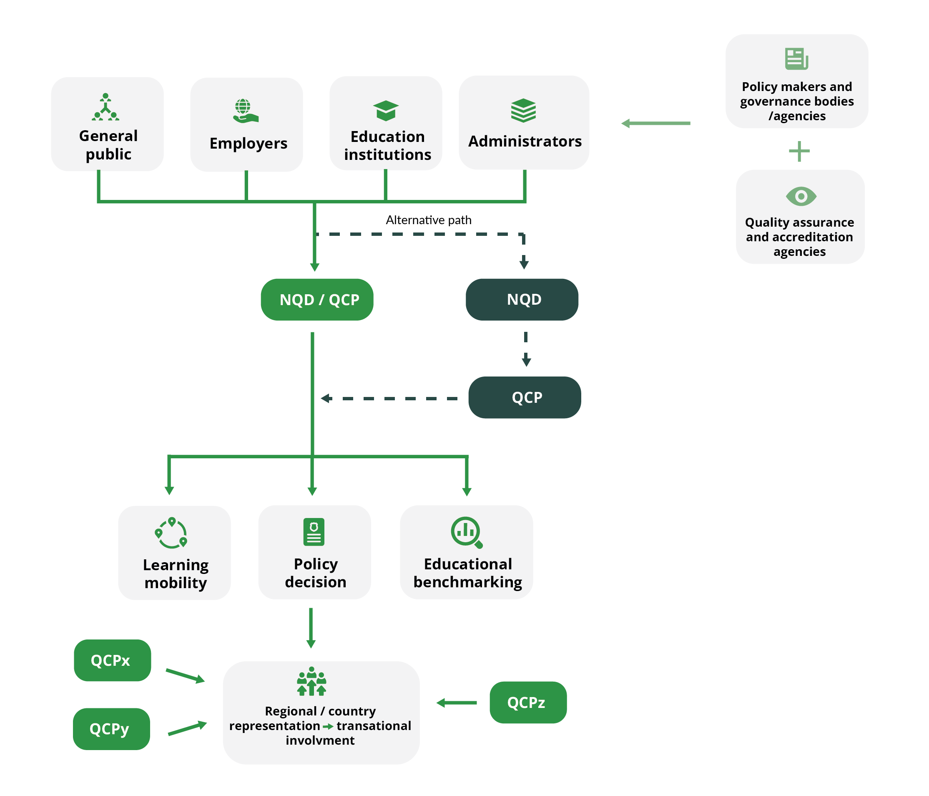
QCP
&
National Qualifications Databases

Slide 22
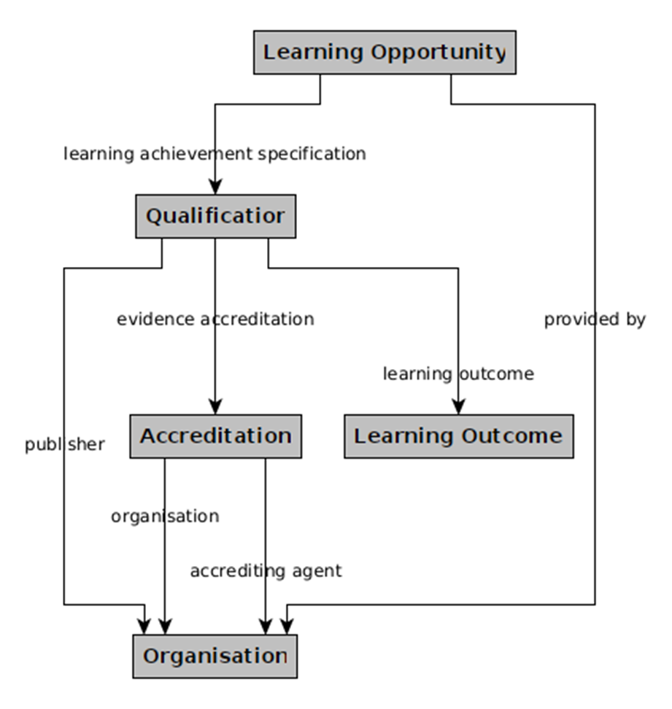
QCP Data Model
n
Simplified view of core elements and their relationships

Slide 23
Overview of data properties
Class | Property | Expected value
Qualification | awarding information | Awarding Opportunity
 | education level | ACQF levels
 | learning outcome | Learning Outcome
 | publisher | Organisation
 | thematic area | ISCED-F
 | title | String with language
Awarding Opportunity | awarding body or note | Organisation or Note
Learning Opportunity | default language | Language
 | provided by | Organisation
 | qualification | Qualification
 | title | String with language
Learning Outcome | title | String with language
 | related skill or note | Skill or Note
Location | spatial code | Location code
Organisation | location | Location
 | name | String with language

Slide 24


QCP Curation Portal
In Development – Launch of first accessible version in January 2025
Current functionality:
Creating Qualifications
Title creation
ESCO skill search

Slide 25
QCP Curation Portal
Practical Demonstration
https://curate.acqf-qcp.africa/

Slide 26


KIC – Skills Finder
Learning Outcomes & skills matching
Uses ESCO skills

Slide 27

ESCO
ESCO is a multilingual classification system developed in the European context, but which is applicable globally
It categorizes skills, competences, qualifications, and occupations
Latest version (1.2) has around 14.000 skills linked to 3.000 occupation

Slide 28

KIC – Skills Finder
Try to enter a description of a qualification in the skills finder:
https://knowledgeinnovation.eu/skill-finder/
use the description from this presentation (slide 14) or any description available through your own data
Identify the three most relevant skills/competences for the qualification description

Slide 29
KIC – Skills Finder
What are main challenges in connecting Course or Programme descriptions to Skills?

Slide 30



Data analysis for policy-making
National qualifications database
Connected qualifications databases
Multi-source analysis
Overview of qualifications supply
Monitoring (trends, policy evaluation, user data)
Development/updating of qualification standards
Improve connections between education levels
More coverage - better trend analysis
Comparisons of qualifications (e.g. design best practice)
Regional policy-making (harmonisation, recognition)
Skills gaps analysis
Forecasting skills demand
Inclusivity
Optimise resource allocation

Slide 31
National qualifications databases
Overview of Supply: Monitor the availability, variety, and distribution of qualifications.
Monitoring Trends: Identify emerging patterns in qualification developments, system evolution, and skill demand shifts; track updates to qualification frameworks over time, such as the introduction of micro-credentials or new vocational qualifications (e.g. Microcred seeker);
Updating or developing standards: faster process; qualifications can be aligned better with emerging industry requirements
Source: https://www.microcredseeker.edu.au/ ; https://credentialengine.org/wp-content/uploads/2021/01/Policy-Brief-1.pdf

Slide 32
Connected qualification databases
The more, the merrier: broader coverage across regions or countries, allows for more comprehensive analysis of the status quo and trends.
Comparisons of Qualifications: compare qualifications and learning outcomes etc. with a best practice examples, identify gaps and opportunities for improvement;
Regional Policy-Making: harmonise standards, track and promote regional mobility, facilitate mutual recognition of qualifications.
Source: Qualifications databases_report.pdf (europa.eu)
https://dataqualitycampaign.org/wp-content/uploads/2018/09/DQC-Workforce-Linkages-Roadmap-09262018.pdf

Slide 33
Multi-source analysis
Skills Gaps Analysis: analyse and contrast supply of qualifications with laber market needs (Big Data for Labour Market Intelligence project); evaluate qualifications vis-a-vis job market statistics to assess relevance
Forecasting Future Skills Demand: integrating qualifications databases with national censuses and labour market surveys, future skills demand can lead to better forecasting, supporting proactive policy decisions.
Optimise Resource Allocation: comprehensive data analysis can inform policy-makers on where and how to best allocate human and financial resources
Source: Day 1_Session 1_ETF_Big Data_E Castel-Branco.pdf (europa.eu); DQC-Workforce-Linkages-Roadmap-09262018.pdf (dataqualitycampaign.org)

Slide 34


Growing Benefits for Policy-Making
As the qualifications and credentials database expands in coverage and frequency of updates, its value for policy-making increases rapidly.
Enhanced precision in policy-making
Better monitoring and tracking
More proactive policies
Better alignment of labour market and workforce
International cooperation
More efficient resource allocation
The better the quality of qualifications data and the more connected it is to other databases and data sources (labour markets, international standards) the stronger the abilities to do in-depth, comprehensive analysis.

Slide 35

Please download and install the Slido app on all computers you use
What specific challenges have you faced with regards to data availability or using data for policy-making, and how could qualifications and credentials databases help address those?
ⓘ Start presenting to display the poll results on this slide.

Slide 36
Please download and install the Slido app on all computers you use
How do you currently track trends in qualifications and skill demand, and what could be improved by having a national qualifications database in place?
ⓘ Start presenting to display the poll results on this slide.

Slide 37
Please download and install the Slido app on all computers you use
How could connecting your country's qualifications database with others in the region benefit cross-border collaboration in education and employment?
ⓘ Start presenting to display the poll results on this slide.

Slide 38
Please download and install the Slido app on all computers you use
What kinds of datasets could be combined with qualifications data that could bring you the largest added value? Would it be feasible? Why, why not?
ⓘ Start presenting to display the poll results on this slide.

Slide 39

Thank you
Obrigado
Merci
Credit: Eduarda Castel Branco

