Slide 1



Forum of the institutions of National Qualifications Frameworks
18 – 20 June 2024

Slide 2


Context
In parallel to the technical development of the Qualifications and Credentials Platform (QCP), we will conduct a training programme for stakeholders involved in managing and using qualifications databases
Means
Training activities (such as during this meeting)
Training material for self-paced learning
Aim
Addressing foundational knowledge and providing hands-on support to ensure successful adaptation and usage of the QCP
Several major themes identified until the end of 2024
Notes:
Welcome, everyone, to this training session on the Qualifications and Credentials Platform (QCP). Our aim today is to address foundational knowledge and provide hands-on support to ensure successful adaptation and usage of the QCP. This training is part of a series of activities identified until the end of 2024, including self-paced learning materials that will be shared in the coming months.
More detailed information on formats, dates and opportunities, as well as the provision of the training material for self-paced learning will be shared with everyone throughout the next months, as we continue the development of the QCP and identify relevant meetings and milestones.

Slide 3
Context
Major themes
Technical Aspects
Using the QCP, navigating UI, accessing/querying databases
Data entry, validation, and management
Interoperability Concepts
Standards and protocols (e.g., Linked Data, ISCED) for data exchange
Data Governance and Security
Data governance principles, ownership, privacy, security
Compliance with data protection regulations
Quality Assurance and Validation
Processes for validating and verifying qualifications data
Capacity Development
Building capacity for managing/updating national databases
Aligning national data with international standards.
Policy and Strategic Alignment
Policy frameworks and strategic initiatives in the African context
Notes:
The major themes we will cover throughout the 2024 training activities include:
Technical Aspects: Using the QCP, navigating the UI, accessing/querying databases, and managing data.
Interoperability Concepts: Standards and protocols like Linked Data and ISCED for data exchange.
Data Governance and Security: Principles of data governance, ownership, privacy, and compliance with data protection regulations.
Quality Assurance and Validation: Processes for validating and verifying qualifications data.
Capacity Development: Building capacity for managing and updating national databases and aligning data with international standards.
Policy and Strategic Alignment: Understanding policy frameworks and strategic initiatives in the African context.

Slide 4
Qualifications and Credentials Platform (QCP) – Training on QCP concepts and tools
Objective of today’s training
Understand qualifications databases and their implementation in the context of ACQF and the QCP
Notes:
Today’s training aims to help you understand qualifications databases and their implementation within the context of ACQF and the Qualifications and Credentials Platform (QCP) we are currently developing.
We will explore the purposes and users of qualification databases, their role in the international context, and key concepts such as data standards and interoperability

Slide 5
Agenda
Purposes and Users of Qualification Databases
Role of Qualification Databases in International Context
Mapping and Standardising Qualifications Data
Integrating Learning Outcomes into Qualifications Databases
Structured Data , Data Standards and Interoperability
Introduction to the ACQF Data Model
Notes:
Our agenda today includes:
Understanding the purpose and users of qualification databases.
Exploring the role of qualification databases in the international context.
Mapping and standardizing qualifications data.
Integrating learning outcomes into qualifications databases.
Understanding structured data and data standards.
Introducing the ACQF data model.

Slide 6


Purposes and Users of Qualification Databases
Purpose
Central repository for storing and managing qualification information
Facilitates recognition and comparison of qualifications
Supports educational and workforce planning
Functions
Storing qualifications data
Providing access to reliable and up-to-date information
Enabling data analysis for policy making
Notes:
Qualification databases serve as a central repository for storing and managing qualification information.
They facilitate recognition and comparison of qualifications and support educational and workforce planning.
Key functions include storing qualifications data, providing access to reliable information, and enabling data analysis for policy making.

Slide 7

Purposes and Users of Qualification Databases
Benefits
Easy access to reliable and up-to-date information for learners, employers, and policymakers
Streamlines the process of verifying and validating qualifications
Enables data-driven decision-making through comprehensive data analytics
Supports the mobility of learners and professionals by providing transparent and comparable qualifications data
Enhances the integration of national qualifications frameworks with regional and international standards
Notes:
Qualification databases offer numerous benefits:
Easy access to reliable and up-to-date information for learners, employers, and policymakers.
Streamlining the process of verifying and validating qualifications.
Enabling data-driven decision-making through comprehensive data analytics.
Supporting the mobility of learners and professionals by providing transparent and comparable data.
Enhancing the integration of national qualifications frameworks with regional and international standards.

Slide 8
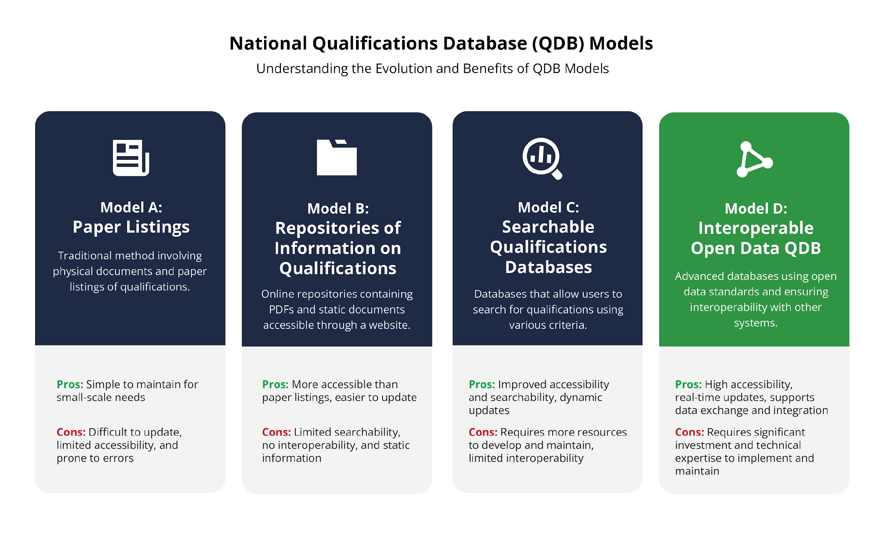

Slide 9
Purposes and Users of Qualification Databases
User groups
General Public (Job Seekers and Learners) - Find and verify qualifications for educational and career planning.
Employers and Industry - Verify the credentials of potential employees and ensure they meet industry standards.
Education Institutions (e.g. Schools and Universities) - Design curriculum and align educational programs with industry standards.
Administrators - Manage and update national qualifications databases and QCP.
Policy-Makers and Governance Bodies/Agencies - Develop and implement educational policies based on reliable qualifications data.
Quality Assurance and Accreditation Agencies - Ensure qualifications meet established standards and maintain quality assurance.
Notes:
The primary users of qualification databases include:
General Public (Job Seekers and Learners): Finding and verifying qualifications for educational and career planning.
Employers and Industry: Verifying the credentials of potential employees to meet industry standards.
Education Institutions (Schools and Universities): Designing curriculum and aligning programs with industry standards.
Administrators: Managing and updating national qualifications databases.
Policy-Makers and Governance Bodies/Agencies: Developing and implementing educational policies based on reliable data.
Quality Assurance and Accreditation Agencies: Ensuring qualifications meet established standards and maintaining quality assurance.

Slide 10
Purposes and Users of Qualification Databases
[SLIDO]
Notes:
Centralises all qualifications data, making it easier to manage and access.
Facilitates the recognition of qualifications nationally and internationally.
Increases transparency in the qualifications process for all stakeholders.
Provides valuable data to support educational policy-making and reforms
Ensures that all qualifications meet established standards and are regularly updated.

Slide 11



Please download and install the Slido app on all computers you use
Please fill in the survey
ⓘ Start presenting to display the poll results on this slide.

Slide 12
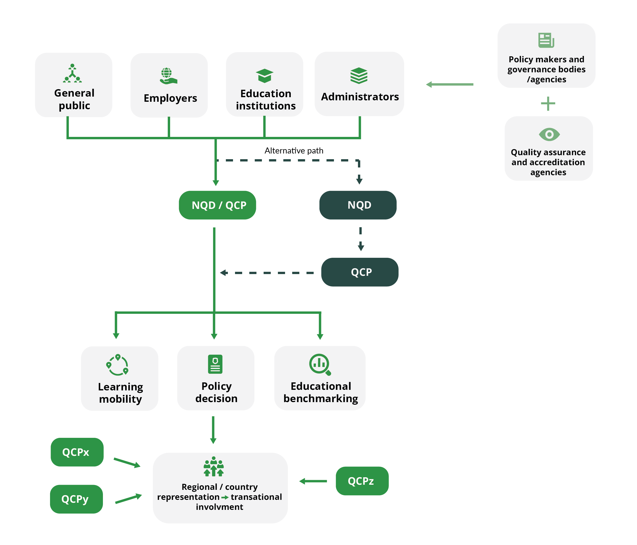
Purposes and Users of Qualification Databases

Slide 13


Role of Qualifications Databases in the International Context
Importance in International Context
Facilitates cross-border recognition of qualifications
Enhances mobility of students and professionals
Information-sharing real time - comparability, transparency, harmonisation
Supports international collaboration,
Case Studies
Referencing of NQFs to RQFs / ACQF
Use of RQF / ACQF levels on newly issued qualifications (upon referencing)
Recognition of qualifications within the African Union
Cross-border education programmes and learning & labour mobility
Notes:
In the international context, qualification databases facilitate cross-border recognition of qualifications, enhancing the mobility of students and professionals.
They enable real-time information sharing, comparability, transparency, and harmonization, supporting international collaboration.
Case studies show the importance of referencing national qualifications frameworks (NQFs) to regional qualifications frameworks (RQFs) or the ACQF. This includes using RQF/ACQF levels on newly issued qualifications upon referencing and recognizing qualifications within the African Union, thus supporting cross-border education programs and learning and labor mobility

Slide 14

Mapping and Standardising Qualifications Data
Steps
Identify and list all existing qualifications
Categorise qualifications by level, field, and awarding body
Use tools like surveys, databases, and official records
Tools and Techniques
National education databases
Collaboration with educational institutions and accreditation bodies
Notes:
Mapping qualifications data involves identifying and listing all existing qualifications, categorizing them by level, field, and awarding body, and using tools like surveys, databases, and official records.
Establishing minimum data fields ensures consistency and completeness, facilitating interoperability and data exchange.

Slide 15
Mapping and Standardising Qualifications Data
Establishing Minimum Data Fields
Ensures consistency and completeness of data
Facilitates interoperability and data exchange
HOW IN 5 STEPS
Notes:
Establishing minimum data fields is crucial for ensuring data consistency and completeness. It also facilitates interoperability and data exchange. When we try to create coherence across African countries with the development of our African Qualifications and Credentials Platform, it is essential to map and standardize qualifications data.
In the following I will present to you 5 simple steps to arrive at this point.

Slide 16
Mapping and Standardising Qualifications Data
Example
Field Name | Description | Example
Qualification Title | The official name of the qualification | Bachelor's Degree in Engineering
Qualification Level | The level of the qualification | QF Level 6
Field of Study | The specific area or discipline of the qualification | Mechanical Engineering
Awarding Body | Institution that issues the qualification | University of Nairobi
Date of Award | The date when the qualification was awarded | June 2020
Learning Outcomes | Skills and competencies gained | Ability to design mechanical systems
Duration | The time taken to complete the qualification | 4 years
Credits | The credit value of the qualification | 240 ECTS
Mode of Study | The mode in which the qualification was delivered | Full-time, Part-time, Online
Others | Any other relevant information | Accreditation details, Language of instruction

Slide 17


Mapping and Standardising Qualifications Data
Step1 - Understand the Education Ecosystem Needs
Engage Stakeholders:
Conduct workshops and meetings with educators, institutions, employers, and policymakers.
Collect feedback on essential data needs for curriculum development, workforce planning, and policy making
Assess Current Systems:
Review existing databases and data collection practices.
Identify gaps and areas for improvement.
Notes:
The very first step every organisation should aim to complete is to understand their national or regional education ecosystem.
Engaging stakeholders by conducting workshops and meetings with e.g. educators, education institutions, employers, and policymakers will help draw a complete picture.
Try to collect feedback on essential data needs for curriculum development, workforce planning, and policy making.
An important component of understanding your Education Ecosystem is to assess current systems by reviewing existing databases and data collection practices.
Identify gaps and areas for improvement to ensure the system meets the educational ecosystem’s needs.

Slide 18
Mapping and Standardising Qualifications Data
Step2 - Define Core Qualification Fields
Example
Field Name | Description | Example
Qualification Title | The official name of the qualification | Bachelor's Degree in Engineering
Qualification Level | The level of the qualification | QF Level 6
Field of Study | The specific area or discipline of the qualification | Mechanical Engineering
Awarding Body | Institution that issues the qualification | University of Nairobi
Date of Award | The date when the qualification was awarded | June 2020
Learning Outcomes | Skills and competencies gained | Ability to design mechanical systems
Duration | The time taken to complete the qualification | 4 years
Credits | The credit value of the qualification | 240 ECTS
Mode of Study | The mode in which the qualification was delivered | Full-time, Part-time, Online
Others | Any other relevant information | Accreditation details, Language of instruction
Notes:
Step2 is the definition of Core Qualification Data Fields
Here is an example of standardised data fields, their name, description and for your convenience a concrete example for each data.

Slide 19
Mapping and Standardising Qualifications Data
Step 3 – Align with International Standards
Use the African Continental Qualifications Framework (ACQF) to ensure compatibility
Implement best practices from international bodies such as UNESCO, OECD, and ISO
Standardise Data Formats
  Use standardised formats like XML, JSON, or CSV to facilitate data exchange and interoperability
Notes:
In a third step, you should use the African Continental Qualifications Framework (ACQF) to ensure compatibility
and implement best practices from international bodies such as UNESCO, OECD, and ISO.
We will introduce you to the initial ACQF data model in just a few slides.
It is also important to try and standardise data formats using e.g. XML, JSON, or CSV formats to facilitate data exchange and interoperability.

Slide 20
Mapping and Standardising Qualifications Data
Step 4 – Implement Data Collection Processes
Create standardised templates for data collection
Ensure all educational institutions use these templates to maintain consistency
Train Data Collectors
Establish Data Governance:
    Set up governance structures to oversee data collection, validation, and management
    Ensure compliance with data protection laws and standards
Notes:
Step4 is the establishment of a solid and robust Data Collection Process.
Creating standardised templates for data collection and ensuring all educational institutions use these templates is crucial to maintain consistency.
Train data collectors and establish governance structures to oversee data collection, validation, and management, ensuring compliance with data protection laws and standards.

Slide 21
Mapping and Standardising Qualifications Data
Step 5 – Validate and Update Data Regularly
Conduct Regular Audits:
  Perform periodic audits to verify data accuracy and integrity
Update Data Fields:
  Regularly update data fields to reflect changes in qualifications, standards, and requirements
Notes:
Lastly, Step 5 concerns itself on how to act after an initial establishment of the data collection process.
We need to ensure that we validate data and also to regularly update data.
For this purpose, we suggest to conduct regular audits to verify data accuracy and integrity.
Try to regularly update data fields to reflect changes in qualification standards and requirements.

Slide 22
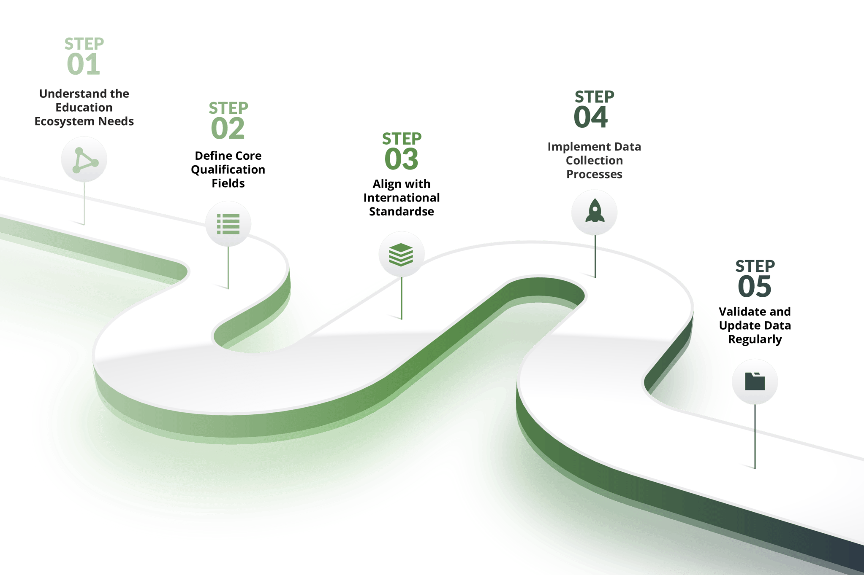
Mapping and Standardising Qualifications Data
Notes:
In summary, these 5 steps are essential to map and standardise your qualifications data. Depending on your current status-quo, you might already have completed some of the steps. In this case, we recommend looking to refine the processes and to focus on the steps that are still outstanding.

Slide 23

Integrating Learning Outcomes into Qualifications Databases
Importance of Learning Outcomes
Provides clear expectations and standards for learners
Facilitates recognition and comparison of qualifications
Enhances transparency and accountability
Learning Outcomes Definition: Statements describing what learners are expected to know, do and value upon completion of a programme

Slide 24
Integrating Learning Outcomes into Qualifications Databases
Steps to Integrate Learning Outcomes
Identify Relevant Learning Outcomes
Standardise Learning Outcomes Descriptions
Embed Learning Outcomes in Qualification Descriptions
Use Competency Frameworks
Implement Quality Assurance Mechanisms
Notes:
Identify Relevant Learning Outcomes
Collaborate with educators, industry experts, and accreditation bodies to identify key learning outcomes for each qualification
Ensure alignment with national and international standards
Standardize Learning Outcomes Descriptions
Use a consistent format and language to describe learning outcomes
Ensure clarity, specificity, and measurability of outcomes
Embed Learning Outcomes in Qualification Descriptions
Include learning outcomes in the official descriptions of qualifications
Ensure they are prominently featured in qualifications databases
Use Competency Frameworks
Align learning outcomes with established competency frameworks (e.g., ESCO, national frameworks)
Map learning outcomes to specific competencies and skills
Implement Quality Assurance Mechanisms
Establish procedures to regularly review and update learning outcomes.
Engage stakeholders in the quality assurance process.

Slide 25
Integrating Learning Outcomes into Qualifications Databases
Tools and Techniques for Integrating Learning Outcomes
Use tools designed for managing qualifications and learning outcomes to ensure effective integration and retrieval
Create and distribute templates and guidelines for documenting learning outcomes consistently
Offer training programmes and workshops for stakeholders on developing and integrating learning outcomes
Involve educators, industry representatives, and learners in the development and review process of learning outcomes
Map learning outcomes to established competency frameworks to ensure they meet national and international standards

Slide 26
Crafting Learning Outcomes
Example Learning Opportunity Description:
Course Topic: Introduction to Data Analysis
Course description: This course will provide students with fundamental skills in data analysis, including data collection, cleaning, visualisation, and interpretation. Students will learn how to use statistical software to manage and analyse data sets, create visual representations of data, and interpret results to make informed decisions.
Example learning outcome:
By the end of this course, students will be able to create visual representations of data with the use of statistical software demonstrating accuracy and clarity as measured by the ability to correctly interpret and explain the visualized data in a project presentation.

Slide 27
Crafting Learning Outcomes
Learning Outcome Structure:
Audience: Who is achieving the outcome.
Behaviour: The outcome, which should start with an action verb
Context or conditions: The context of, or the condition under which the knowledge or skills will be applied.
Criterion for acceptable performance: The standards that the learner should meet to achieve the outcome.
By the end of this course, students will be able to create visual representations of data with the use of statistical software demonstrating accuracy and clarity as measured by the ability to correctly interpret and explain the visualized data in a project presentation.

Slide 28
Crafting Learning Outcomes
Audience activity:
Structure a Learning Outcome for the following learning opportunity
Course Topic: Environmental Science
Description: In this course, students will learn the principles of environmental science, including ecosystem dynamics, natural resource management, and environmental policy. They will engage in fieldwork where they will apply different methods for collecting samples and data, analyse the collected environmental data using basic software tools, and develop strategies for sustainable resource management.
Read the course description and structure at least one learning outcome, completing the sentence:
"By the end of the course, students should be able to ..."

Slide 29
Crafting Learning Outcomes
Audience activity:
Structure a Learning Outcome for the following learning opportunity
Possible response:
“By the end of the course, students should be able to apply appropriate methods for collecting samples and data during field work in different environmental contexts, providing clear and well-supported reasons for their choices, and demonstrating adherence to best practices, including correct use of equipment and safety protocols. “

Slide 30


Structured Data and Data Standards
Understanding Structured Data
Definition
Data that is organised in a fixed, predefined format or schema, making it easily viewable, sortable and searchable.
Examples
Databases, spreadsheets
(.xls, Google Sheets), XML files, CSV files

Slide 31


Structured Data and Data Standards
Benefits and Importance of Structured Data
Consistency and reliability:
Structured data ensures data is consistent and reliable across the database, and reduces errors in data handling.
Example: all entries in a "date" field will follow the same date format (YYYY-MM-DD), reducing discrepancies.
Efficient storage & retrieval:
The consistent format allows databases to store information in an efficient way 🡪 through indexes it also reduced the amount of data examined during a search operation 🡪 speeds up data retrieval.

Slide 32

Structured Data and Data Standards
Benefits and Importance of Structured Data
Enhanced data analysis & visualisation:
The organised and consistent format, with defined data types and relationships, makes it easier to apply analytical tools and techniques.
The predictability and integrity of structured data help visualisation tools to easily generate meaningful and interactive visualizations such as charts, graphs, and dashboards, helping to uncover patterns, trends, and insights that drive informed decision-making.

Slide 33
Structured Data and Data Standards
Understanding Data Standards
Definition
Agreed-upon conventions and guidelines for formatting and handling data.
Examples
XML, JSON, CEDS (Common Education Data Standards), SWIFT, SCORM…

Slide 34


Structured Data and Data Standards
Benefits and Importance of Data Standards
Interoperability: Different systems and applications can understand and use data in a consistent way, which facilitates better data exchange, integration, and communication across different platforms, organisations and systems.
Consistency and Accuracy: Standardised data formats and definitions ensure that data is captured, stored, and processed uniformly, which reduces eros in data.
Data Quality and Integrity: Standards provide guidelines for data validation, ensuring data meets defined criteria.

Slide 35
Structured Data and Data Standards
Data Standards in Education
Many US states use CEDS (Common Education Data Standards) to align their data systems, enabling consistent data reporting to federal agencies.
SCORM (Sharable Content Object Reference Model), is a set of technical standards used in e-learning software products, which tells programmers how to write their code so that it works with other e-learning software.
ISCED 2011, a UNESCO maintained standard, describes educational levels which can be attained by learners.
ISCED-F 2013, a UNESCO maintained standard defining subject matters so that education elements can be compared.
MLO (Metadata for Learning Objects - Advertising), a European Standard specifying the characteristics of electronic representation of Learning Opportunities, to make it easier for prospective learners to find them.
EuroLMAI (European Learner Mobility - Achievement information), a EU standard specifying the model for recording and exchange of achievement information between student management information systems.

Slide 36
Introduction to the ACQF Data Model
The ACQF Data Model (ALM) is developed in line with the international best practices and principles, as discussed above. In short, the data model considers:
Centralised management of identifiers: consistent data referencing across the countries of the continent
Common data exchange format
Common data specification: constrained and uniform language; structural requirements
Interoperability between models: alignment with international standards, existing LMs - ALM

Slide 37
International standards
The data model observes various international standards to ensure seamless exchange and recognition of educational achievements across borders.
Standardised metadata (Dublin Core - DCMI)
Widely used elements of existing LMs (e.g. credit system, QF)
Standards for describing individuals/entities and their relationships (Friend of a Friend ontology)
System for representing knowledge organisation systems i.e. hierarchical taxonomies such as qualifications frameworks (Simple Knowledge Organisation Systems - SKOS)

Slide 38
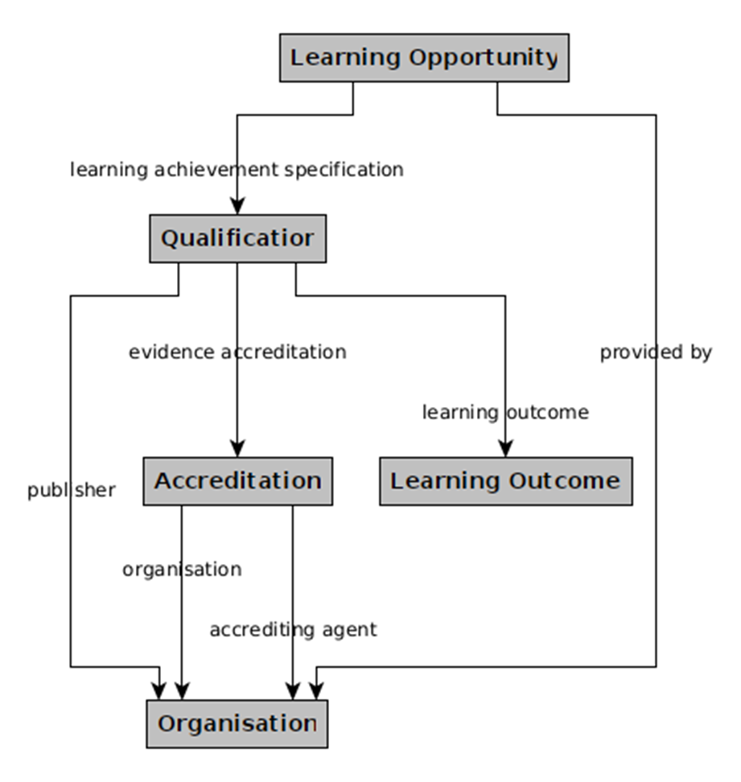
Classes and
properties of the data model
Simplified view of the core elements and their relationships within the ACQF Data Model

Slide 39
Overview of data properties
Class | Property | Expected value
Qualification | awarding information | Awarding Opportunity
 | education level | ACQF levels
 | learning outcome | Learning Outcome
 | publisher | Organisation
 | thematic area | ISCED-F
 | title | String with language
Awarding Opportunity | awarding body or note | Organisation or Note
Learning Opportunity | default language | Language
 | provided by | Organisation
 | qualification | Qualification
 | title | String with language
Learning Outcome | title | String with language
 | related skill or note | Skill or Note
Location | spatial code | Location code
Organisation | location | Location
 | name | String with language

Slide 40
Controlled vocabularies
Controlled vocabularies are essential in the ACQF Data Model for ensuring consistency, accuracy, and interoperability of qualifications data across different systems and regions.
Reduces ambiguity and ensures uniform data entry
Allows for data sharing between various systems
Global recognition
Validation mechanism and data integrity
Enhanced searchability and data linking
Areas of application: accreditation type, credit points, learning entitlement, learning outcome, location, education level, thematic area

Slide 41
Conclusion and Next Steps
Software development next steps
User experience and final data modelling steps ongoing until the end of August 2024
First-phase qualification curation portal to be delivered by the end of 2024
Dissemination and testing of the curation portal start from early 2025
Training
Ascertain further training needs
Coordination with ACQF-II project to present you with more interactive activities
Provision of training material rolled out throughout 2024

Slide 42

Thank you
Obrigado
Merci

