Slide 1



4 December 2024

Slide 2
01
QCP User Interface

Slide 3
Summary of previous Q/A sessions
Which security measures are in place to ensure security and integrity of the DB?
  All security measures are described in the architecture document
    Authentication and authorisation (frontend and backend)
    Encrypted transfer (TLS)
    Data access restrictions (VS can only access their own data)
    Data validation on creation/update
    Vulnerability monitoring

Slide 4
Summary of previous Q/A sessions
What are the minimal IT equipment requirements for managing the national virtual space?
  The QCP UIs are WEB applications
    They will run on any device with sufficient processing power for modern web browsers
    Recommendation : use recent version of mainstream browsers (Chrome/Chromium based, Firefox, Edge, Safari)
    A consistent and reliable internet connection is essential to avoid disruptions.
Will it be possible to grant access to the data input (aka Curator) UI to more than 1 authorised institution?
  The administrator of the VS will have full ownership of the user management
  Only one VS per country is foreseen but it can have multiple administrators

Slide 5
Summary of previous Q/A sessions
Will there be a record of the changes made on a qualification?
  This feature is not in scope of this version of the system
  It will be included in the project backlog
How will the integration with external systems be handled?
  Specific use cases to be defined
  “Reference ID” mapping national identifier to a qualification

Slide 6
Summary of previous Q/A sessions
How can we add information about the “type” (full/partial/micro-credential) and the “assessment criteria” of a qualification?
  Additional fields will need to be added in the UI for these values
  The data model will need to be updated in that perspective
  These features were added in the project backlog

Slide 7
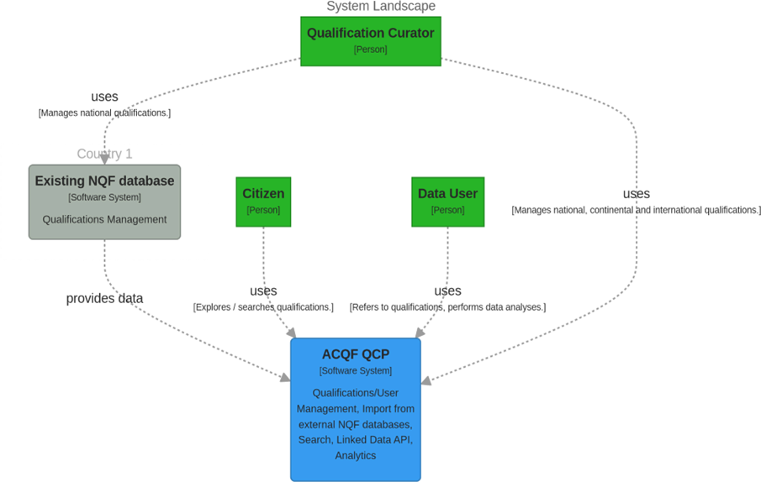
Centralized
System
Architecture
Manage: Virtual Space Administrator
Manage: Administrator

Slide 8
Sections of User Interface
Curator user interface: Provides an interface for curating and editing individual qualifications directly within visual forms.
General Public user interface: Enables the general public to view and explore qualifications.
Import Service user interface: Facilitates the bulk import of qualifications from existing databases.

Slide 9
Today’s showcase
Curator user interface: Provides an interface for curating and editing individual qualifications directly within visual forms.
General Public user interface: Enables the general public to view and explore qualifications.
Import Service user interface: Facilitates the bulk import of qualifications from existing databases.

Slide 10
Today’s showcase
Curator UI User stories
  Enter Qualifications Data Directly in UI
  Verify Data
  Manage Qualification Status
  Require User Confirmation for Publication
  Sandbox Data between countries
  Define Virtual Space Administrators
  Virtual Space Administrator Permissions
  Define Qualification Curators
  Qualification Curator Permissions

Slide 11
Today’s showcase
Public UI User stories
  Add URI & Publication Metadata
  Search for Qualifications
  Filter Qualifications
  View Qualifications
  View Similar Qualifications
  Compare Qualifications side-by-side

Slide 12

Mockup showcase

Slide 13
02
Interoperability

Slide 14
Key Interoperability Concepts
Core Dimensions of Interoperability
Semantic: Using shared data dictionaries and ontologies (e.g., ISCED classifications)
Technical: APIs and data exchange protocols (e.g., JSON, XML)
Organisational: Harmonising workflows and responsibilities across stakeholders
Practical Tip: Always validate your semantic mappings with sample datasets to ensure compatibility with the QCP.
Notes:
this section will be on ensuring interoperability between national qualifications databases, or QDBs, and the African Qualifications and Credentials Platform, or QCP.
We will focus on advanced protocols and practical strategies to achieve seamless data exchange. By the end of this session, you will have a clearer understanding of how to implement interoperability frameworks and ensure your systems are aligned with the QCP requirements.
The concepts presented in this section apply for the QCP, meaning that for countries that do not have their own QDB, the concepts are already applied through the way the QCP is designed and developed.
Interoperability is the foundation for effective integration between systems. To achieve this, we must address three key dimensions:
Semantic interoperability ensures that data has the same meaning across systems. For example, aligning qualification levels using international standards like ISCED helps us create a shared understanding.
Technical interoperability focuses on the ability of systems to exchange and interpret data through APIs and common data protocols like JSON or XML.
Organisational interoperability ensures that workflows and responsibilities across national and regional entities are harmonised for consistent data exchange. Organisational Interop is often not covered sufficiently in theory but becomes really important when it comes to practically implementing interoperability. You can for example see that for the QCP you utilise data collection protocols and templates, the ACQF-II project has established clear contact points and a constant dialogue is ensured. Similarly, organisational interoperability applies at the national level as well. In a way, you as QCP contact persons are the proxy for the providers of qualifications data in your respective national context.
Practical application of these three dimensions requires careful planning, validation, and collaboration between stakeholders. For example, before deploying any data, you should validate semantic mappings using a sample dataset to ensure compatibility.

Slide 15
Data Mapping and Standardisation
Harmonising National QDB Data for QCP Integration
Align qualifications with QCP’s quasi-standards
Use common reference points (e.g., NQF-EQF alignment)
Implement a mapping framework for equivalencies
Practical Tip: Use tools like data validation scripts to pre-test your mapping before full integration.
Notes:
Mapping and standardisation are critical for aligning diverse national QDBs with the QCP. Here are the essential steps:
First, qualifications data must be harmonised with the QCP’s standards, covering fields such as qualification names, awarding institutions, and learning outcomes.
Second, using common reference points like NQF and EQF alignment ensures data is comparable and recognisable across systems
Third, a structured mapping framework defines equivalencies and highlights gaps that need to be resolved.
A practical tip here is to use data validation tools. For instance, you can run scripts to pre-test your mappings, flagging inconsistencies early before full integration.

Slide 16
Technical Interoperability Protocols
Building Seamless Data Exchange
Implement open APIs for real-time data sharing
Follow Linked Data principles for resource discoverability
Adopt JSON-LD for flexible metadata exchange
Example: Integrate institutional learning outcomes as structured fields for direct querying by the QCP.
Notes:
Let’s look at technical interoperability, the backbone of data exchange.
Successful integration requires:
APIs for real-time data sharing, allowing systems to communicate without manual intervention.
Following Linked Data principles enables the data to be discoverable and interconnected, improving usability.
Formats like JSON-LD ensure metadata is both flexible and easy to exchange.
An example of this in action would be integrating institutional learning outcomes as structured fields that can be queried directly by the QCP. This approach reduces redundancy and ensures consistency across systems
[JSON-LD (JavaScript Object Notation for Linked Data) is a lightweight data format used for structuring and linking data on the web. It is based on JSON but includes additional context to make the data meaningful and machine-readable. By embedding metadata into web documents or APIs, JSON-LD allows different systems to understand and use the data consistently.]

Slide 17
Ensuring Data Accuracy and Security
Validation Routines: Automate checks for missing fields and inconsistent formats
Data Governance Policies: Define roles, access levels, and update cycles
Security: Encrypt sensitive information (TLS, HTTPS)
Practical Solution: Setting up dashboards to monitor interoperability issues in real-time.
Notes:
Ensuring data quality and security is non-negotiable in interoperability. Here’s how you can achieve it:
Use automated validation routines to check for missing fields, inconsistent formats, or other anomalies before data is uploaded to the QCP.
Implement comprehensive data governance policies. Clearly define who can access and modify data, and ensure regular audits to maintain integrity.
Security is paramount. Techniques like TLS encryption and HTTPS protocols are essential to protect sensitive information during data transmission.
For continuous monitoring, set up real-time dashboards that flag errors or inconsistencies as they arise, enabling quick resolution. While the initial release of the QCP will not provide this solution yet, the development plan foresees support in this regard.

Slide 18
Practical Application and Challenges
Simulated Case and Solutions
Scenario: Your QDB integrates qualifications data, but mappings to the QCP’s taxonomy fail.
Solution Workflow:
Diagnose error
Update mappings with correct ISCED codes
Revalidate
Key Takeaway: Iterative testing and stakeholder collaboration ensure integration
Notes:
Let’s consider a practical scenario to tie everything together. Imagine your national QDB has integrated learning outcomes, but during the data submission process, you encounter issues with taxonomy mappings to the QCP.
To resolve this:
First, review API response logs to diagnose where the mismatch occurs—whether in coding, structure, or standards used.
Update the mappings, ensuring that all qualification levels and descriptors align with the QCP taxonomy, such as ISCED codes.
Finally, revalidate the corrected data using the QCP’s test environment to confirm successful integration.
The key takeaway here is that achieving interoperability is an iterative process requiring testing, feedback, and collaboration. With these strategies, you’ll be better prepared to handle such challenges effectively

Slide 19
03
Mapping showcase

Slide 20
General view
Label | Filed type | Comment | Description | Example 1 - South Africa: Bachelor of Education Honours in Chemistry Education | Example 2- Mauritius: National Certificate in Sales and Marketing
Editorial Status | single-select | Can be seen regardless of step (not only "General), but only in edit mode, not create
Title* | short-text in any language | Obligatory field for publication |  | Bachelor of Education in Chemistry Education in South Africa | National Certificate Level 5 in Sales and Marketing
Reference ID | short-text |  |  | 115821
ACQF Level | single-select |  | An associated level of education within a semantic framework describing education levels.
NQF Level | single-select |  | An associated level of education within a semantic framework describing education levels. | Level 8 | Level 5
Thematic area | multi-auto complete | ISCED-F 2013 | The thematic area according to the ISCED-F 2013 Classification. It should be provided using the ISCED-F controlled vocabulary. | 0114 Teacher training with subject specialisation | 0414 Sales and marketing
Related occupation | multi-auto complete | Occupations | ESCO | An occupation or occupational category. If provided, the value should come from a controlled vocabulary. An Occupation or Occupational Category. | Teaching professionals | Sales, marketing and public relations professionals
Homepage | URL input |  |  | https://www.saqa.org.za/ | http://mqa.govmu.org/
Other documents | URL input |  |  | https://allqs.saqa.org.za/showQualification.php?id=115821 | https://mqa.govmu.org/mqa/wp-content/uploads/2022/04/National-Certificate-Level-5-in-Sales-and-Marketing.pdf
Source of data model: https://data.acqf-qcp.africa/

Slide 21
Learning outcomes
Label | Filed type | Comments | Description | Example 1 - South Africa: Bachelor of Education Honours in Chemistry Education | Example 2- Mauritius: National Certificate in Sales and Marketing
Title* | short-text in any language | Only one value per language. In the UI, each LO will have its own corresponding field. Each LO will have its own clafficiations of "Further details" and "Related skills" Obligatory field for publication | The title. One value per language is permitted. | 1) Prepare learners for research knowledge and skills for further postgraduate studies in Masters in education in Chemistry Education or another relevant Degree in education. 2) Consolidate specialised and theoretical knowledge in Chemistry Education. 3) Develop research capacity in the methodology and techniques of Chemistry Education. 4) Provide learners with theoretical engagement and intellectual enhancement in Chemistry Education. 5) Develop a systematic array of current thinking, practice and research methods in Chemistry Education as well as their application to educational settings. 6) Ability to use research projects to conduct and report on research under the supervision of a competent and qualified academic staff. | 1) Communicate product information to sales clients 2) Develop and coordinate the sales team 3) Implement personal selling strategies to achieve targeted results 4) Identify, interpret, and apply direct selling techniques and strategies 5) Demonstrate and apply accounting skills for sales operations and activities [list continues further]
Further Details | long-text in any language | In the UI, each LO will have its own corresponding field. | An additional free text note about the resource.
Related skills | multi autocomplete | ESCO Skills types | An additional free text note about the resource. | 1) chemistry 2) teach chemistry 3) scientific research methodology 4) teach chemistry 5) education science 6) assist scientific research, | 1) sales argumentation 2) team building, manage sales teams 3) implement sales strategies, sales argumentation 4) implement sales strategies 5) accounting
Source of data model: https://data.acqf-qcp.africa/

Slide 22
Accreditations
Label | Filed type | Tooltip / Hint text | Description | Example 1 - South Africa: Bachelor of Education Honours in Chemistry Education | Example 2- Mauritius: National Certificate in Sales and Marketing
Title* | short-text in any language | Obligatory field for publication | The title. One value per language is permitted.
Type* | single select | EDC Controlled List of Accreditation Types | The type of accreditation. It should be provided e.g. using the EDC Controlled List of Accreditation Types.
Accrediting Organisation* | single select | Obligatory field for publication | The Quality Assuring Authority (i.e., assurer). | CHE - Council on Higher Education
 | The location of the organisation. |  | This field is classified to the "Accrediting Organisation" | ZAF | MUS
Accreditee* | multi-valued autocomplete | Obligatory field for publication | The organisation whose activities are being accredited. | University of Venda
 | The location of the organisation. |  | This field is classified to the "Accreditee " | ZAF | MUS
Expiry date | date picker |  | The date when the accreditation expires or has expired. | 30/06/2031
Note: * obligatory fields for publication
Source of data model: https://data.acqf-qcp.africa/

Slide 23
Credit Point
Label | Filed type | Description | Example 1 - South Africa: Bachelor of Education Honours in Chemistry Education | Example 2- Mauritius: National Certificate in Sales and Marketing
Points* | integer | The credit points assigned to the learning specification. | 120 | 104
Framework* | select | The framework used to assign the credit points to the learning specification. It could be provided using the EDC Controlled List of Educational Credit Systems. | Credit Accumulation and Transfer within the National Qualifications Framework | MQA CATS
Note: * obligatory field (if credit points field is created)
Source of data model: https://data.acqf-qcp.africa/

Slide 24
Awarding opportunity
Label | Filed type | Description | Example 1 - South Africa: Bachelor of Education Honours in Chemistry Education | Example 2- Mauritius: National Certificate in Sales and Marketing
Awarding Body | multi-values autocomplete | The awarding body related to this awarding activity (i.e., the organisation that issues the qualification) Only in cases of co-awarding/co-graduation, where a qualification is issued to an individual by two or more organisations, the cardinality is greater than 1. | University of Venda
More information | long-text in any language | An additional free text note about the resource.
Source of data model: https://data.acqf-qcp.africa/

Slide 25
Learning opportunity
Label | Filed type | Description | Example 1 - South Africa: Bachelor of Education Honours in Chemistry Education | Example 2- Mauritius: National Certificate in Sales and Marketing
Title* | short-text in any language | The title. One value per language is permitted. | Bachelor of Education Honours in Chemistry Education
Provider* | multi-valued autocomplete | The organisation providing or directing the learning opportunity. In the case of, e.g., joint qualifications, there may be several organisations directing the learning opportunity. | University of Venda
 | The location of the organisation. | This field is classified to the "Provider" | ZAF | MUS
Language of Instruction* | single-select | The base language of the learning opportunity to be considered authoritative. | English
Note: * obligatory fields for publication
Source of data model: https://data.acqf-qcp.africa/

Slide 26
04
Learning outcomes

Slide 27
Reminder - Learning Outcome relevance
Statements that describe what learners should know, understand, or be able to do upon completion of a qualification or programme.
Key Characteristics:
Learner-Centred: Focuses on what the learner achieves.
Measurable: Clear and specific, using action verbs (e.g., "analyse," "design").
Broad Yet Specific: Covers knowledge, skills, and attitudes (cognitive, affective, psychomotor domains).

Slide 28
Relevance of Learning Outcomes
Provides a transparent framework for aligning qualifications with national and regional priorities.
Helps identify gaps in skills provision and supports targeted reforms.
Policy-Making
Facilitates the comparability and recognition of qualifications internationally.
Governments: Data-driven insights for planning and decision-making.
Employers: Clear understanding of graduate skills and competencies.
Learners: Recognised achievements and career pathways
Stakeholders
Cross-Border Mobility
Aligns with frameworks like ACQF and global standards.

Slide 29
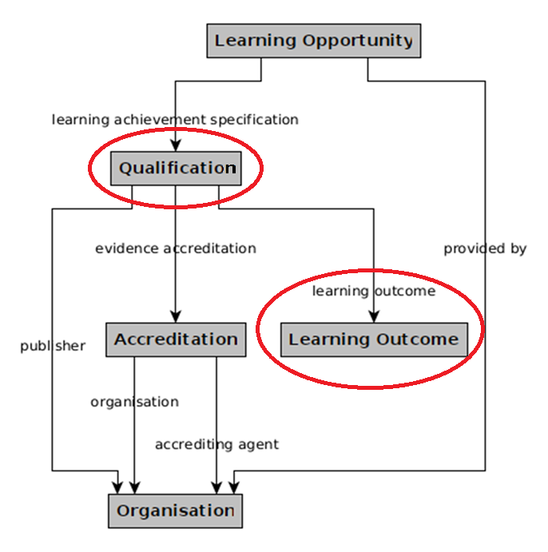
QCP Data model - ALM
Every qualification has Learning Outcome(s)

Slide 30
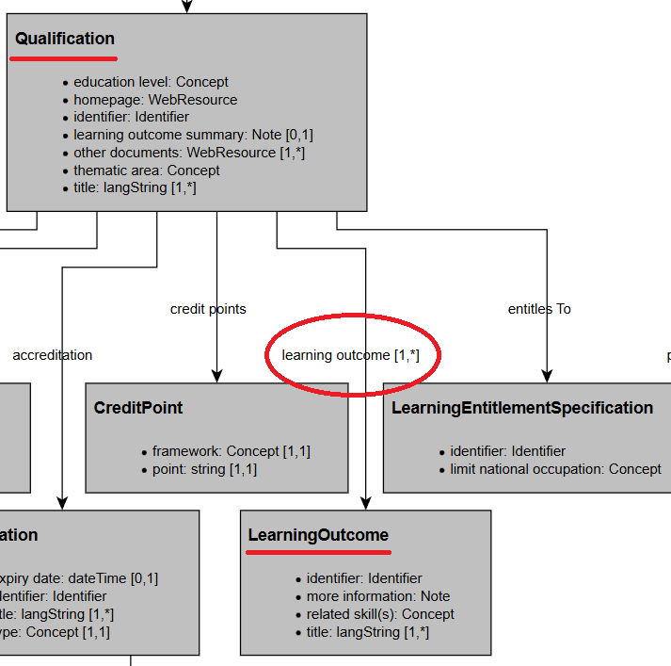

QCP Data model - ALM

Slide 31
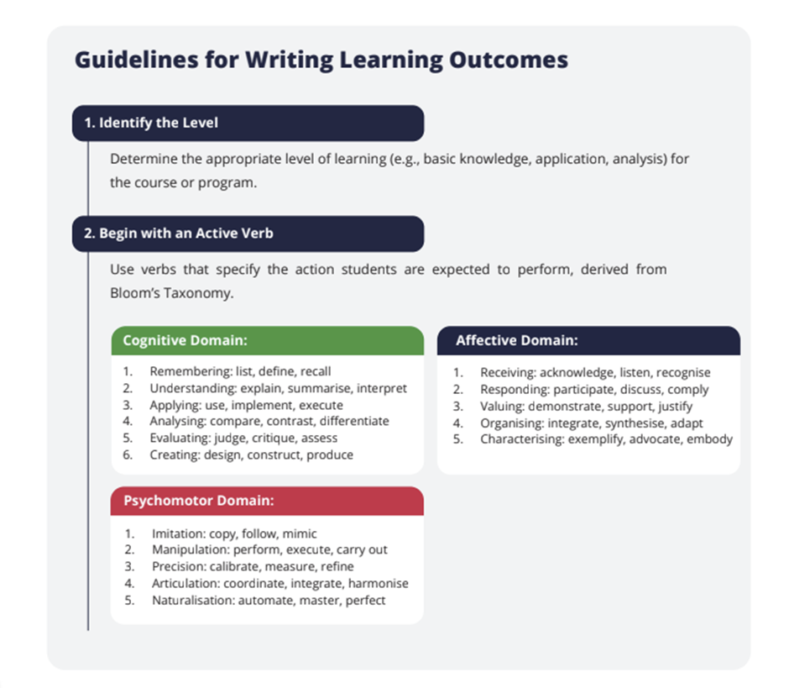
Support your education providers
ACQF QCP - Training Unit dedicated to Learning Outcomes
“T4 - Integrating Learning Outcomes into Qualifications Databases”
https://acqf.africa/qualifications-platform/qcp-training-modules-and-presentations

Slide 32
05
Quality assurance

Slide 33
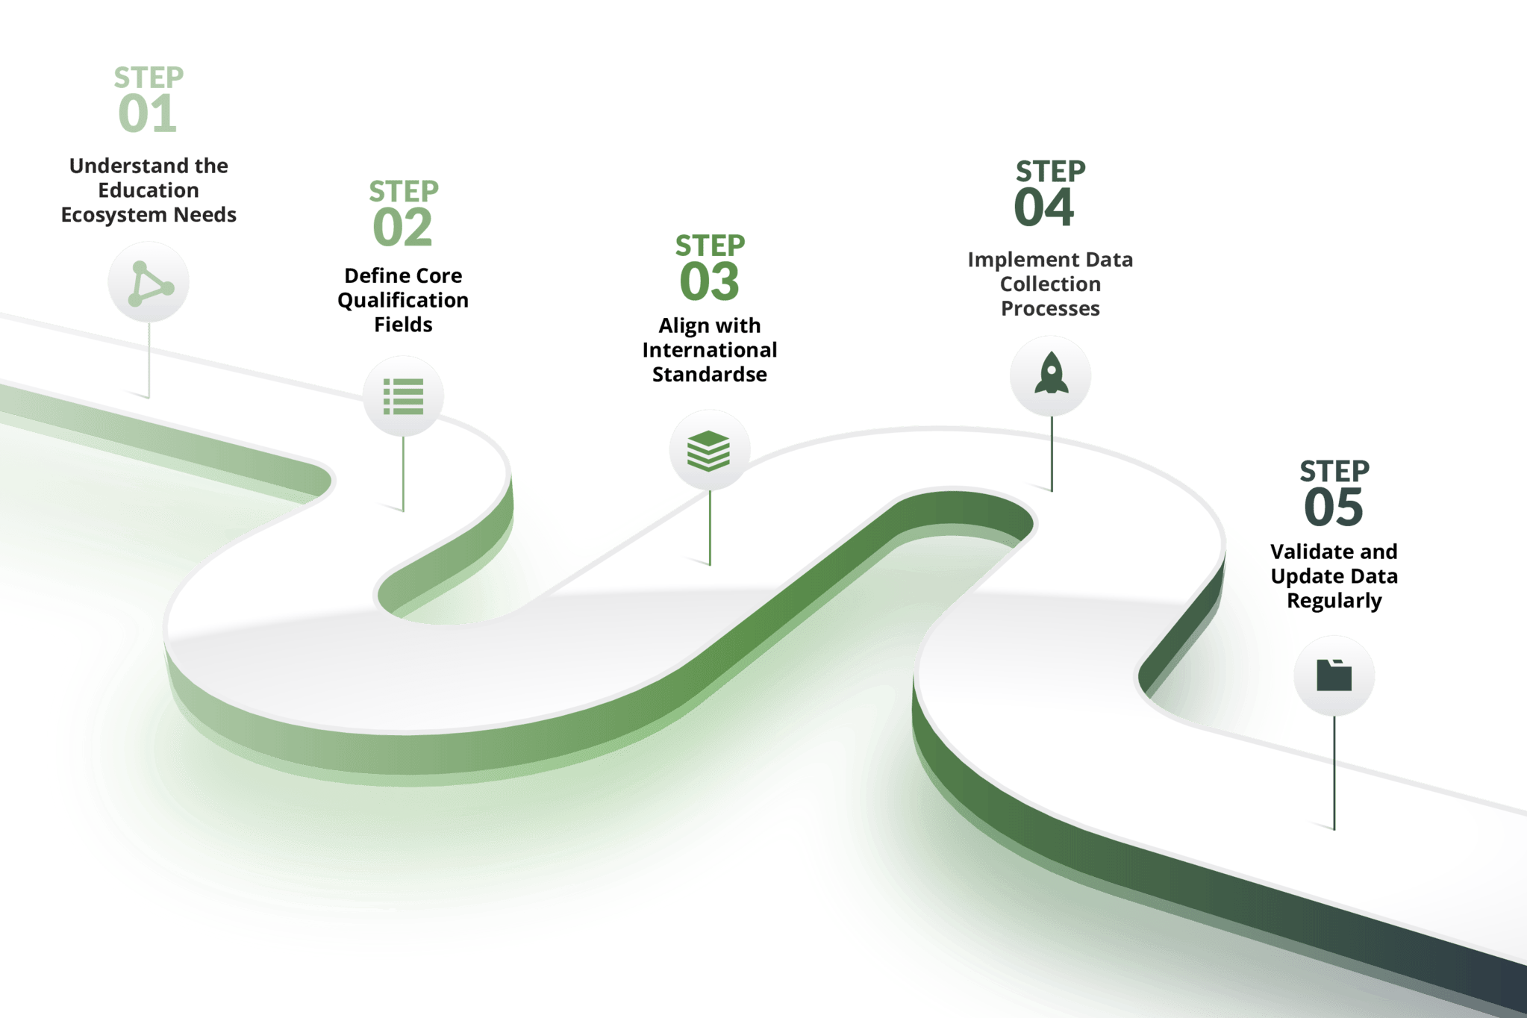
Mapping and Standardising Qualifications Data

Slide 34


Key objectives of data quality assurance
Why is it important?
  Promotes trust
  Support to policy development
Main principles
  Accuracy: the data accurately reflects qualifications defined by the relevant authority
  Completeness: all required fields are completed with relevant data
  Consistency: standardised concepts, lack of discrepancies
  Timeliness: data is up-to-date

Slide 35
Verification and validation processes
Pre-upload preparation and verification
  Review and understand the ACQF Data Exchange Model (data standardisation, required fields)
  Compare and contrast national data with the QCP ACQF Data Exchange Model
  Prepare qualifications data according to the standardised format
  Check mapped qualification against requirements
Ongoing validation and monitoring
Data validation tools
Random spot-checks
Monitoring reports
Audit trails
Track data changes
Apply version control

Slide 36





Practical tips
Develop a data entry checklist for the persons handling data imputation
Designate clear roles (e.g. mapping, imputation, quality control)
Conduct regular audits: perform periodic audits to verify data accuracy and integrity (random checks, error tracking)
Integrate feedback loops
Regularly check the learning materials posted on the ACQF QCP website

Slide 37
Support by the project team
Technical support
Guidance on data formats
Platform integration
Automated validation system
Manual checks
Monitoring reports
Communication channels
Dedicated mailbox
Bilateral calls
Regular progress updates

Slide 38
06
Wrap-up and Next Steps

Slide 39
Development, Testing, and Launching of the ACQF QCP
2024 :
  Development of the Curator user interface service
  “General Public UI” and “Import service” prototypes
20/12/2024: Initial demonstration of the QCP
2025:
  UAT of the user interface service
  Prototypes validation and development of “General Public UI” and “Import service” (partial)

Slide 40
Operationalisation and Scaling of the ACQF QCP
2024
  Preparatory steps, data collection protocol
  Framework set-up, communication with stakeholders
2025
  Q1: Data collection system set-up, ongoing data collection and initial upload
  Q2: Ongoing data collection and validation
  Q3: Final validation and consolidation of collected data, upload (out of the scope of this Order Form)

Slide 41
Capacity Development and Advocacy
2024
  Knowledge and skills to effectively manage Qualification Databases (QDs)
  Special focus on how to utilise the African Qualifications and Credentials Platform (QCP) that is being developed
2025
  Discussion ongoing on focus and targets

Slide 42
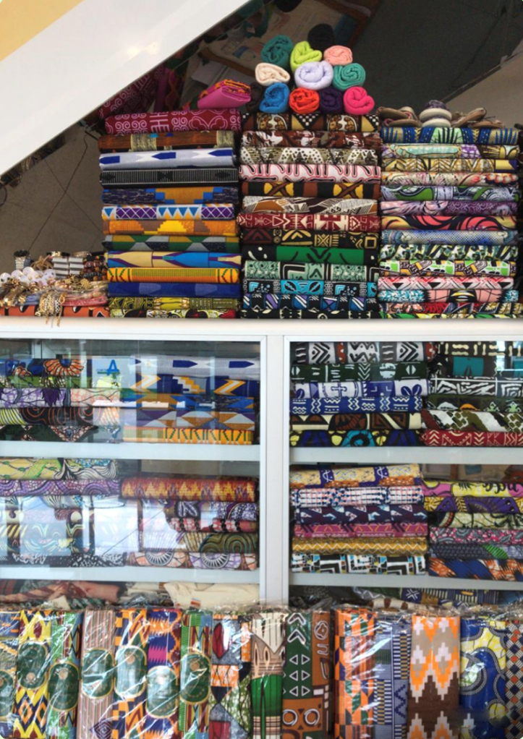
Thank you
Obrigado
Merci
Credit: Eduarda Castel Branco

Slide 43
4 December 2024

Slide 44
01
QCP User Interface

Slide 45



Please download and install the Slido app on all computers you use
What are your initial thoughts about the design and functionality of the mock-ups? [e.g. Intuitiveness / User-friendliness / Appeal]
ⓘ Start presenting to display the poll results on this slide.

Slide 46
Please download and install the Slido app on all computers you use
Are there any concerns or recommendations you would like to address before the next round of development?
ⓘ Start presenting to display the poll results on this slide.

Slide 47
02
Capacity development

Slide 48
Please download and install the Slido app on all computers you use
Which areas should the capacity development focus on (e.g. Data collection/governance, Interoperability and Standards, Use of QCP interface, Strategic Policy alignment, Qualifications data)
ⓘ Start presenting to display the poll results on this slide.

Slide 49

Please download and install the Slido app on all computers you use
Who should the capacity-building efforts target
ⓘ Start presenting to display the poll results on this slide.

