Slide 1
Greening Skills and Qualifications in Africa – Users’ Engagement

Slide 2
Outline
Introduction
Objectives
A Concept for Greening Skills and Qualifications in Africa – Users’ Engagement
Outline
Call for Good Practices and Green Skills and Qualifications Survey
Questions And Answers

Slide 3
Introduction
The All-Africa Students Union (AASU), the leading representative organization of African students is undertaking the ACQF-II Pilot Project: "Greening Skills and Qualifications in Africa – Users’ Engagement.“ This initiative seeks
To actively involve stakeholders in the contextualisation and integration of green skills and qualifications into education systems and national qualification frameworks.
To align these systems with the requirements of the emerging green economy, emphasizing sustainability, climate action, climate justice, and the incorporation of indigenous knowledge
This project is rooted in strategic frameworks, including the SDGs, Agenda 2063, and the Continental Education Strategy for Africa (CESA 2.0

Slide 4
Objectives
Define Green Skills and Qualifications in Africa by analysing employer demands, education supply
Alignment with climate policies and trade agreements, including AfCFTA
Develop insights for a stakeholder toolkit to guide curriculum design, certification, and workforce greening strategies.
Identify gaps and best practices for Green Skills development to aid academic institutions and industry
Propose preliminary recommendations for integrating Green Skills into Qualifications Frameworks, leveraging RPL and micro credentials for flexible upskilling.

Slide 5
ACQF priority countries
This project will focus on engaging stakeholders and contextualizing green skills and qualifications by targeting the following countries across the continent, which are in alignment with the ACQF priority countries
Angola
Ghana
DR Congo
Senegal
Zimbabwe
Botswana
The Gambia
Cameroon
Mozambique
Cape Verde
Togo
Sierra Leone
Uganda

Slide 6
Call for Good Practices: Greening Skills and Qualifications in Africa
We are seeking models integrating sustainability into education, training, and workforce development, focusing on innovative practices in skills recognition (RPL), micro-credentials, institutional partnerships, and policies.
Why Submit Your Practice?
Successfully share initiatives on how to incorporate green competencies into education and training systems
Demonstrate alignment with continental qualifications frameworks and climate objectives
Share insights on how to advance equitable workforce development through innovative recognition methods (RPL/micro-credentials)
Offer scalable models for policy and institutional adoption
Notes:
Selected examples will shape continental qualifications frameworks, offer replicable solutions for African institutions, and strengthen links between skills development and green economic transformation. Help us create a sustainable workforce by sharing your institution’s experience

Slide 7
FOCUS AREAS
Policy Innovations – National/regional strategies for green skills
All initiatives must be Africa-based with proven results
Local climate resilience innovations
Employer-led green job certifications
Sustainability-focused curricula & teacher development

Slide 8
Who Can Submit
Students & Youth-led Organisation
Governments & educational institutions
TVET centers, NGOs, and private sector

Slide 9
SUBMISSION REQUIREMENT
Case Study (500–800 words): Context, objectives, result and scalability
Supporting Evidence: Reports, policies and testimonials,
Relevance: Clear connection to green skills, qualifications frameworks, or just transition strategies

Slide 10
SUBMISSION DEADLINE
Submit here: bit.ly/44HqtdD
Extended Deadline: 9 June 2025

Slide 11
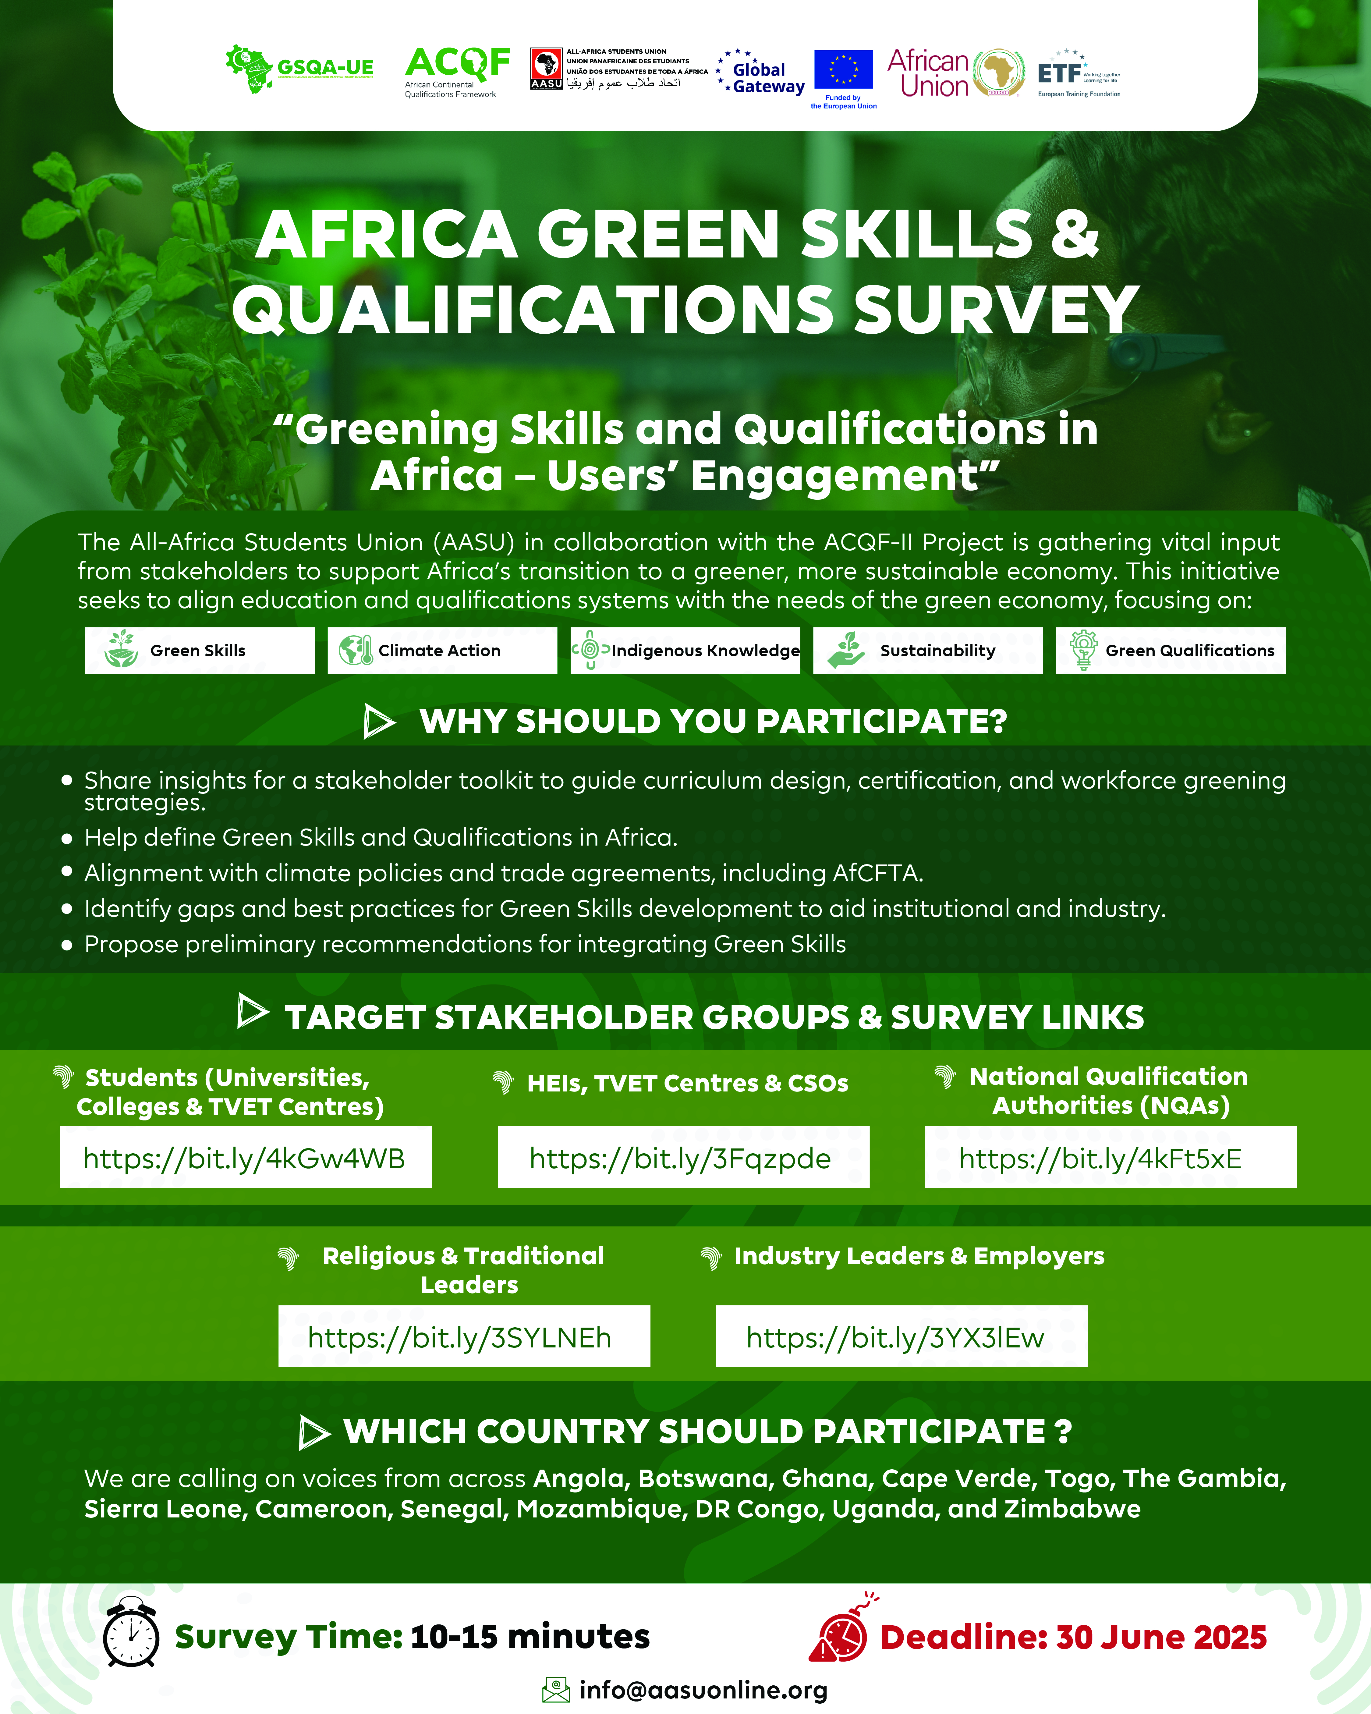

Slide 12
Questions and Answers

Slide 13
THANK YOU

