Slide 1



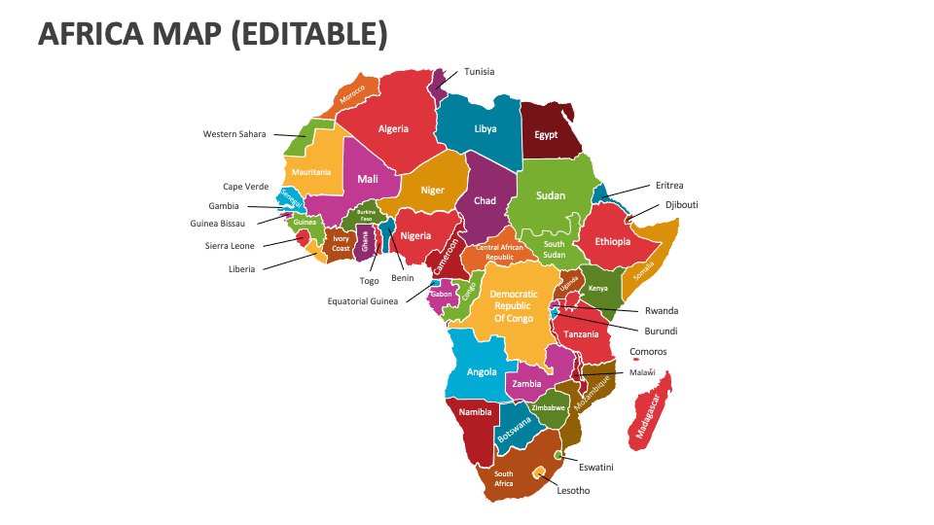
ACQF Network Webinar
05/06/2025
ACQF WORK PLAN, 2025.

Slide 2


Storyline
A Brief Background
Work Plan
Way forward

Slide 3
Background information
Establishment of the ACQF is a policy initiative of the African Union (AU), required by key continental integration strategies and initiatives in the fields of education and training.
The European Training Foundation was entrusted by the EU Delegation to African Union (AU) with implementation of the project “Support to the implementation of the African Continental Qualifications Framework (ACQF) & further ACQF-II.
ACQF-I: (2019-2022) involved over 40 African countries in different types of activities, from the initial mapping study to capacity development and knowledge-sharing, and support to countries.

Slide 4
ACQF-II (2023 – 2026)
ACQF-II: builds upon the achievements and outputs of the first ACQF project and are oriented to implementation at national, regional, and continental levels.
Overall Objective (Impact) of the ACQF-II project is to contribute to improved mobility, lifelong learning opportunities for African youth, as a result of enhanced comparability and transparency of qualifications, recognition of skills and diplomas, improved mutual trust and information-sharing between qualifications frameworks and systems on the continent.

Slide 5
ACQF Network: sustainability
Main objectives of the ACQF Network
To support and sustain the implementation of the ACQF and QCP
To foster further development of clear, meaningful, comparable and
Core Values of ACQF Network
Focus on ACQF-QCP and common interest
African knowledge
Inclusiveness
Innovation
Supported by evidence
Collaborative approaches and
participative governance
Transparency and integrity
operational ‘green’ NQFs in African countries and support their cooperation, referencing, peer support and mutual trust.
To promote the use of ACQF levels on qualifications and credentials and databases of qualifications upon referencing to ACQF, facilitating mutual recognition of qualifications.
To contribute to change and reforms, supporting impact-oriented education and training, improved access and completion rates, accessible recognition of prior learning, functioning credit accumulation and transfer systems and quality assurance.
To support efficient management of qualifications and credentials and real- time information-sharing, through data analysis, anticipation of skills needs, and interoperable databases of qualifications connected to QCP, across all African countries and regions.
To cooperate and work in synergy with the Addis Recognition Convention, promoting linkages and synergies between ACQF-NQFs and facilitating recognition of qualifications and credentials.
To contribute to improve global recognition and transparency of education, and qualifications and credentials from African countries.
To foster joint research projects for the advancement of the ACQF Network.
To collaborate with existing regional structures, especially with the regional economic communities, and relevant global networks and frameworks.

Slide 6
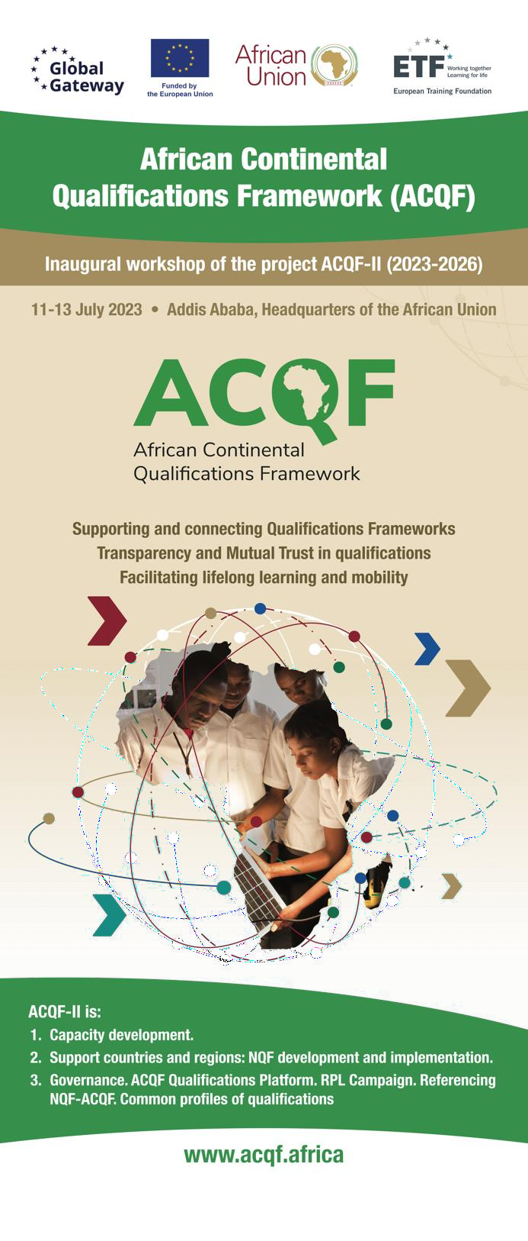
Main areas of activity of ACQF-II
Referencing of national qualifications frameworks and systems to the ACQF, following agreed criteria and procedures.
Support recognition of prior learning – for example, the development of common guidelines and approaches, updated inventory of RPL systems on the continent, a wide information and support campaign
ACQF Qualifications & Credentials Platform (QCP) and management information system
Qualifications: Development of qualifications profiles adequate for common continental use (e.g. related with economic integration / AfCFTA).
Capacity development in relevant areas. Online, onsite, hybrid.
Advocacy, communication, networking and cooperation: African stakeholders (education and training, employment, social partners) and other RQFs globally
Analysis, monitoring and evaluation: for continuous improvement.

Slide 7








Actions and achievements
Capacity development, peer learning – Output 1.1
Policy documents developed – Output 2.1
Angola: Handbook and training - supporting implementation qualifications National Catalogue. Website INQ
DR Congo: NQA, start NQF
Eswatini: RPL. Website EQA
Ghana: NQF, RPL, CATS
Guiné-Bissau: NQF
Mozambique: 2 regulations NQF TC; M&E system
Senegal: NQF
Seychelles: CATS
Sierra Leone: RPL, CATS
Somalia: NQF, RPL, CATS
Zambia: start NQF review
Handbooks and guidelines
– continental
Surveys, Data, Tools
Multi-country:
11 Forums
Country specific: 16 workshops, many webinars
QCP: 8 webinars
M&E: 5 workshops and webinars
All co-hosted with national NQA – NQI
RPL for Practitioners
Micro-credentials
Referencing ACQF short guide
Registration of
qualifications
QCP training modules and communication leaflet
Green skills
Common profiles of occupations – data driven
NQF
RPL - 2
Micro-credentials
– 3
Satisfaction
Big Data –
Dashboards
ACQF Website
QCP

Slide 8
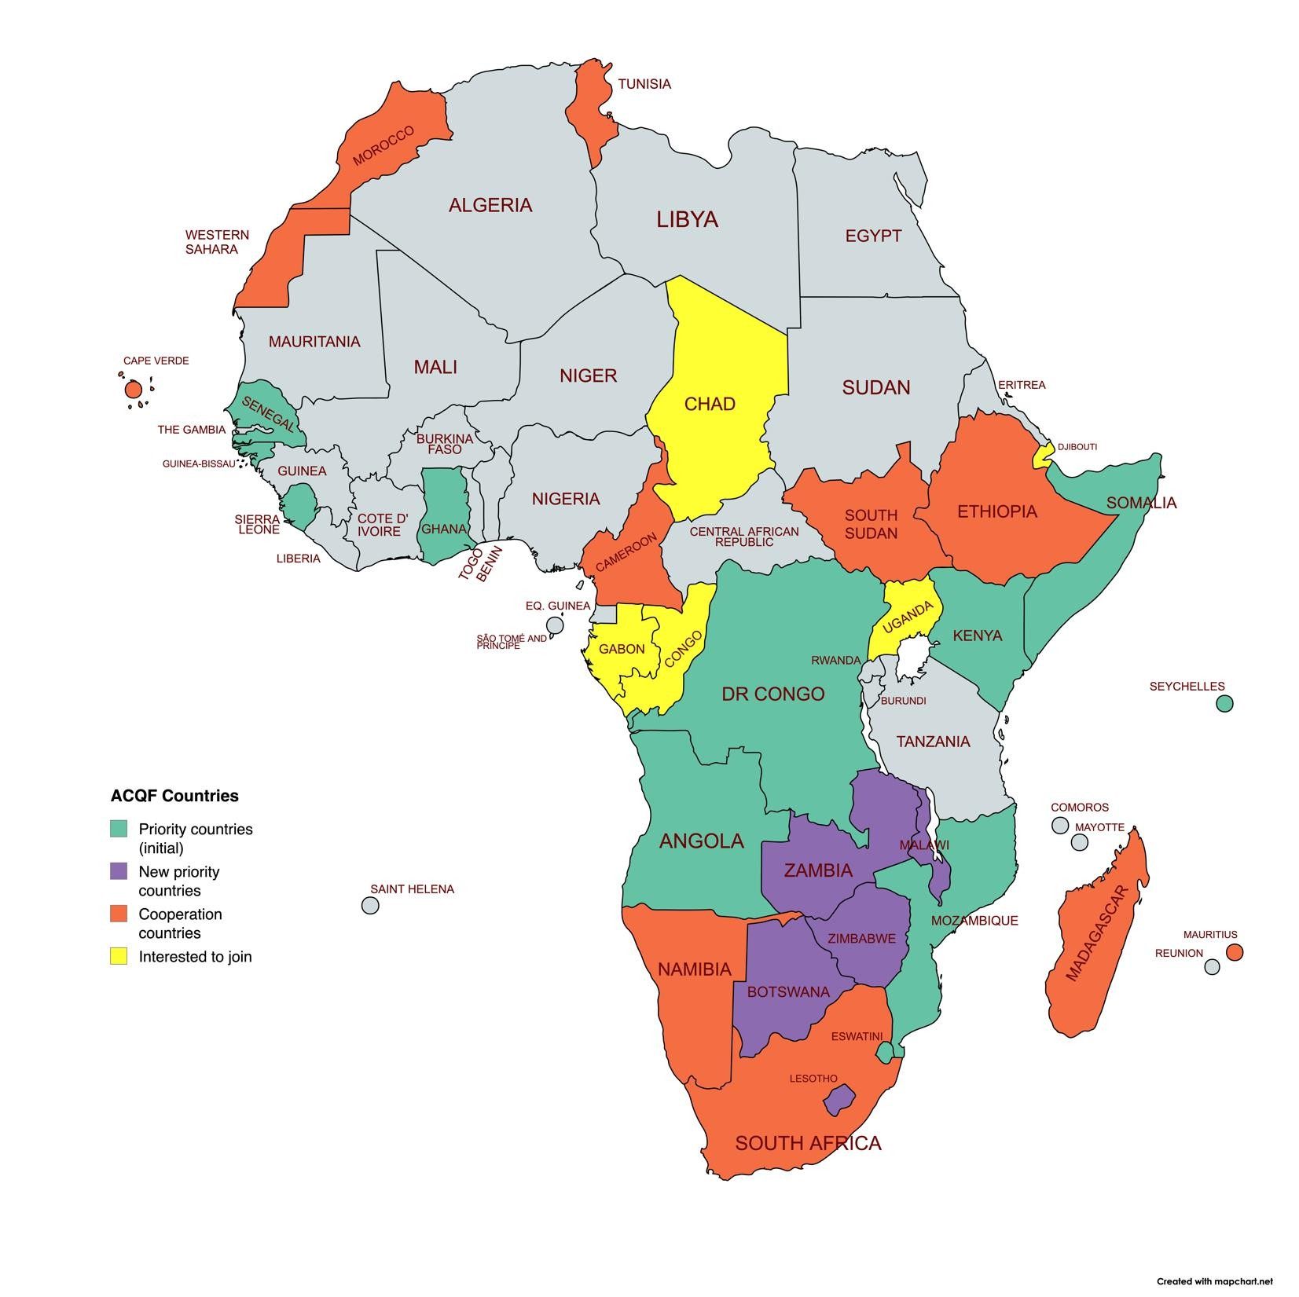
ACQF-II 2025-2026
Continuation of all strands of activities
Capacity development: a) Forums of NQF Authorities and stakeholders; b) Country- specific
Support to development and implementation of
NQFs, RPL, CATS
QCP: full operationalisation, specific support to
country teams
ACQF Network – support for sustainability
Green skills: new pilot project implemented by AASU
Micro-credentials: policies and guidelines with countries
More common profiles of occupations and
qualifications
Page 26

Slide 9










2023-2024: 11 ACQF-II capacity development, peer learning, referencing multi-country workshops; 21 countries - 3 regions
May 2023
Johannesburg: 2 WS
- SADCQF, TVET
Symposium
Jul 2023 Addis: validation ACQF Policy
Oct 2023 Nairobi: Programme NQF training
Nov 2023 Accra: NQF training
May 2024
Johannesburg: SADCQF
June 2024 Kinshasa: 1st Forum NQF Authorities
Sept 2024 Luanda: 2nd Forum NQF Authorities
Dec 2023 Maputo: NQF training
Nov 2024
Seychelles: 4th Forum – Micro-
Oct 2024 Nairobi: 3rd Forum - RPL
Plus over 16 Country-specific workshops!
Campaign
credentials
Page 37

Slide 10
THE ACQF Network Calendar of Activities
Jan 2025 – December 2026

Slide 12



