Slide 1
Capacity Building in the Field of RPL Botswana and distance, 16 March 2026 Understanding Recognition of Prior Learning (RPL) and Ways Forward for Implementation Patrick Werquin, ACQF Team An ACQF Activity (African Continental Qualifications Framework) European Training Foundation (ETF)

Slide 2
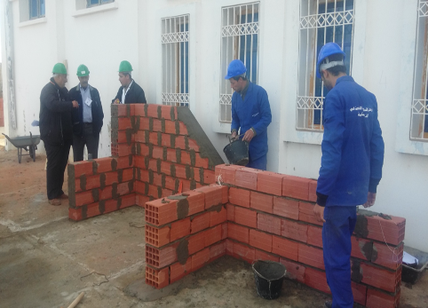

Slide 3


Slide 4
Agenda
Minimum Glossary
Definition, and the General Idea
The Many Applications in General
The Many Names
Key Issues
Barriers
Rationale
Institutional Arrangements
Assessment
Process (RPL in practice)
Patrick Werquin, Capacity Building in the field of RPL, Botswana and distance, 16 March 2026

Slide 5
Agenda
Minimum Glossary
Definition, and the General Idea
The Many Applications in General
The Many Names
Key Issues
Barriers
Rationale
Institutional Arrangements
Assessment
Process (RPL in practice)
Patrick Werquin, Capacity Building in the field of RPL, Botswana and distance, 16 March 2026

Slide 6
Minimum Glossary
Qualification
Qualifications System
Qualifications Framework (sectoral, national; or international, i.e. meta framework)
Catalogue of Qualifications
Competence
Learning outcomes
Credit
Credit accumulation and transfer (system)
Formal learning, Non-formal learning, and Informal learning
Lifelong Learning, Adult Learning
Validation and recognition
Patrick Werquin, Capacity Building in the field of RPL, Botswana and distance, 16 March 2026

Slide 7
Minimum Glossary
Qualification ☺
Qualifications System ☺
Qualifications Framework (sectoral, national; or international, i.e. meta framework) ☹☹☹
Catalogue of Qualifications ☺
Competence ☹☹☹☹☹
Learning outcomes ☹☹
Credit ☹☺
Credit accumulation and transfer (system) ☹
Formal learning ☺ Non-formal learning ☹ and Informal learning ☺
Lifelong Learning, Adult Learning ☹☺
Validation and recognition ☺☹
Patrick Werquin, Capacity Building in the field of RPL, Botswana and distance, 16 March 2026

Slide 8
Most are Dual Concepts
It’s not rare that there are confusions:
Qualifications vs. Competences
Qualifications Framework vs. Qualifications Systems
Qualifications Framework vs. Catalogue of Qualifications
Non-formal Learning vs. Informal Learning
Lifelong Learning vs. Adult Learning
Validation vs. Recognition
Patrick Werquin, Capacity Building in the field of RPL, Botswana and distance, 16 March 2026

Slide 9
Agenda
Minimum Glossary
Definition, and the General Idea
The Many Applications in General
The Many Names
Key Issues
Barriers
Rationale
Institutional Arrangements
Assessment
Process (RPL in practice)
Patrick Werquin, Capacity Building in the field of RPL, Botswana and distance, 16 March 2026

Slide 10
A Simple Idea
RPL is about one simple idea (it’s a philosophy):
We all learn everywhere and all the time…
… throughout life
But it has many applications
And it has many names
And there is some confusion and misconception:
E.g. no need to have a portfolio system to actually have RPL
E.g. some countries have an RPL system and they don’t know they have one (Germany, Malawi)
E.g. no need to award a full qualification (many alternatives)
Patrick Werquin, Capacity Building in the field of RPL, Botswana and distance, 16 March 2026

Slide 11
The Main Idea behind RPL
We all learn everywhere and all the time and the corresponding learning outcomes…
… should be given currency, and
… should be widely recognised (e.g. through a qualification), and this demands sound assessment and validation
This demands…
… the awarding of a document
… assessment (with quality assurance)
Patrick Werquin, Capacity Building in the field of RPL, Botswana and distance, 16 March 2026

Slide 12

STOP: there is no consensus all the way
We are all learning everywhere and all the time: consensus
There are systematic learning outcomes: less consensus
Awarding a qualification on the sole basis of an assessment (i.e., without formal learning at all): No consensus
Patrick Werquin, Capacity Building in the field of RPL, Botswana and distance, 16 March 2026

Slide 13
RPL: Abridged Definition
RPL is a process by which all the learning outcomes of an individual applicant are assessed against predefined standards, and a document is awarded to successful applicants.
And a process means guidance
And therefore capacity building (guidance officers, assessors)
Patrick Werquin, Capacity Building in the field of RPL, Botswana and distance, 16 March 2026

Slide 14
RPL: Full Definition
RPL is a process by which any set of consistent learning outcomes of an individual, however acquired (i.e. formally, non-formally and/or informally) are given currency through the awarding of an officially recognised document clearly stating what the applicant knows and is able to do (a qualification typically, but not necessarily1), and the extent to which they are mastered by the applicant (level); after a thorough quality assured assessment process against predefined [preferably widely agreed] standards that provide a set of criteria, and a norm, for assessing these learning outcomes
Patrick Werquin, Capacity Building in the field of RPL, Botswana and distance, 16 March 2026

Slide 15
STOP Again: Just to Insist
The heart of RPL is assessment
RPL is not about education and training (not at the first stage)
It’s about assessing competences candidate already have
Patrick Werquin, Capacity Building in the field of RPL, Botswana and distance, 16 March 2026

Slide 16
Agenda
Minimum Glossary
Definition, and the General Idea
The Many Applications in General
The Many Names
Key Issues
Barriers
Rationale
Institutional Arrangements
Assessment
Process (RPL in practice)
Patrick Werquin, Capacity Building in the field of RPL, Botswana and distance, 16 March 2026

Slide 17
The Many Possible Applications
Full qualification
Partial qualification, or partial certificate (block of competences)
Credits toward a qualification
Exemption of academic prerequisite to enter the formal education and training system
Positioning potential learners on formal learning pathways (e.g. before continuing training)
Exemption of all or part of the curriculum (shortening)
Certificate of labour market competences
Patrick Werquin, Capacity Building in the field of RPL, Botswana and distance, 16 March 2026

Slide 18
The Many Possible Applications
Full qualification: not accepted in many countries
Partial qualification, or partial certificate (block of competences): A key avenue for sustainable RPL
Credits toward a qualification: simple
Exemption of academic prerequisite to enter the formal education and training system: very relevant for HE
Positioning potential learners on formal learning pathways (e.g. before continuing training): formative
Exemption of all or part of the curriculum (shortening)
Certificate of labour market competences: widely used
Patrick Werquin, Capacity Building in the field of RPL, Botswana and distance, 16 March 2026

Slide 19
Applications in Short
Saving time
Saving money
For [potential] learners (time, money, hidden competences, employability, decent job)
Highly motivating
Patrick Werquin, Capacity Building in the field of RPL, Botswana and distance, 16 March 2026

Slide 20
Agenda
Minimum Glossary
Definition, and the General Idea
The Many Applications in General
The Many Names
Key Issues
Barriers
Rationale
Institutional Arrangements
Assessment
Process (RPL in practice)
Patrick Werquin, Capacity Building in the field of RPL, Botswana and distance, 16 March 2026

Slide 21
The Many Names
PLAR (Canada only)
APL, APEL (UK)
RAC (Quebec, Belgium)
RLO (European Commission)
RNFILO (Werquin, OECD 2010)
VAE (France)
RPL (everywhere)
VPL (Netherlands)
Patrick Werquin, Capacity Building in the field of RPL, Botswana and distance, 16 March 2026

Slide 22
The Many Names
PLAR (Canada only) ☺ ☺
APL, APEL (UK) ☹ ☹ ☹
RAC (Quebec, Belgium) ☺ ☺
RLO (European Commission) ☹ ☺
RNFILO (Werquin, OECD, 2010) ☺ ☺
VAE (France) ☹ ☺
RPL (everywhere) ☺ ☹
VPL (Netherlands) ☹
Patrick Werquin, Capacity Building in the field of RPL, Botswana and distance, 16 March 2026

Slide 23
RNFILO ☺☺☺
I like better: Recognition of non-formal and informal learning outcomes (my OECD books)
Long and boring but…
… it says what it does, and it does what it says
Patrick Werquin, Capacity Building in the field of RPL, Botswana and distance, 16 March 2026

Slide 24
Recognition of What: NFILO
Many definitions of non-formal and informal learning outcomes (NFILO) ☹
Not consensual ☹☹☹
Formal learning: structured in terms of content, scheduling, organisation and financing
Informal learning: not structured, never intentional
Non-formal learning: varies a lot (no consensus): in between formal and informal, with variations to allow for national/regional/local or sectoral specificities
Patrick Werquin, Capacity Building in the field of RPL, Botswana and distance, 16 March 2026

Slide 25
Non-formal and Informal Learning in Short
Don’t panic
You don’t need definitions that are valid everywhere and all the time
Continuum (from formal to informal)
Please note, my definitions do NOT contain “[usually] leads to a qualification”, which would be silly ☹ (because precisely RPL aims at awarding a qualification whatever the learning context)
Patrick Werquin, Capacity Building in the field of RPL, Botswana and distance, 16 March 2026

Slide 26
Agenda
Minimum Glossary
Definition, and the General Idea
The Many Applications in General
The Many Names
Key Issues
Barriers
Rationale
Institutional Arrangements
Assessment
Process (RPL in practice)
Patrick Werquin, Capacity Building in the field of RPL, Botswana and distance, 16 March 2026

Slide 27
Key Idea 1
Target group:
RPL/RNFILO is for people with competences…
… but without the corresponding qualification
Useful also for specific groups: migrants, refugees, post conflict situation
For people without competences (if any), the next best alternative is : education and/or training
Patrick Werquin, Capacity Building in the field of RPL, Botswana and distance, 16 March 2026

Slide 28
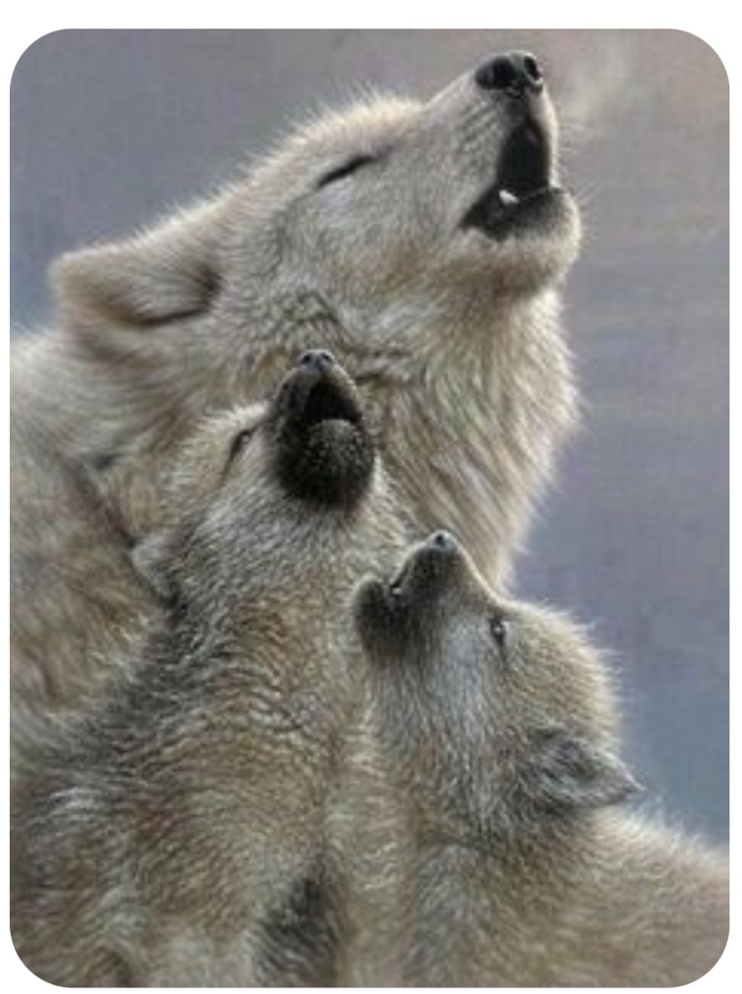
Key Idea 2
It is the learning outcomes that are assessed, and potentially validated, not the learning
Patrick Werquin, Capacity Building in the field of RPL, Botswana and distance, 16 March 2026

Slide 29
Key Idea 3
Assessment is the heart of the system; for
Trust
Parity of esteem
And because the input process is unknown
Patrick Werquin, Capacity Building in the field of RPL, Botswana and distance, 16 March 2026

Slide 30
Key Idea 4
Double currency:
In the education and training formal system
In the labour market
Patrick Werquin, Capacity Building in the field of RPL, Botswana and distance, 16 March 2026

Slide 31
Key Idea 5
RPL is relevant in all education and training sectors:
Adult learning,
TVET,
Higher education
More relevant for adults, because applicants need to prove they have experiential learning outcomes, and therefore experience
RPL for young people is an option but more difficult to implement
Patrick Werquin, Capacity Building in the field of RPL, Botswana and distance, 16 March 2026

Slide 32

Key Idea 6
There is no such a thing as a good RPL system
But there is are systems that will better fits Botswana’s needs
Patrick Werquin, Capacity Building in the field of RPL, Botswana and distance, 16 March 2026

Slide 33

Key Idea 7
RPL is about visibility of competences
Patrick Werquin, Capacity Building in the field of RPL, Botswana and distance, 16 March 2026

Slide 34

Key Idea 8
RPL is offering a new route to qualifications
Patrick Werquin, Capacity Building in the field of RPL, Botswana and distance, 16 March 2026

Slide 35
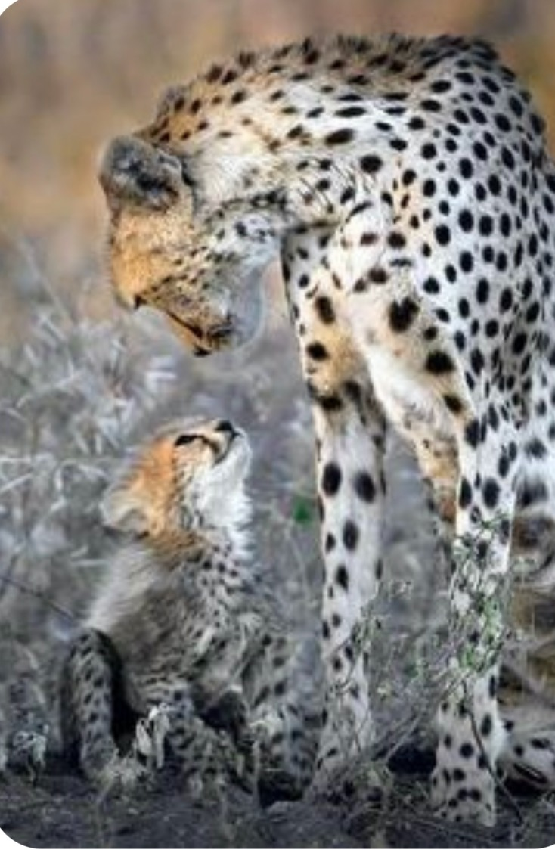
Key Idea 9
RPL is about equity
One of the most inclusive approaches in the field of education and training
Patrick Werquin, Capacity Building in the field of RPL, Botswana and distance, 16 March 2026

Slide 36
Key Idea 10
RPL/RNFILO demands that the country has already adopted a learning outcome based system
I.e., curriculum and qualifications standards are clearly written in terms of competences
And also the Law should state that a qualification is the result of a learning process, not a learning programme
If the Law says a number of hours is necessary for such and such qualification, RPL will prove difficult to implement
Patrick Werquin, Capacity Building in the field of RPL, Botswana and distance, 16 March 2026

Slide 37
Key Idea 11
What matter is:
Societal recognition (Not only technical recognition)
Idea:
Involve key stakeholders up front in the process
Create a sense of ownership (the objective of the communication policy/strategy)
Patrick Werquin, Capacity Building in the field of RPL, Botswana and distance, 16 March 2026

Slide 38
Key Idea 12
RPL is key for employability
Because a qualification is one of the main components of employability
But RPL does not provide a job ☹ ☹ ☹
It helps with finding or keeping a job, and with better wage and promotion
Patrick Werquin, Capacity Building in the field of RPL, Botswana and distance, 16 March 2026

Slide 39
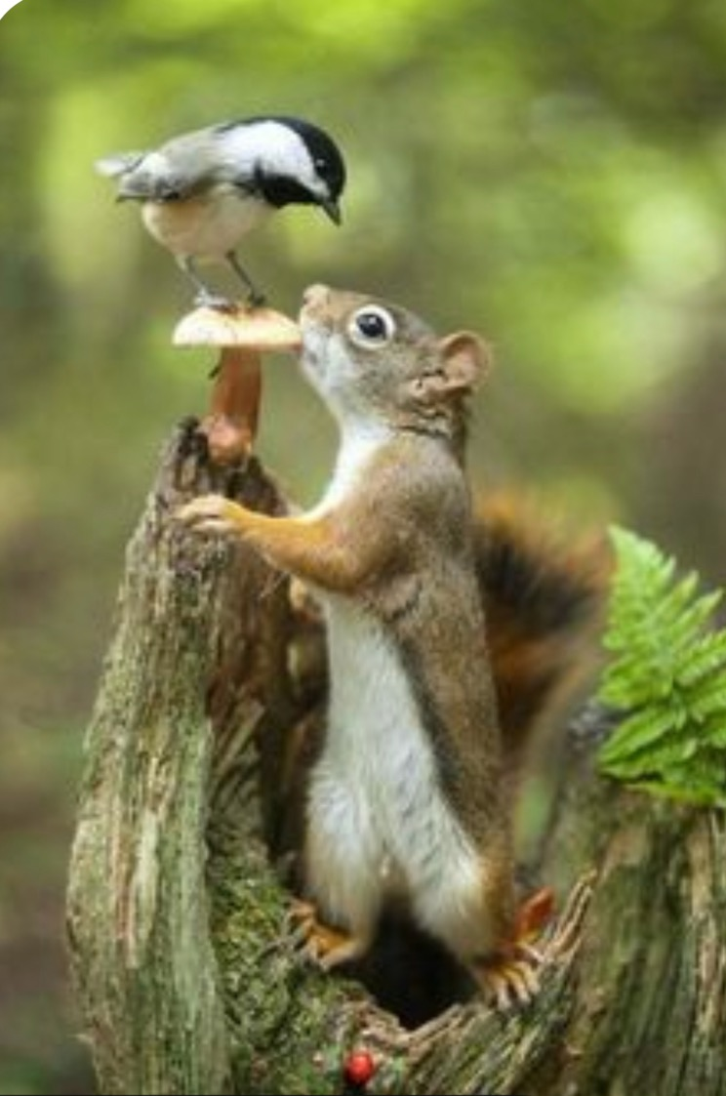
Key Idea 13
RPL is not a competitor to he education and training formal system
It’s a companion ☺
Patrick Werquin, Capacity Building in the field of RPL, Botswana and distance, 16 March 2026

Slide 40

Key Idea 14
RPL needs a smart governance
(Clear leadership, key stakeholders involved, key issues well identified: cost, price, funding, training of staff…)
Patrick Werquin, Capacity Building in the field of RPL, Botswana and distance, 16 March 2026

Slide 41
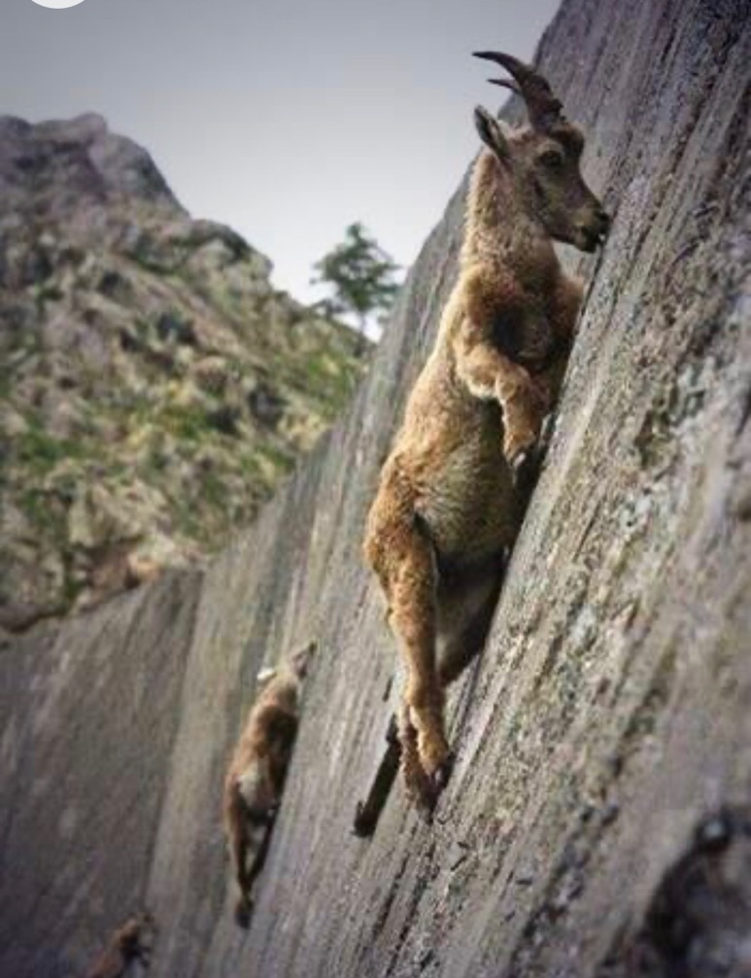
Key Idea 15
Take no risks
Run a pilot
A vertical pilot
Patrick Werquin, Capacity Building in the field of RPL, Botswana and distance, 16 March 2026

Slide 42

Key Idea 16
Do not leaves candidates on their own
Proper guidance
Strong evidence, guidance is key for:
Success in the RPL assessment process
Success later in the labour market in using newly acquired qualifications
Patrick Werquin, Capacity Building in the field of RPL, Botswana and distance, 16 March 2026

Slide 43
Key Idea 17
Award: THE Big Issue
If full qualifications are awarded to successful candidates, should they be similar to qualifications delivered in the formal education and training system?
Idea: yes ☺ exact same, with same rights ☺
Patrick Werquin, Capacity Building in the field of RPL, Botswana and distance, 16 March 2026

Slide 44

Don’t panic: we are only half way through ☺
Patrick Werquin, Capacity Building in the field of RPL, Botswana and distance, 16 March 2026

Slide 45
Agenda
Minimum Glossary
Definition, and the General Idea
The Many Applications in General
The Many Names
Key Issues
Barriers
Rationale
Institutional Arrangements
Assessment
Process (RPL in practice)
Patrick Werquin, Capacity Building in the field of RPL, Botswana and distance, 16 March 2026

Slide 46

Many Barriers – Mostly Psychological
Many stakeholders are against RPL:
E.g. Faculty ☹
RPL not understood
You will be told:
“You will award qualifications to everybody”
“You will award undeserved qualifications”
“You will create a competitor to the formal education and training system”
Recommendation: explain, explain, explain
Patrick Werquin, Capacity Building in the field of RPL, Botswana and distance, 16 March 2026

Slide 47
Agenda
Minimum Glossary
Definition, and the General Idea
The Many Applications in General
The Many Names
Key Issues
Barriers
Rationale
Institutional Arrangements
Assessment
Process (RPL in practice)
Patrick Werquin, Capacity Building in the field of RPL, Botswana and distance, 16 March 2026

Slide 48
Rationale
Why recognising non-formal and informal learning outcomes?
… to have a more qualified labour force (i.e., workers with a qualification)
Why do countries need a more qualified labour force?
… because it is a key reliable indicators of competences (business climate)
Patrick Werquin, Capacity Building in the field of RPL, Botswana and distance, 16 March 2026

Slide 49
Rationale: A More Qualified Labour Force!
Visibility of knowledge, skills and competences
Competences shortages: No (it is not availability of competences the issue, it’s visibility)
Distribution of qualifications, occupational mobility
Regulated occupations, and labour markets
ISO processes (quality…)
Bidding for public contracts
Patrick Werquin, Capacity Building in the field of RPL, Botswana and distance, 16 March 2026

Slide 50
Rationale: A Policy Tool
Time and cost for the individual (direct costs and opportunity costs), consistent with the constraints of adult life
Cost for the system (untapped human capital)
Motivation (not starting from scratch) ☺☺☺
Motivation: it’s what people know and can do that matter (different from the school/teacher approach)
Demography…
Employers do it all the time (practical/informal)°
Patrick Werquin, Capacity Building in the field of RPL, Botswana and distance, 16 March 2026
Notes:
° next step, badge and the like

Slide 51
Rationale: A Policy Tool
It’s flexible: continuum of outputs, from self assessment (portfolio) to full certification
Job matching
For migrants, refugees
It has a cost (RPL is not free, but cheaper than formal ET)
Workers without qualifications may have competences
Motivator for resuming formal studies (LLL, HE)
Crisis (assessment a good start before reskilling)
Certificates awarded by vendors > Certification MOE
Patrick Werquin, Capacity Building in the field of RPL, Botswana and distance, 16 March 2026

Slide 52
The Virtuous Circle of RPL
Acquisition of competences
Assessment
- Promotion
- Better job
- Self employment
Qualification
More opportunities (incl. formal learning)
Patrick Werquin, Capacity Building in the field of RPL, Botswana and distance, 16 March 2026

Slide 53
The Virtuous Circle of RPL
Acquisition of competences
Assessment
- Promotion
- Better job
- Self employment
Decent Jobs and poverty reduction
Qualification
More opportunities (incl. formal learning)
Patrick Werquin, Capacity Building in the field of RPL, Botswana and distance, 16 March 2026

Slide 54
Agenda
Minimum Glossary
Definition, and the General Idea
The Many Applications in General
The Many Names
Key Issues
Barriers
Rationale
Institutional Arrangements
Assessment
Process (RPL in practice)
Patrick Werquin, Capacity Building in the field of RPL, Botswana and distance, 16 March 2026

Slide 55
Starting Points
Check your needs…
… the needs of:
. Botswana as a whole
. The stakeholders involved
. The stakeholders you would like to involve
. The stakeholders you will have to involve
Patrick Werquin, Capacity Building in the field of RPL, Botswana and distance, 16 March 2026

Slide 56
A Vision
The countries that succeeded are those who had a vision
Where do you want Botswana to be in 3, 5, 10 years?
Patrick Werquin, Capacity Building in the field of RPL, Botswana and distance, 16 March 2026

Slide 57
Initial Conditions
Some stakeholders are ready to accept an RPL qualification as a proof of competences
Among the other stakeholders some have an interest in it, even if they may not be ready
The broader public is somewhat ready; if strong attachment to the formal education and training system: NOT good ☹
You have evidence that a fair fraction of the population has competences but no qualifications to prove them (your primary target group)
Patrick Werquin, Capacity Building in the field of RPL, Botswana and distance, 16 March 2026

Slide 58
Who Should be in Charge?
Ministry of Education?
Ministry of Labour?
Both?
More ministries?
Interministerial delegation?
Patrick Werquin, Capacity Building in the field of RPL, Botswana and distance, 16 March 2026

Slide 59
National Qualifications Framework
A national qualifications framework is just a useful companion:
For promoting the concept of learning outcomes
For providing (more) transparency
For equity
For transparency and comparability
Patrick Werquin, Capacity Building in the field of RPL, Botswana and distance, 16 March 2026

Slide 60
Pilot
A must: RPL systems should be piloted
And piloted vertically (i.e. all the way from drafting/selecting standards, to selecting industry sectors, to selecting qualifications awarded or any other outcomes, to involving stakeholders, to designing an RPL system (assessment, flow chart…) and to tracer studies…)
Patrick Werquin, Capacity Building in the field of RPL, Botswana and distance, 16 March 2026

Slide 61
Guidance
Guidance leads to better achievement rate in RPL (Recotillet & Werquin, 2009)
Guidance leads to a better use of the qualifications once achieved through RPL (Recotillet & Werquin, 2009)
Patrick Werquin, Capacity Building in the field of RPL, Botswana and distance, 16 March 2026

Slide 62
Cost and Price
Not free, not necessarily cheap
But a lot cheaper than formal education and training
What should be the price?
Who should pay for it?
Idea: not advisable to make it free, even if the price could be made symbolic
Patrick Werquin, Capacity Building in the field of RPL, Botswana and distance, 16 March 2026

Slide 63
Agenda
Minimum Glossary
Definition, and the General Idea
The Many Applications in General
The Many Names
Key Issues
Barriers
Rationale
Institutional Arrangements
Assessment
Process (RPL in practice)
Patrick Werquin, Capacity Building in the field of RPL, Botswana and distance, 16 March 2026

Slide 64
Assessment
Assessment: where do you need to look?
Key components of assessment
Eligibility: an issue on its own
The key to RPL assessment (Assessment Procedures vs. Assessment Standards)
Patrick Werquin, Capacity Building in the field of RPL, Botswana and distance, 16 March 2026

Slide 65

ASSESSMENT: How Much do you Need to See?
Notes:
65

Slide 66
ASSESSMENT: How Much do you Need to See?
Notes:
66

Slide 67
ASSESSMENT: How Much do you Need to See?
Does NOT help much!
☹
Notes:
67

Slide 68
ASSESSMENT: How Much do you Need to See?
Where do you need to watch?
☹☹☹
Notes:
68

Slide 69
ASSESSMENT: How Much do you Need to See?
Better!
☺
Notes:
69

Slide 70
ASSESSMENT: How Much do you Need to See?
Probably enough ☺ ☺ ☺
Notes:
70

Slide 71
ASSESSMENT: How Much do you Need to See?
You may not need to see the full picture to figure out competences
Notes:
71

Slide 72
Assessment – The Heart of the System
At least:
Transparent
Valid
Reliable and fair
Authentic°
Quality Assurance°° (depending on the level of formalisation you need)
Professional assessors (teachers? professionals?)
Patrick Werquin, Capacity Building in the field of RPL, Botswana and distance, 16 March 2026
Notes:
°° The first line of the QA in Assessment is verified in RPL: the assessor should never be the trainer
°Authentic assessment is actually assessing the person doing what they are being evaluated on.
Presentation skills:
Authentic assessment = do a presentation
Not authentic = only multiple choice on key cenceptd of presentations

Slide 73
Assessment – Methods
Simulation
Observation
Portfolio (a self reflecting tool, not a list)
Written examinations
Tests
Interviews
Panel
Practical task(s)
Virtual reality
Patrick Werquin, Capacity Building in the field of RPL, Botswana and distance, 16 March 2026

Slide 74
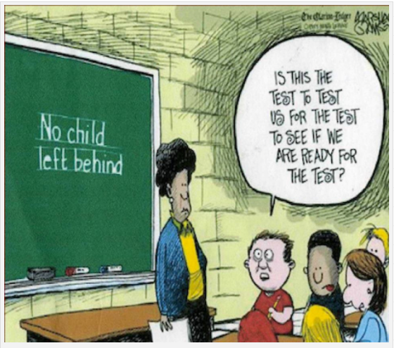
Initial Stage: Eligibility (or the Right to Apply for RPL)
Cost
How many years?
There is room for improvement

Slide 75
The Key to RPL Assessment
Same assessment standards
But different assessment procedures
Patrick Werquin, Capacity Building in the field of RPL, Botswana and distance, 16 March 2026
Notes:
That is what is not understood in Germany
The French system proves it’s possible

Slide 76
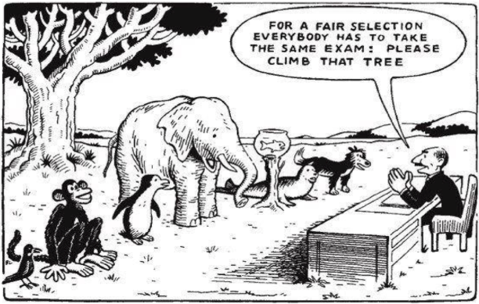
Exact reference unknown (see for instance: http://imgur.com/VPqOi ) - Maybe Based on Einstein's quote

Slide 77
Main Challenge
Finding the qualifications that matches your experiential learning outcomes
Finding in the experience of the applicant what could match the Qualifications Standards
Promising avenue: holistic portfolio (Petruskevich and Werquin, 2019)

Slide 78
Assessment – Recommendation
Consult about what would be acceptable
Decide
Communicate about it
Do quality assurance at the level of assessment (most appropriate moment to do it)
Patrick Werquin, Capacity Building in the field of RPL, Botswana and distance, 16 March 2026

Slide 79
Agenda
Minimum Glossary
Definition, and the General Idea
The Many Applications in General
The Many Names
Key Issues
Barriers
Rationale
Institutional Arrangements
Assessment
Process (RPL in practice)
Patrick Werquin, Capacity Building in the field of RPL, Botswana and distance, 16 March 2026

Slide 80
Information Advice and Guidance

Slide 81
Information Advice and Guidance | Welcome

Slide 82
Information Advice and Guidance | Welcome
 | Information (comprehensive)

Slide 83
Information Advice and Guidance | Welcome
 | Information (comprehensive)
 | Decision, by the individual, to apply

Slide 84
Administrative registration (web page)

Slide 85
Administrative registration (web page) | Provision of the administrative form to the potential applicant

Slide 86
Administrative registration (web page) | Provision of the administrative form to the potential applicant
 | Guidance (light)

Slide 87
Administrative registration (web page) | Provision of the administrative form to the potential applicant
 | Guidance (light)
 | Handover of the completed administrative form by the applicant

Slide 88
Administrative registration (web page) | Provision of the administrative form to the potential applicant
 | Guidance (light)
 | Handover of the completed administrative form by the applicant
 | Administrative decision to accept the applicant

Slide 89
Application screening and eligibility

Slide 90
Application screening and eligibility | Guidance (intermediate)

Slide 91
Application screening and eligibility | Guidance (intermediate)
 | Handover of the eligibility portfolio

Slide 92
Application screening and eligibility | Guidance (intermediate)
 | Handover of the eligibility portfolio
 | Eligibility interview

Slide 93
Application screening and eligibility | Guidance (intermediate)
 | Handover of the eligibility portfolio
 | Eligibility interview
 | Decision to send the (eligible) applicant to the assessment

Slide 94
Assessment

Slide 95
Assessment | Guidance (comprehensive)

Slide 96
Assessment | Guidance (comprehensive)
 | Handover of the portfolio of (self-analysed) competences

Slide 97
Assessment | Guidance (comprehensive)
 | Handover of the portfolio of (self-analysed) competences
 | Analysis of the portfolio

Slide 98
Assessment | Guidance (comprehensive)
 | Handover of the portfolio of (self-analysed) competences
 | Analysis of the portfolio
 | Convening notice sent to applicant

Slide 99
Assessment | Guidance (comprehensive)
 | Handover of the portfolio of (self-analysed) competences
 | Analysis of the portfolio
 | Convening notice sent to applicant
 | Final assessment (practical test, written examinations, on-the-job observation, simulation…)

Slide 100
Assessment | Guidance (comprehensive)
 | Handover of the portfolio of (self-analysed) competences
 | Analysis of the portfolio
 | Convening notice sent to applicant
 | Final assessment (practical test, written examinations, on-the-job observation, simulation…)
 | Interview with the panel of assessors

Slide 101
Certification

Slide 102
Certification | Validation of learning outcomes

Slide 103
Certification | Validation of learning outcomes
 | Making and stamping of the qualification

Slide 104
Certification | Validation of learning outcomes
 | Making and stamping of the qualification
 | Awarding of the qualification to successful applicants

Slide 105
Certification | Validation of learning outcomes
 | Making and stamping of the qualification
 | Awarding of the qualification to successful applicants
 | Explaining the reasons for failure to unsuccessful applicants. Recommendations (further practice, or formal training)

Slide 106
Appeal | ?????

Slide 107
Take Away Points Ways Forwards for Implementation
Set a system in motion (do NOT wait for the NCQF)
Pilot it
For the pilot, target low hanging fruits:
RPL-ready workers (some sectors, some levels)
Use synergies
Learn from the pilot
Improve your system (feedback the TVET system)
Delegate (Identify partners (ETPs))
Check your qualification standards
Prepare the front office staff
Work in coordination with Botswana NCQF team
Communicate communicate communicate
Patrick Werquin, Capacity Building in the field of RPL, Botswana and distance, 16 March 2026

Slide 108
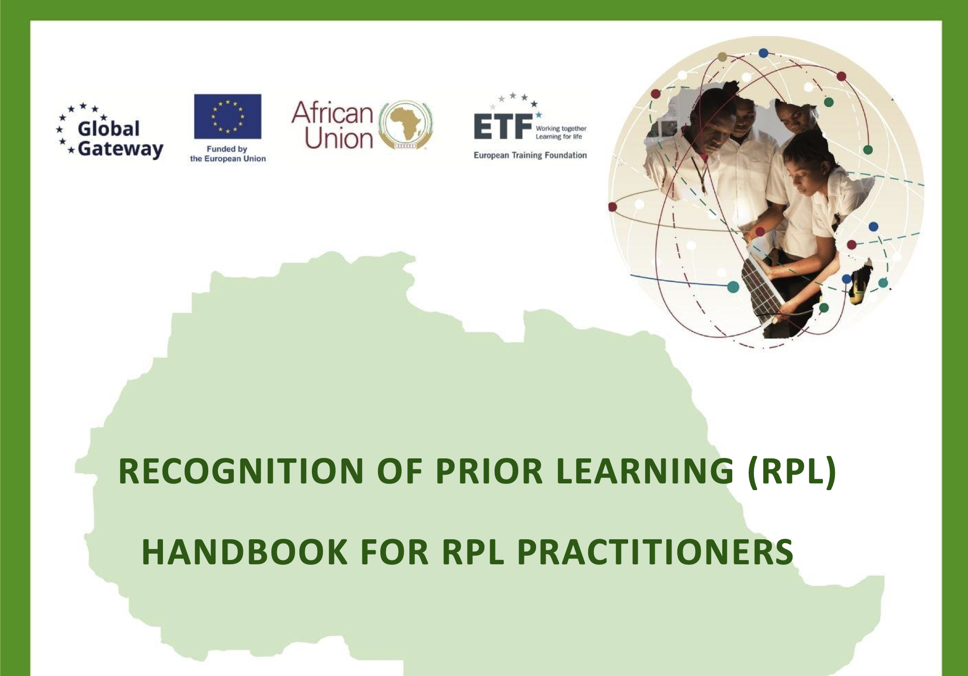
Read More?
https://acqf.africa/capacity-development-programme/training-modules/recognition-of-prior-learning-rpl-handbook-for-rpl-practitioners/recognition-of-prior-learning-rpl-handbook-for-rpl-practitioners-en/@@display-file/file/ACQF_RPL%20Handbook%20for%20Practitioners-EN_07082024_FINAL%20WEB.pdf

Slide 109


Read More?
https://www.oecd.org/content/dam/oecd/en/publications/reports/2007/04/qualifications-systems_g1gh7ef6/9789264013681-en.pdf
https://www.oecd.org/content/dam/oecd/en/publications/reports/2010/04/recognising-non-formal-and-informal-learning_g1ghaff6/9789264063853-en.pdf

Slide 110
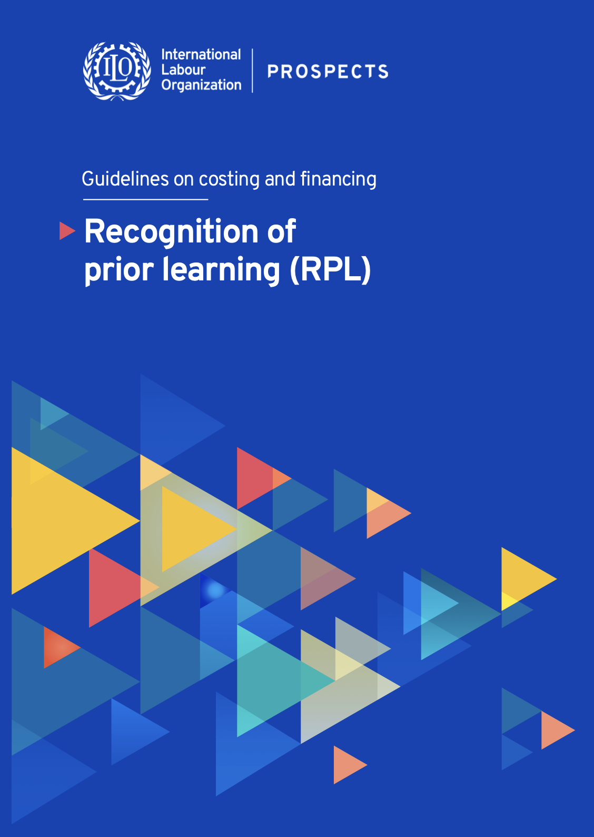

Read More?
https://www.ilo.org/sites/default/files/2025-08/Recognition%20of%20Prior%20Learning_Guidelines%20on%20costing%20and%20financing.pdf
https://www.ilo.org/sites/default/files/2026-01/A%20Think%20Piece%20on%20Apprenticeship%20Development%20in%20Africa%20FV.pdf

Slide 111
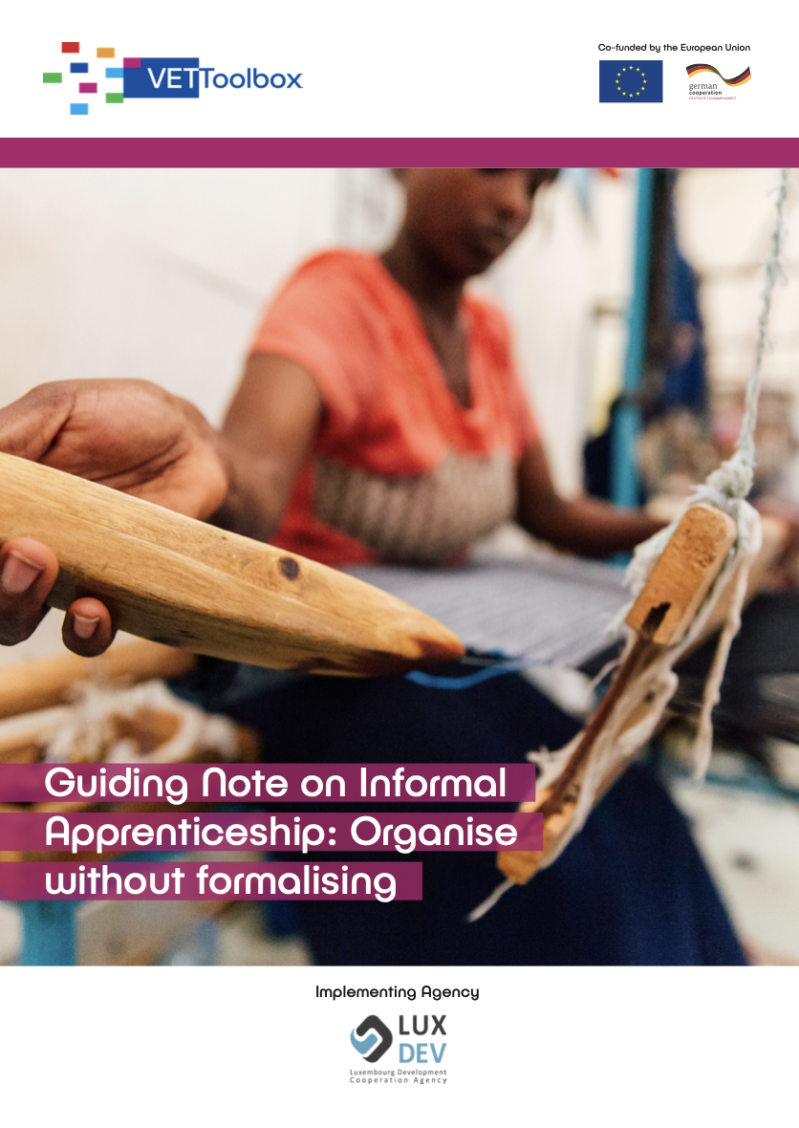
Read More?
https://www.dcdualvet.org/wp-content/uploads/2021_VETToolbox_Guiding-note-on-informal-apprenticeship-organise-without-formalising.pdf

Slide 112
Suggestions for the Breakaway Sessions
Three Docx files for you to brainstorm:
The Floor is Yours
A Communication Strategy
Pilot
Key objective:
Social Engineering
Patrick Werquin, Capacity Building in the field of RPL, Botswana and distance, 16 March 2026

Slide 113
M e r c i Comments and question please to: patrick.werquin@gmail.com

