Slide 1
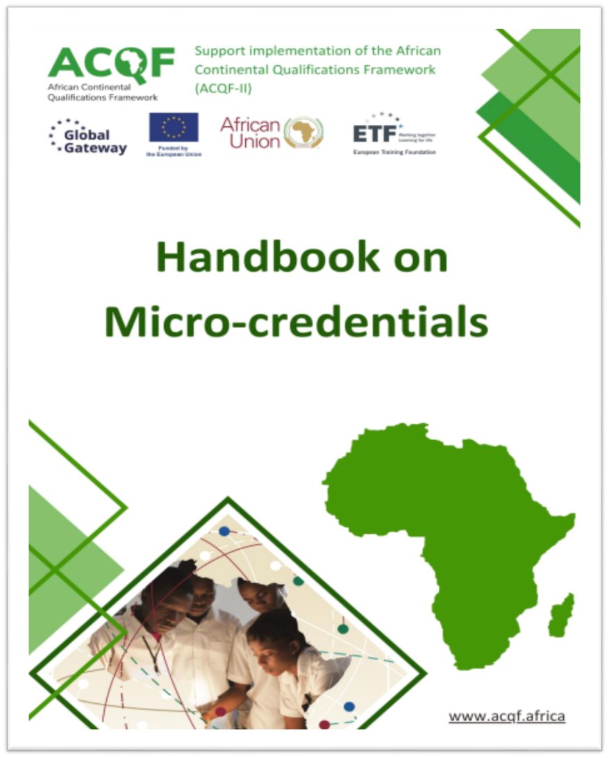





The 7th ACQF Continental Forum - Kenya
Session 5:
A Deep Dive into the Development of Responsive National Micro-credentials Policy Frameworks
Facilitators:
Anatolii Garmash; James Mwewa
28th July, 2026

Slide 2

Shaping the concept of micro-credentials
Micro-credentials are mostly associated with existing credentials that certify:
Small learning experience
upskilling/reskilling short courses (both in formal and non-formal settings)
parts of formal education programmes (units of learning, modules)
Demonstrated competence
professional certificates/ certificates of competence awarded by professional or other authorized bodies
validation of non-formal and informal learning/ RPL
Micro-credentials
All learning settings (formal, non-formal, informal)
Providers are not only learning providers, but also others (awarding bodies, assessment centres)
The tools for qualifications can apply to MC (credits, NQF, RPL, QA standards..)
Notes:
MC are relevant for:
All learning settings (formal, non-formal, informal)
Not only for formal learning providers, but also for non-formal and informal learning providers and other types of provides (awarding bodies, assessment centres)
MC principles in line with global and EU definition
The tools for qualifications can apply to MC (credits, NQF, VNFIL, QA standards..)

Slide 3
What credentials are not micro-credentials?
A credential is not a micro-credential if it:
does not include assessment of skills/ competences (assessed LO)
is a full formal education qualification (macro-credential)
has no standalone value (a meaningful unit of a qualification or complementary to it)
is not subject to quality assurance process (or not awarded by a recognised body)
does not represent a small volume of learning outcomes (a short period of learning)

Slide 4
Defining Micro-credentials
UNESCO global definition (2022)
A micro-credential:
is a record of focused learning achievement verifying what the learner knows, understands or can do;
includes assessment based on clearly defined standards and is awarded by a trusted provider;
has stand-alone value and may also contribute to or complement other micro-credentials or macro-credentials, including through recognition of prior learning; and
meets the standards required by relevant quality assurance
ACQF Policy document (2022)
Micro-credential means the record of the learning outcomes that a learner has acquired following a small volume of learning:
Assessment: These learning outcomes will have been assessed against transparent and clearly defined criteria
Skill or competency focused: Learning experiences leading to micro-credentials are designed to provide the learner with specific knowledge, skills and competences
Relevant: that respond to societal, personal, cultural or labour market needs
Stackable: They may be stand-alone or combined into larger credentials
Quality: They are underpinned by quality assurance following agreed standards in the relevant sector or area of activity
Notes:
Defining a common concept or approach to micro-credentials is crucial to support their implementation as a shared tool
Micro-credentials are a tool aiming at facilitating recognition of individual’s learning achievements throughout life
The survey results show that the following key components or features of micro-credentials can be highlighted:
Skill or competence focused
Standards-based assessment
Quality
Recognition
Micro-credentials represent learning achievements in a specific skill or competence
Micro-credentials represent skill or competency standards used for the assessment
Organisations that award micro-credentials are responsible for developing skill/ competence standards, and they have responsibility to ensure that assessment of individual’s learning achievements addresses these standards. These competence standards may need to be validated by external bodies (industry partners, quality assurance agency), where possible.
Micro-credentials can be recognised under the recognition of prior learning process, including through credit recognition and accumulation towards a qualification.

Slide 5

Why do you need a national micro-credentials policy framework?

Slide 6




Developing a responsive national MCs
policy framework – what do you need?

Slide 7
Not a one-size-fits-all intervention: context matters
Prevailing or predicted national context – education completion rates, employment rates, skills gaps/ mismatches, ease of access to quality, relevant and equitable education and training, technological advancements, etc.
National policies and legal instruments in favour of MCs

Slide 8
Amplify the relevance/ importance of the national MCs policy framework
Stakeholder engagement and involvement.
Link MCs policy frameworks to national:
      Development blueprints/ plans;
      Policies;
      Strategies;
      Legislation; and
      Labour market research data.

Slide 9
Secure stakeholder buy-in and support: leaving no one behind
Conduct stakeholder analysis and mapping: power/ influence, interest, effect/ urgency:
- High Power/ Influence, High Interest: Manage them closely - involve them heavily in decisions and provide constant updates;
- High Power/ Influence, Low Interest: Keep them satisfied - keep them informed of major milestones;
- Low Power/ Influence, High Interest: Keep them informed - gather their feedback and provide regular updates; and
- Low Power/ Influence, Low Interest: Monitor/ Minimum Effort - check on them periodically to ensure their status has not changed.
Clearly define stakeholder roles and responsibilities:
Govt./ Policy Makers
NQF Agencies/ Bodies
QA/ Regulatory Agencies
Education and Training Institutions/ Providers
Employers/ Industry
Students/ Learners/ Applicants
Professional/ Industry Bodies/ Associations
Sector Councils.

Slide 10
Stakeholder collaboration as a key success factor
Providers of MCs should collaborate with other providers, companies, industry or professional bodies, employer bodies, CSOs and sector councils to ensure the relevance of micro-credentials for the labour market and responsiveness to societal needs

Slide 11
Consider financing options
Government funding mechanisms: national education and training budget – link to priority sectors and disadvantaged groups
Employer co-financing: for employees; skills or sectoral training funds; training levy rebates, tax deductions for employer-funded micro-credential training; or as part of CSR reporting requirements
Development partner and international financing: infrastructure, system development, and capacity-building
Cost implications for providers: cash-flow positivity, cost recovery basis: demand-driven approach to the development of micro-credentials

Slide 12
Best practices in the implementation of a national micro-credentials policy framework
Effective implementation, as shown by models in Australia and Europe, often involves:
A "Pilot-first" approach: testing and refining before full roll-out;
Simplicity in design: making credentials easy to understand, issue, and stack; and
Stakeholder engagement and involvement: involving key stakeholders early in the process.

Slide 13
Plenary discussion – time to reflect

Slide 14
Questions for open discussion…
How is a micro-credential defined in your country context?
What conditions must providers of micro-credentials in your country satisfy?
What are the conditions/ criteria for inclusion of micro-credentials in your country's NQF?
How will micro-credentials be externally quality assured in your country?
What types of micro-credentials exist or will be recognised in your country?
What pathways exist in your country for recognition of micro-credentials?

Slide 15
Next steps and challenges ahead
To Seychelles, Zambia, Kenya, all countries here present:
Are you ready to roll up your mat and walk?
What challenges lie ahead?
How can these challenges be overcome?

Slide 16
Thank you!
Merci!
Obrigado!

