Slide 1



Stefan Jahnke and Honza Forster
31 July 2025
Notes:
Welcome colleagues,
My name is Stefan Jahnke and I am here with my colleague Honza Forster.
We are part of the QCP Team that has designed and implemented the ACQF Qualifications and Credentials Platform.
Over the past day and a half we have already seen the strength of the ACQF Network in in action with countries learning with and from each other and we are excited to shift focus to one of ACQF’s most tangible instruments: The QCP.
While you already have a high-level understanding of the platform, this introductory presentation aims to give you a deeper understanding on the QCP’s functionalities, policy relevance and strategic potential.
Together we will explore how QCP supports national priorities, enabled continental cooperation and provides the infrastructure for building something bigger together: A shared African Learning Model.

Slide 2
ACQF
Country Worksheet

Slide 3
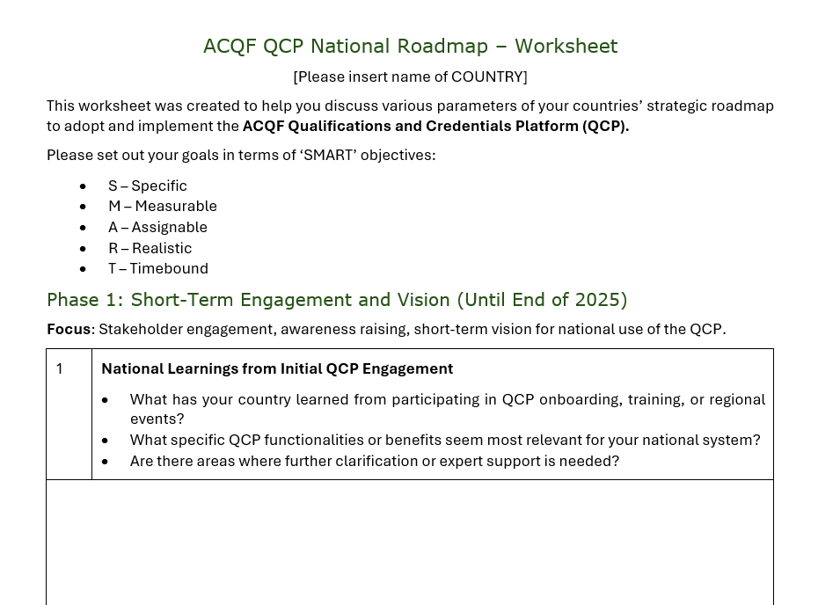
Notes:
Before we talk about the solution, let’s take a brief look at the reality we’re working with.
Across the continent, qualifications data is often scattered and inconsistent. Many systems still rely on paper records, PDFs, or Excel sheets -> formats
that are difficult to standardise, verify, or integrate.
There’s a lack of a common language or shared standard for describing qualifications, which severely limits cross-border recognition and collaboration.
At the same time, qualifications often remain invisible to the public; students, employers, and institutions struggle to access reliable, structured information.
And where public interfaces do exist, they’re often limited in functionality or coverage. The result is clear: fragmented systems, limited trust, and missed opportunities for learners and policy-makers alike.

Slide 4
Objective
Guide your country teams through structured reflection and planning for the adoption and use of the ACQF QCP
Development in 3 phase
Phase 1
Short-Term Engagement and Vision (Until End of 2025)
Phase 2
Mid-Term National Strategy
(H1 2026)
Phase 3
Long-Term National Vision & Handover (H2 2026)

Slide 5
Phase 1 - Short-Term Engagement and Vision (Until End of 2025)
Stakeholder engagement, awareness raising and short-term vision for national use of QCP
Key steps:
National Learning from initial QCP Engagement
Short-Term Vision of Using the QCP
"Inventory" of existing NQDs or Data Sources
Stakeholder Mapping and Engagement Strategy
Immediate Enablers and Risks

Slide 6
Phase 2 - Mid-Term National Strategy (H1 2026)
Using first national experience with the fully operational QCP to build a realistic, country-specific strategy
Key steps:
First Experiences with the QCP
Mid-Term Strategy for QCP Integration
Sustainable Governance and Data Processes
Funding and Technical Resources

Slide 7
Phase 3 - Long-Term National Vision & Handover (H2 2026)
Ensuring national ownership and sustainability as part of the handover for the ACQF Network
Key steps:
National Long-Term Vision for QCP implementation
Institutional National Use of QCP
Measuring Impact and Continuous Improvement
National Commitments Post-Handover and integration with ACQF Network

Slide 8
QCP Team – Peer-Learning continues
Additional (digital) peer-learning activities to support you with completing your ACQF QCP Country Worksheets
Work Together!
Involve all relevant team members at your organization
Share experiences with other countries (e.g. strategic partners)
Guidance document and accountability for yourself!
  → QCP Team will ask you to submit files at different intervals for our own understanding of ambitions and remaining challenges

