Slide 1

SQA’s referencing journey: Enhancing quality, recognition and mobility
From National Frameworks to Continental Alignment
Seychelles Qualifications Authority
30 July 2025

Slide 2
Overview
Introduction: The importance of Qualifications Frameworks
General Principles and Processes
Process of SNQF to ACQF Referencing
Outcomes of SQA's Referencing Journey
Diagram of the Seychelles Education System
Progress of SNQF to ACQF Referencing
SNQF to ACQF level to level comparison map
Issues to be addressed

Slide 3

Introduction: The importance of Qualifications Frameworks
What is a National Qualifications Framework (NQF)?
System describing types, levels, and standards of qualifications.
Facilitates quality assurance, national recognition, and consistency.
Why Reference Qualifications Frameworks?
Ensuring international comparability and understanding of qualifications.
Promoting learner and worker mobility (national, regional, international).
Building trust and facilitating mutual recognition.

Slide 4
General Principles and Processes
What is Referencing?
Process of formally linking the levels of one qualifications framework to another.
Involves technical analysis of level descriptors, learning outcomes, and contextual information.
A "best fit" approach is often used.

Slide 5
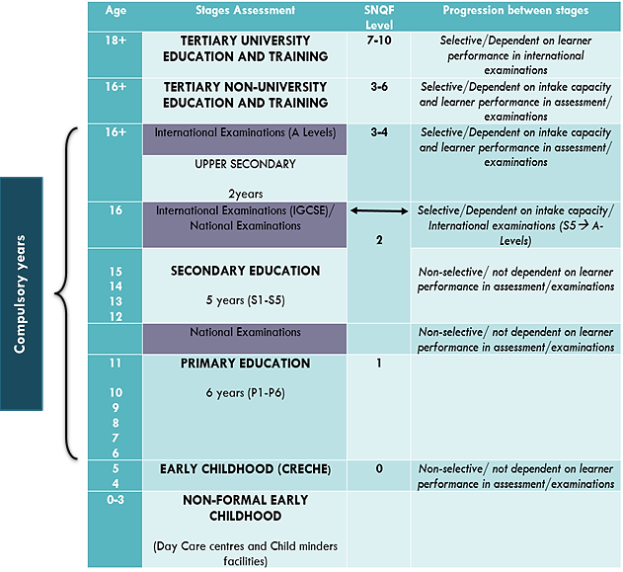
Diagram of the Seychelles Education System

Slide 6

Process of SNQF to ACQF Referencing
Set up the National Referencing Team (NRT)
Draw up a calendar of meetings of the NRT
Divide and conquer: divide tasks among members of the NRT
Engage with Stakeholders: Notably Ministry of Education, National Bureau of Statistics, Ministry of Finance, Institute of Early Childhood Development, Education and training providers
Work on the technical analysis as a team: Detailed comparison of SNQF and ACQF level descriptors and principles.
Preparation of the Referencing Report: Documenting the process, findings, and conclusions.
Notes:
The process of the SNQF to ACQF referencing
First we set up the National Referencing Team.
For Seychelles the National Referencing Team is comprised of the SQA CEO and 3 Principal Officers of the SQA.
We blocked meeting times to ensure time was dedicated to the exercise so that it could be completed in a timely manner.
We divided the work according to the referencing guidelines; each member had a section of the document and some sections were worked on as a team, for instance the summary and conclusions.
We ensured to consult with relevant stakeholders to get accurate information, such as the Ministry of Education, National Bureau of Statistics among others
We worked on the technical analysis as a team, we would do that during the set meetings.
Lastly we finalized the Referencing Report

Slide 7
Outcomes of SQA's Referencing Journey
The referencing exercise demonstrated clear linkages:
Structural comparison: Similar architecture-10 levels, use of level descriptors for each level, identical domains, both are underpinned by level descriptors and the learning outcome paradigm.
Conceptual comparison : Level-to-level analysis shows comparison, with specific matches (e.g., SNQF Level 6 closely matching ACQF Level 6).
1
Notes:
Conceptual comparison:
For both frameworks, the level descriptors are written as a hierarchy of learning
The level descriptors for both frameworks show how the three domains of knowledge, skills and autonomy and responsibility increase in breadth, depth and complexity when moving from lower to higher levels.
Both frameworks use concepts/statements which are very broad, and this is more prominent at the level of the ACQF.

Slide 8
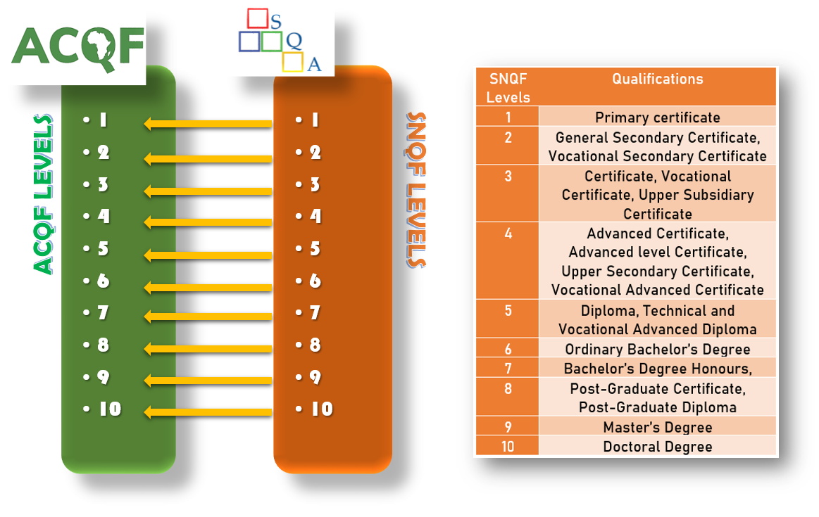
SNQF to ACQF level to level comparison map

Slide 9
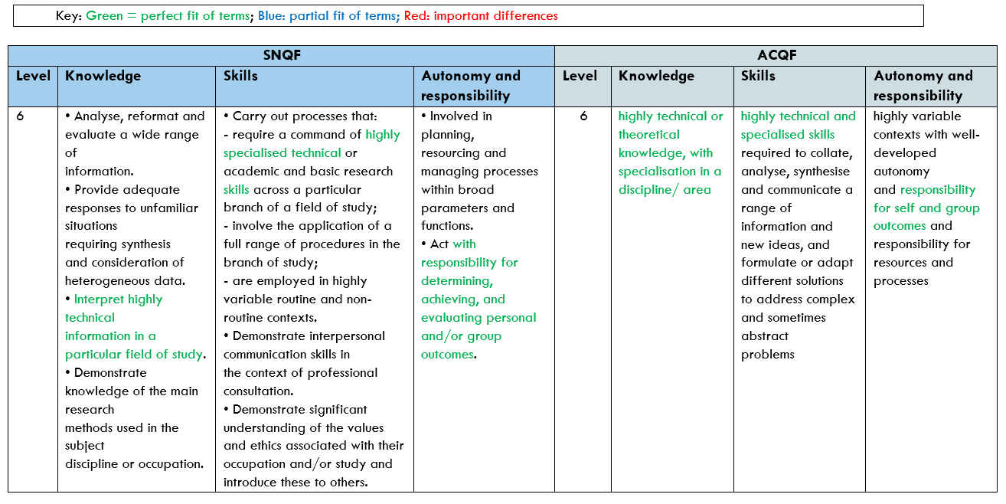
Outcomes of SQA's Referencing Journey
2
Some minor differences were also noticed:

Slide 10
Outcomes of SQA's Referencing Journey
Some differences were also noticed:
Structural comparison: SNQF does not define the domains of learning and does not provide details of the scope of the 3 domains, compared to ACQF.
Conceptual and technical comparison: formulation of the level descriptors are different, notably in levels 3 and 5 in relation to autonomy and responsibility; ACQF level descriptors are more generic as it is a meta and reference framework, SNQF’s are specific as they are linked to qualification types
3

Slide 11
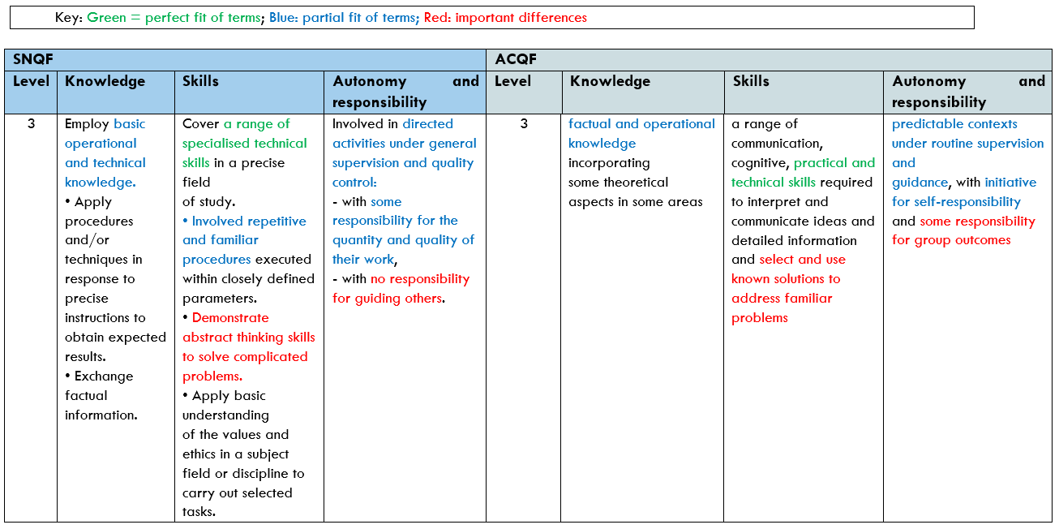
Outcomes of SQA's Referencing Journey
4
Some minor differences were also noticed:

Slide 12
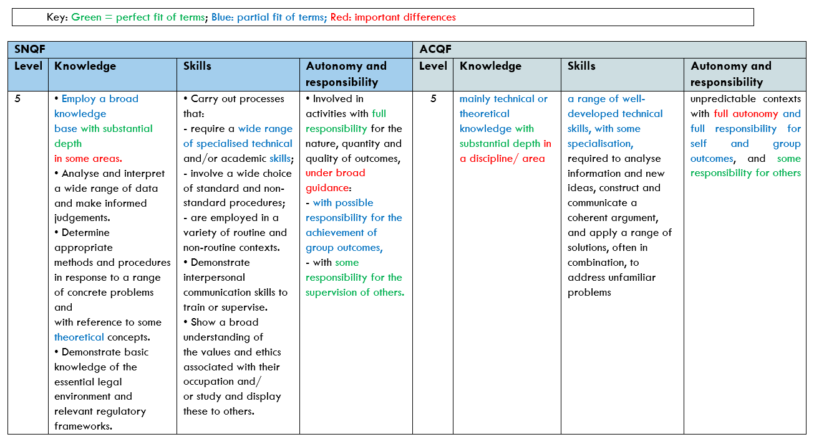
Outcomes of SQA's Referencing Journey
5
Some minor differences were also noticed:

Slide 13
Issues to be addressed
Absence of a Centralised Information Management System
Weak internal quality assurance mechanisms
Need for external review
Inadequate stakeholder involvement in qualification design
Definition and scope of the three domains of learning of the SNQF
Lack of systematic data on qualification effectiveness
Notes:
Absence of a Centralised Information Management System
This constrains evidence-based monitoring, planning, and decision-making. We need it to support transparency, traceability, and strategic oversight especially in the increasingly digitalised and fast-moving world
Weak internal quality assurance mechanisms
Internal self-assessment processes at the SQA are being done, but they not adequately structured or documented. We need to work on a formal internal quality assurance (QA) policy or framework.
Need for external review
SQA needs to subject itself to periodic external review by regional, continental or international QA bodies but due to various reasons, mostly linked to lack of resources, it has not yet been able to do so
Inadequate stakeholder involvement in qualification design
The development of qualifications and standards requires stronger collaboration with industry, professional councils, and other stakeholders, to ensure that qualifications reflect real-world competencies and workforce needs.
Definition and scope of the three domains of learning of the SNQF
I mentioned this when I was talking about the structural comparison of the SNQF to ACQF. SQA now needs to define the domains of learning of the SNQF as well as provide details of the scope of each.
Lack of systematic data on qualification effectiveness
There is no established mechanism for collecting and analysing data on the quality and impact of qualifications for learners, employers, and society. There is a destination survey but the information gathered is not shared and the way that the survey is carried out is also not well-known. Such data is vital for ensuring accountability, guiding reforms, and building trust in the national qualifications system

Slide 14
Progress of SNQF to ACQF Referencing
Current Status: The first draft of the Referencing Report has been submitted to ACQF
Validation and Endorsement:
We have the official approval of SQA Board,
We will present to the Ministry of Education’s Executive Committee for support similarly to,
the Cabinet of Ministers

Slide 15


Thank you!
SQA, July 2025

