Slide 1



National Institute of Qualifications (INQ) of Angola
July/2025

Slide 2
Governance . Policy-strategic framework
National Vocational Training System Act. Lei No 16/24 of 22 October.
NDP 2023-2027 – Programme: Employment, Entrepreneurship and Vocational Training.
Presidential Decree 225/23 of 30 November.
National Human Capital Development Plan - ACH 2023-2037
Presidential Decree 122/24 of 4 June.
National Agenda for Employment. Programme: Consolidation of the National Qualifications System. Presidential Decree 226/23 of 5 December.

Slide 3
Alignment with International Strategic Instruments
AGENDA 2030 - Sustainable Development Goals;
SADC AGENDA 2050 is based on three (3) pillars:
  Industrial Development and Market Integration,
  Development of infrastructures to support regional integration;
  Development of Social and Human Capital.
AGENDA 2063 of the African Union “African Aspirations for the Africa We Want”.
CONTINENTAL EDUCATION STRATEGY FOR AFRICA - CESA-25 - guides the implementation of National Qualifications Frameworks and Regional Qualifications Frameworks to facilitate the creation of multiple pathways the acquisition of skills and competences, as well as the mobility of citizens and the development of a Continental Qualifications Framework linked to regional qualifications and National Qualifications Frameworks.
AFRICAN CONTINENTAL QUALIFICATIONS FRAMEWORK POLICY DOCUMENT
- ACQFII (2023-2026) - Approved by all member countries in July 2023 in Addis Ababa. ACQF is an African Union policy initiative, funded by the European Union and managed by the European Training Foundation (ETF).

Slide 4
Legal background. Organisational Structure
The Ministry of Public Administration, Labour and Social Security (MAPTSS) is the Ministerial Department, which is responsible within the scope of its duties, through the National Institute of Qualifications (INQ), to implement the National Qualifications System.
Date of creation of the INQ: July 2022, by Presidential Decree 208/22 of 23 July.
The Legal Framework of the National Qualifications System, approved by Presidential Decree No 210/22 of 23 July 22.

Slide 5
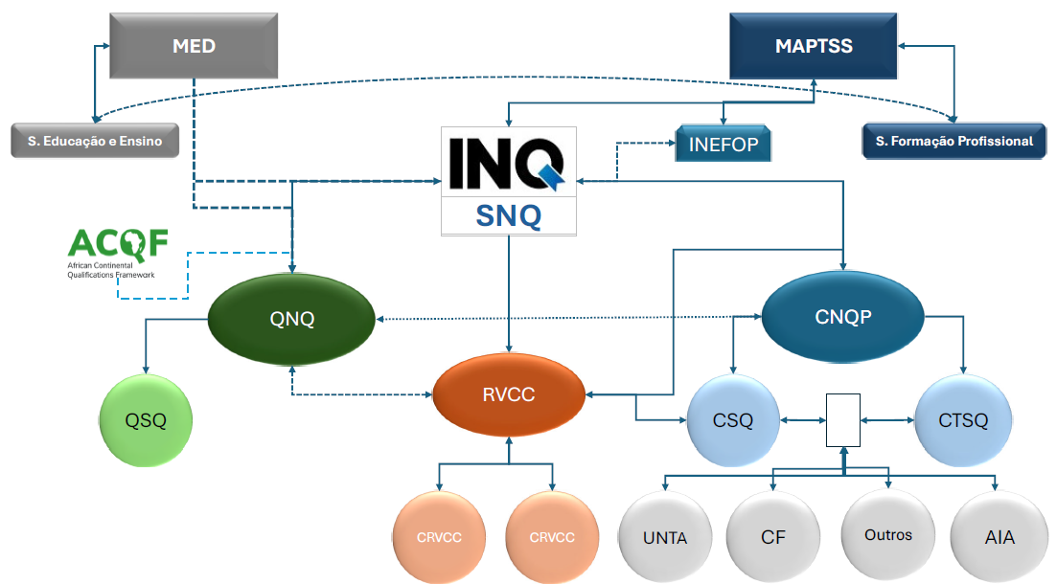

Slide 6
Mission and Main Tasks of the INQ
MISSION - Contribute to the improvement of qualification levels among young people and adults by providing an attractive and diversified range of qualifications, to promote and enhance initial and continuous training, lifelong learning, and the integration of qualified young people and adults into the labor market.
Ensure a Qualifications System with international standards recognized, through a process of referencing the National Framework of Angola with other Qualifications Frameworks (SADC/ACQF/QE...);
Manage and keep up-to-date the National Catalogue of Professional Qualifications;
Promote the international recognition of national qualifications;
Promote the coordination between Vocational Training and Technical Education (MINISTRY OF EDUCATION).

Slide 7
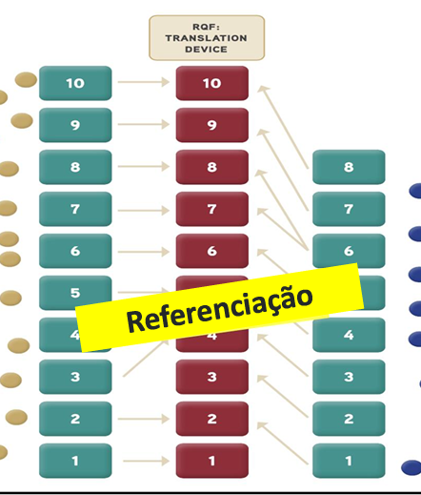
ACQF Referral Day

Slide 8
Recommendations
2nd Qualifications Frameworks Forum, held in September 2024 in Luanda, Republic of Angola;
Meeting of Southern African Development Community (SADC) Ministers of Employment, Labour and Social Partners held in March 2024 in Victoria Falls, Republic of Zimbabwe.
ACQF benchmarks
Level descriptors
Learning outcomes approach
Qualifications in the NQF
Quality assurance
Criterion 1
Criterion 2
Criterion 3
Criterion 4

Slide 9
ACQF Benchmark 1: There is a clear and demonstrable link between the qualification levels in the national qualifications framework or system and the ACQF level descriptors.
AREAS OF LEARNING/ GUIDELINES 2 ACQF
KNOWLEDGE |  | Competences/Aptitudes |  | AUTONOMIES AND RESPONSIBILITIES/ RESPONSIBILITIES AND AUTONOMIES
ACQF | NQF | ACQF | NQF | ACQF | NQF
"Knowledge" includes various types of knowledge, such as facts, principles, and theories in various areas. | “knowledge” means the body of facts, principles, theories and practices relating to a field of study, work or vocational training; as a result of the assimilation of information through learning. | "Skills" refers to the ability to use knowledge to respond to information and solve problems. Skills include cognitive, communication, digital, environmental, innovation, practical and social skills. | “fitness” means the ability to apply knowledge and use acquired resources to complete tasks and solve problems, including the application of logical, intuitive and creative thinking and manual skills and mastery of methods and tools. | “Autonomy and responsibility” refers to the context and extent of the application of autonomy and responsibility. | “Responsibility and Autonomy” means the ability to apply; autonomously, knowledge, skills and personal, social and/or methodological abilities, in professional situations or in study, work or vocational training contexts for the purpose of professional and personal development.

Slide 10
 | QUALIFICATION LEVELS | STRUCTURE OF THE NATIONAL QUALIFICATION FRAMEWORK OF THE REPUBLIC OF ANGOLA
 |  | EDUCATION, EDUCATION AND VOCATIONAL TRAINING (TVET) |  | HIGHER EDUCATION
HIGHER EDUCATION | Level 10 |  |  | Doctorate
 | Level 9 |  |  | Masters
 | Level 8 |  |  | Bachelor's degree
 | Level 7 |  |  | Secondary school diploma
TECHNICAL-PROFESSIONAL SECONDARY EDUCATION AND VOCATIONAL TRAINING | Level 6 |  | Vocational Training Level 5
 | Level 5 | Pedagogical Secondary Education | Vocational Training Level 4
 |  | 2nd Cycle of Technical-Professional Secondary Education
 | Level 4 | 2nd Cycle of General Secondary Education | Vocational Training Level 3
 | Level 3 | 1st Cycle of Technical-Professional Secondary Education | Vocational Training Level 2
 | Level 2 | 1st Cycle of General Secondary Education | Vocational Training Level 1
 | Level 1 | Primary education

Slide 11
KNOWLEDGE
OPPORTUNITIES
RESPONSIBILITIES AND AUTONOMIES
Level Descriptors
NQF
Specialized knowledge in more than one area and ability to collect, analyze and systematize a wide range of theoretical and technical information.
Specialised professional skills and abilities applicable to varied contexts and formulates answers to complex problems.
carries out tasks and activities with complete autonomy and independence; manages processes and results of work and takes responsibility for own or group results.
Level 6
Expertise in at least one area of study and/or work, and ability to analyse information and produce coherent arguments.
Professional skills and abilities applicable to varied contexts and resorts to standardized and non-standardized procedures.
Performs tasks and activities under general guidance or in a semi-independent manner and assumes supervisory responsibilities for own or group results.
Level 5
Knowledge incorporating theoretical and technical concepts and ability to analyze basic information.
Professional skills and abilities applicable to known or unknown contexts and resorts to routine and non-routine procedures.
Performs tasks and activities under general supervision or self-orientation and assumes limited responsibilities for own or group results.
Level 4
Basic and operational knowledge and ability to interpret basic information.
Professional skills and abilities applicable to simple contexts and resorts with limitations in finding solutions to routine problems.
It performs tasks and activities under general supervision, with limited responsibility for its own results.
Level 3
Basic knowledge applied to a limited and defined set of activities using oral and written communication.
Basic operational skills and abilities applicable to simple and routine tasks and activities.
It performs tasks and activities under direct supervision in a structured context or environment with limited responsibilities and autonomy.
Level 2
Basic knowledge applied to a very limited and defined set of activities.
Basic operational skills and abilities applicable to contexts of limited and routine tasks and activities.
It performs tasks and activities under direct supervision in a structured context or environment, without its own autonomy.
Level 1

Slide 12
ACQF Guideline 2
This guideline proposes a set of level descriptors for the ACQF, which compares qualification levels in terms of learning outcomes, embraces a future-oriented lifelong learning goal, recognises all forms of learning (formal, non-formal and informal) and covers the full spectrum of qualifications, including general education, TVET and higher education.
Presidential Decree No. 210/22 of 23 July
SECTION I - National Qualifications Framework
ARTICLE 10
(Scope)
The National Qualifications Framework covers all diplomas and certificates issued and/or recognised by the competent national bodies, namely Primary, Secondary, Higher and Vocational Education and Training, as well as those resulting from processes of recognition, validation and certification of professional skills acquired through non-formal or informal channels.

Slide 13
ARTICLE 11
(Objectives)
The National Qualifications Framework has the following objectives:
Integrate and articulate the qualifications obtained within the different Education and Vocational Education and Training Systems, as well as those obtained through professional experience or non-formal and informal learning;
Improve the transparency of qualifications by making it possible to identify and compare their value in the labour market, in education and training, and in other contexts of personal and social life;
Enable the transfer and accumulation of credit in education, vocational training and higher education, where possible, in order to enhance the mobility of citizens and facilitate the recognition of skills acquired throughout life;
Promote the recognition, validation, certification and quality of the qualifications obtained;
Enabling the comparability of national qualifications with those of other countries;
Promote links and/or referrals to other qualifications frameworks.

Slide 14
ARTICLE 12
(Structure of the National Qualifications Framework)
The National Qualifications Framework is structured around ten levels of qualifications, with levels 1, 2, 3, 4, 5 and 6 corresponding to non-higher qualifications and levels 7, 8, 9 and 10 to higher qualifications.
Qualification levels, as indicators of the complexity and/or depth of learning outcomes, specify the competences corresponding to the qualifications that concern them, and set out the list of what the learner should know, understand and be able to achieve or do at the end of a learning process.

Slide 15
ACQF Benchmark 2: National qualifications frameworks or systems are based on learning outcomes principles and relate to agreements for the recognition of prior learning (including non-formal and informal learning) and, where appropriate, credit systems.
Approved in Council from Ministers, 5 SNQ regulatory acts, await their publication.
  Recognition, Validation and Certification of RVCC Competencies;
  Ongoing (transfer of methodology to INQ teams), elaboration of technical and methodological tools, support manual, methodological guides, interview scripts, elaboration of professional qualifications ...;
  Dissemination of the Presidential Decree approving the Legal Regime of the RVCC / National Qualifications System.
  Training of teams, guidance technicians, coordinators, trainers, organization of juries for validation of competencies....

Slide 16
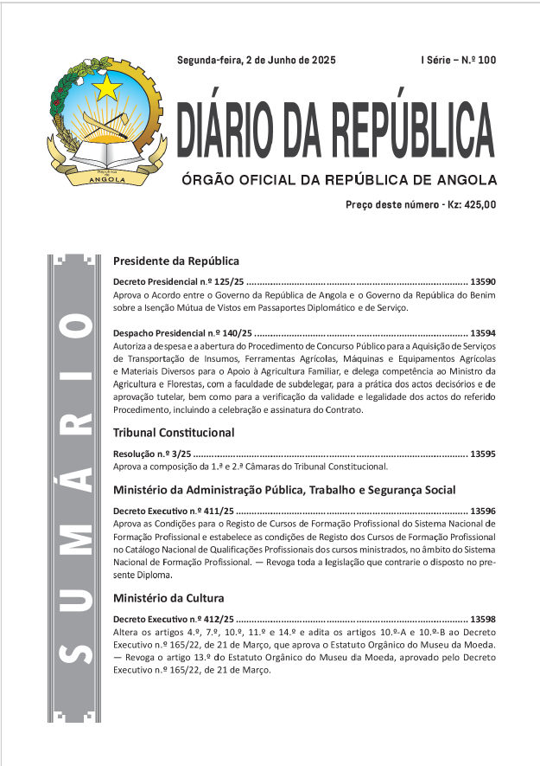
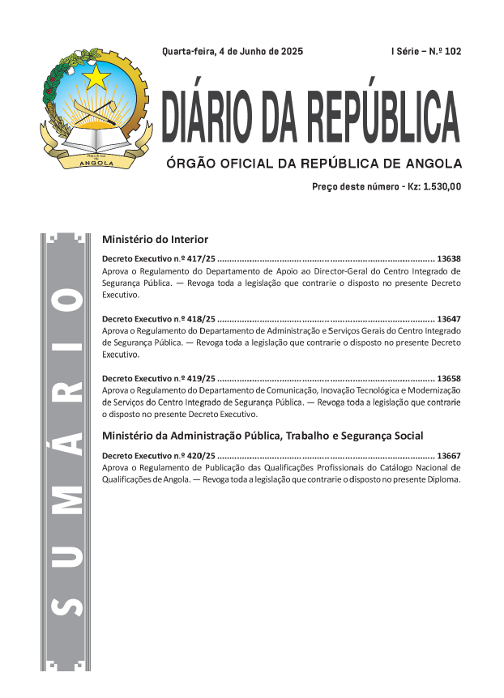

ACQF Benchmark 3: Transparent processes and procedures are in place to include qualifications in the NQF or to describe the place of qualifications in the NQS, and information on qualifications is accessible, reliable and verifiable in one or more national qualifications registers.

Slide 17
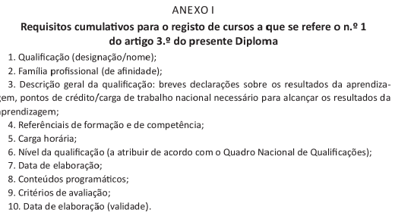
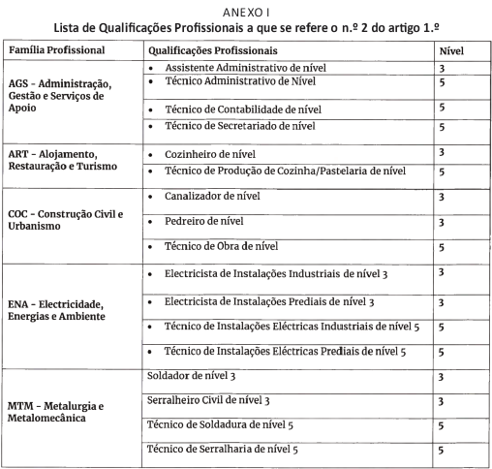
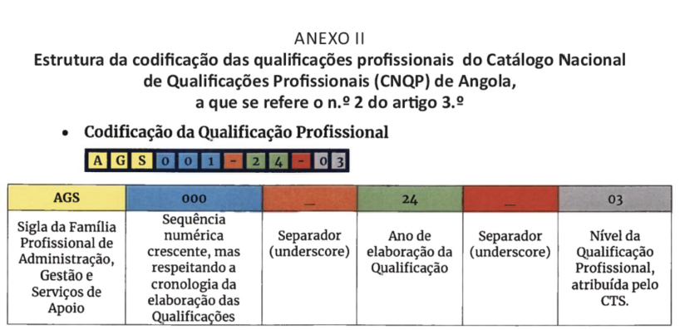

Slide 18
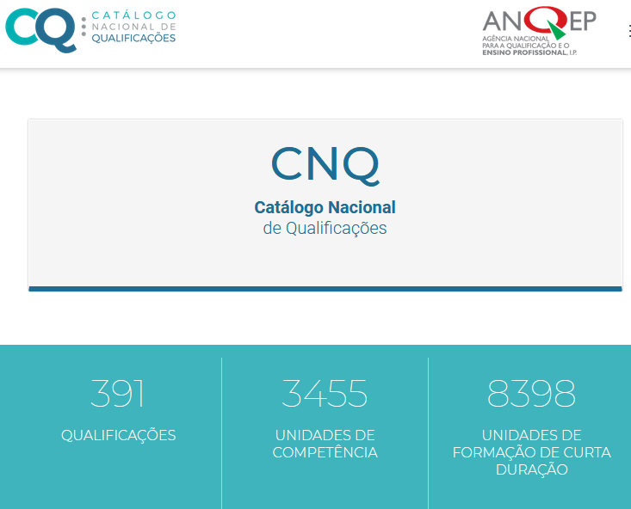

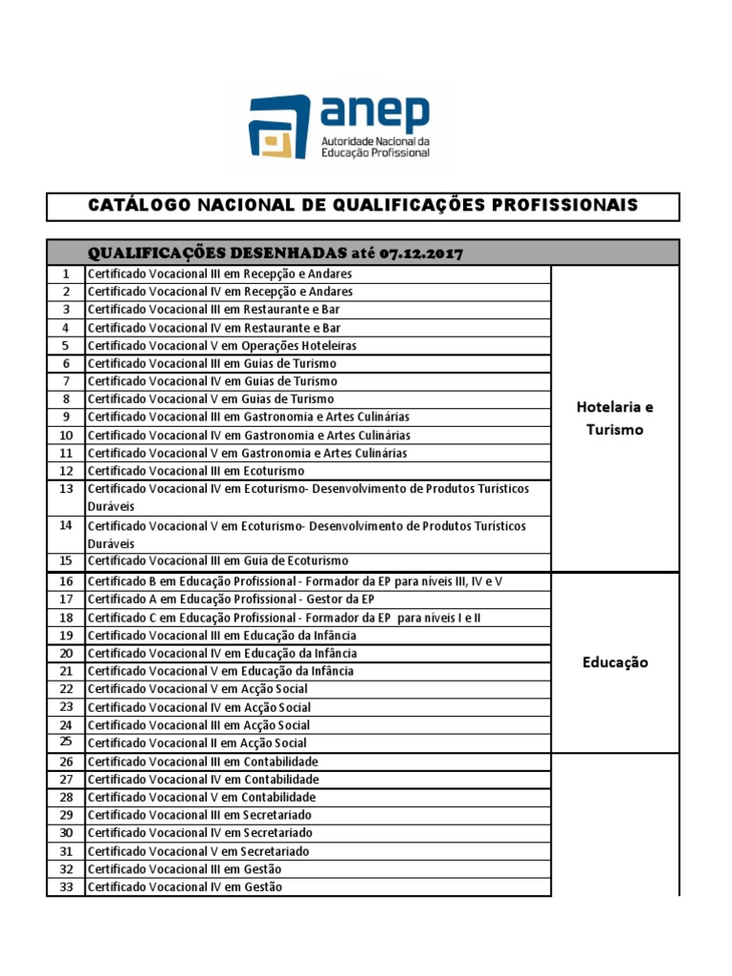
CODE QP | PROFESSIONAL QUALIFICATION | Level QP | PROFESSIONAL PROFILE + FORMATIVE PROGRAMME | REFERENCIAL RVCC PROFESSIONAL
AGA001_5 | Management of agricultural and livestock production | 5 |  | –
AGA002_4 | Horticulture | 4 |  | –
AGA003_3 | Semi-intensive production of ruminants | 3 |  | –
AGA004_2 | Basic Activities of Agriculture | 2 |  | –

Slide 19


Available on the INQ Institutional Website https://inq.gov.ao/en,
National Catalogue of Professional Qualifications - National Institute of Qualifications
Qualifications and Credentials
Platform (QCP)

Slide 20
ACQF Benchmark 4: The national quality assurance system for education and training refers to the national qualifications framework or system and is consistent with the quality assurance principles of the African Continental Qualifications Framework (ACQF).
Joint Executive Decree approving the Legal Regime of the System for Monitoring and Quality Assurance of Technical-Professional Secondary Education and Vocational Training in Angola.
Visiting road map
Definition of Indicators
Preparation of Monitoring Instruments
Structure of the Annual Quality Report

Slide 21
Main challenges
Continuing with dissemination of SNQ and related subjects: quality assurance, credits, RVCC/RPL, micro-credentials, green and digital skills, NQF referencing, certification of training providers ....;
Implementing an Integrated Management and Information System to provide qualifications and new programmes aligned with the NQF;
Continuing the implementation of new Sectoral Diagnoses in Professional Families/Productive Sectors strategic for development and with employability potential;
Continuing the process of developing new qualifications, expanding the National Catalogue of Professional Qualifications;
Effectively participating in the NQF referencing process;
Integrating green and digital skills in the context of the NQF is one of the recommendations of the 2nd NQF Forum.

Slide 22
THANK YOU A LOT!

