Slide 1

Enhancing Access through the National Qualifications Register: Enabling Data-Driven Recognition and Mobility
Ms Omotola Akindolani
Manager: Data Management and Analysis
The South African Qualifications Authority (SAQA)
The 5th ACQF Continental Forum
Peer learning Session 1
Johannesburg, South Africa
30 July – 1 August 2025

Slide 2
Overview
Introduction
Current Insights
Imminent Insights
Future Aspirations
Way forward

Slide 3

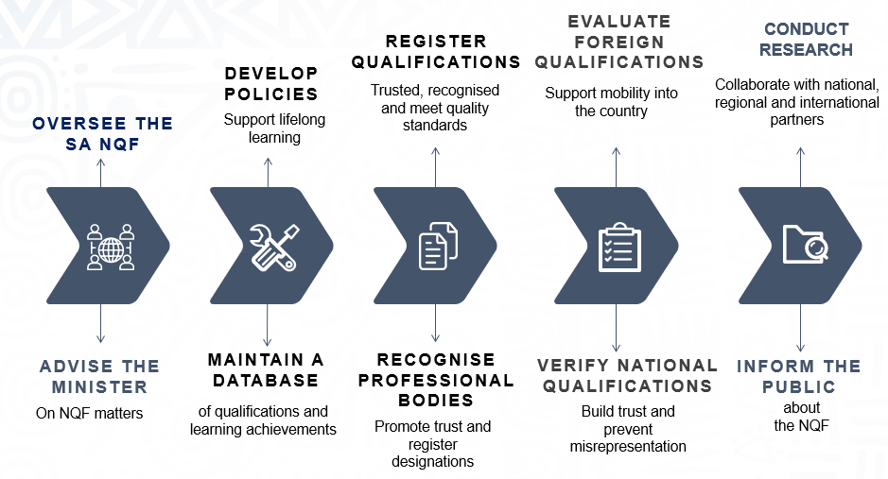
Introduction - SAQA
Vision:
A world-class National Qualifications Framework that works for the people in South Africa
Underpinning our work is Data

Slide 4
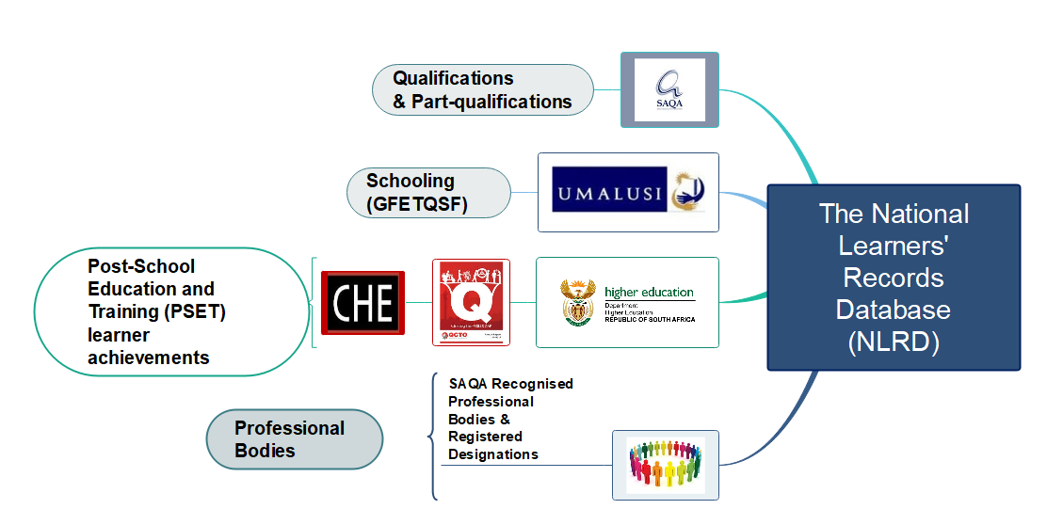
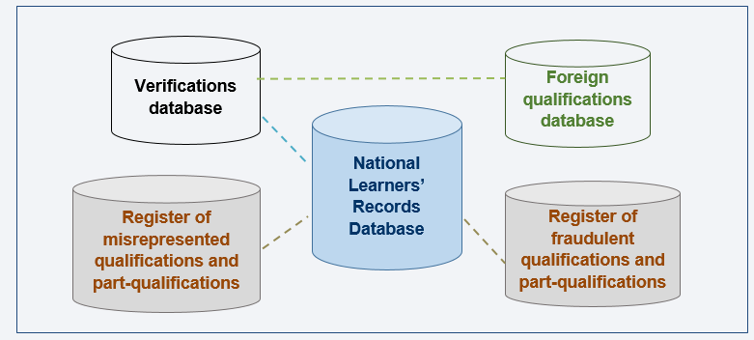
Introduction - NQFMIS
SAQA’s NQF Management Information System (NQFMIS)

Slide 5
Introduction - NQFMIS
SAQA’s NQFMIS Facilitates:
Learning recognition
Verification of national qualifications for work and/or study in South Africa
Evaluation and comparison of foreign qualifications
Tracking of mobility
Informed decision making - macro-policy level analysis and research

Slide 6
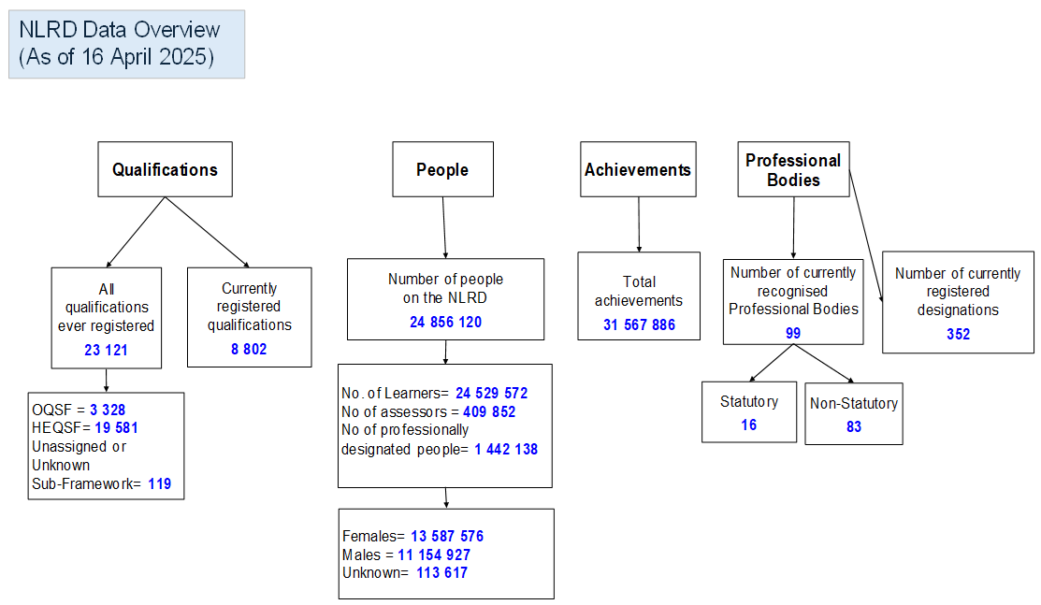
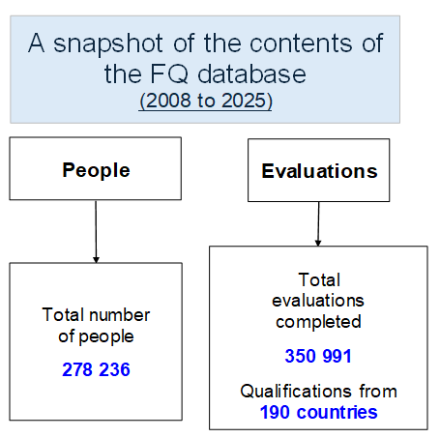
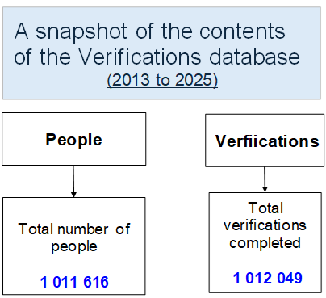
NQFMIS Snapshot
Notes:
Records of achievement: +31 million
47% from schools, 42% Higher Education and 11% Occupations and Trades

Slide 7
Current Insights
Asia
Mobility: Into SA
Learning pathway analyses
Trend analyses
Thematic reports
Europe
Average 20,000 foreign qualification evaluations pre-COVID
Since 2021, an average of 12,000 evaluations, but gradually increasing
16%
16%
Mobility: Out of SA
4.5%
SAQA does not currently collect data on the destination of national qualifications
N. America
Africa
Mobility out of South Africa?
62%
Requests for national qualifications verifications

Slide 8


Imminent Insights : What will be enhanced?
Deeper insights into qualification data:
Track learning pathways to understand progression
Link qualifications to scarce and critical skills
Assess whether graduate output meets national skills demands
Leverage micro-credentialing to enable data-driven and labour-aligned recognition of skills
Understanding qualification mobility:
Identify where South Africans present their qualifications abroad
Explore key drivers: employment, further study, or emigration

Slide 9


Future Aspirations
Enhanced Interoperability:
Shift towards a connected qualifications ecosystem
  Adopt functional open-data standards with technical and regulatory alignment
Enable real-time Application Programming Interface (API) integration with institutions, verifiers and employers (example: QCP, Credential Engine)
Enhanced use of Artificial Intelligence (AI):
Leverage governed data architecture and AI ethics principles
AI-enabled insights into learning demands by sectors
Enable digital credentialing to verify and share qualifications securely
Connect to unstructured data for deeper insights

Slide 10
Way Forward
Building a connected, trusted data data-driven future!
SAQA’s journey reflects challenges and lessons
Collaboration is essential: connect registers, systems, and insights
Uphold sound data governance pillars and principles
The future is digital, interoperable and learner-focused
Our transformation journey spans Now >> Soon >>> Future

Slide 11

Thank you
Ngiyathokoza
Enkosi
Dankie
Ngiyabonga
Kea leboga
Ndza khensa
Ndo livhuwa

