Slide 1


Study on the Impact of the National Qualifications Framework on Education, Training, and Employment in Zambia from 2016 to 2024
Jericho Kashiya
5th Continental ACQF Forum
Johannesburg – South Africa
July 2025

Slide 2
Presentation Outline
Brief about Zambia
ZAQA Timeline
Background and Rationale of the Study
Objectives of the NQF
Anchor Theories for the Study on the NQF
Research questions
Research Aims
Research Methodology
Findings
State of education before NQF
Impact of NQF on Education, Training and Employment
Stakeholder Understanding and Perception of the NQF
Research Limitations
Recommendation and Way Forward

Slide 3


Brief About Zambia
Zambia has been independent since 1964
The education sector has been operating for over sixty years
The education sector includes early childhood, primary, secondary, technical and vocational training and higher education and is currently managed by two ministries, namely:
  Ministry of Education
  Ministry of Technology and Science
Some government Ministries overseeing Agriculture, Community Development, Defence, Health, and Tourism have specialised training Institutions for the Human Capital

Slide 4
Timeline of ZAQA
2015
Establishment of the Institution and appointment of the Director General
2018
Issuance of Statutory Instrument to operationalise some functions of the Act
2020
Zambia Qualification Management Information Systems Developed
2024
ZAQA ACT repealed and replaced
2011
Enactment of the ZAQA Act
2016
Implementation of 10-level NQF, Level descriptors commenced

Slide 5
Background and Rationale for the Study
The Zambia Qualifications No 13 Act of 2011 and its replacement Act No 8 of 2024 provide for conducting periodic studies on the Impact of the NQF on education, training and employment
The institutions’ Monitoring and Evaluation of the Strategic Plan Objectives.
Implementation of the NQF is one of the objectives of the strategic plan therefore M&E of the NQF is important to assess its outcomes and relevance

Slide 6
Objectives of the NQF in the ZAQA ACT
Integration
To create a single, coherent and integrated national Qualifications framework for learning achievements
Quality
To standardized and ensure the quality of education and training
Employment
The ZQF promotes education, training and employment opportunities
Access, Mobility and Progression
Development
  To facilitate access to, and mobility and progression within education, training and career paths
  The ZQF contribute to the full personal development of each learner and the social and economic development of the nation

Slide 7

Theories anchoring the Study
Education and NQF are drivers of human capital. Education is viewed as a driver of economic growth by developing the human capital.
Normalisation Process Theory (NPT) enables reflection on how different participants integrate new work into everyday practice, including their roles, actions and interactions with different participants and sustain it within a system.
For this to happen, there is a need for stakeholder buy-in to fully engage cognitively and practically with implementation of a new innovation (Sivakumar, Pan, Choi, Wang, & Yu, 2022)

Slide 8

Research Questions
What was the state of education and qualifications before the implementation of the NQF (prior to 2016)?
What is the impact of the NQF on education, training and employment in Zambia from 2017 to 2024
How do stakeholders understand the NQF and its role
What are the perceptions of stakeholders on the impact of NQF on education, training and employment in Zambia since its implementation

Slide 9

Research Aims
The study aimed to assess the Impact of the National Qualifications Framework on education, training, and employment in Zambia from 2016 to 2024
Monitor and evaluate the relevance of the NQF
Develop a baseline study of the NQF and related studies in the future
Provide literature about the NQF in Zambia

Slide 10
Research Methodology
A mixed-methodology of qualitative and quantitative methods and techniques was used to triangulate information and data sources
The research involved a desk review, analysis of secondary data, and interview to collect primary data
The quantitative data showed statistics, while the qualitative data provided insights into the awareness and perceptions of stakeholders.
Purposive sampling was applied to identify the population, which included key individuals from:
Government Institutions,
Civil Society organisations,
Higher Education Institutions,
Vocational Institutions,
Foreign examination bodies
Employer organisations,
Commercial Businesses
Students,
Primary and Secondary schools,
Educational experts
Professional Associations,
and Professional Regulating Bodies.
Desk Review
Methodology
Secondary Data Analysis
Interviews

Slide 11
Research Limitations
The population size had a wide range of institutions and individuals to participate in the survey; however, only half of the population participated. Therefore, the results should be taken with limitations of the population in mind

Slide 12
Findings from the Study

Slide 13
State of Education and Qualifications Systems in Zambia before 2017: Regulations
Year | Policy or Act | Intended result
1965 | University of Zambia Act | Established the first university
1966 to 1977 | Education Act and Education Reforms | Opened up access to primary, secondary and vocational training institutions
1983 | Examinations Council of Zambia Act | Established the Examination Council of Zambia to run and regulate local examinations and award certificates for primary, secondary and vocational programmes
1987 | Copperbelt University Act No. 19 | Established the Copperbelt University
1992 | Universities Act No. 26 Focus on Learning Policy | Repealed the CBU and UNZA acts Establishment and regulation of the 2 public universities Registration of private universities and foreign examination bodies Concerns for quality and involvement of stakeholders
1996 | Educating Our Future Policy | Address issues of quality and relevance Proposed a quality assurance body for higher education
1998 | The Technical Education, Vocational and Entrepreneurship Training (Amendment) Act No. 11, 2005 | Established the Technical Education, Vocational and Entrepreneurship Training (TEVETA) as an Institution to develop curriculum, regulate standards, conduct national examinations and award qualifications in the TVET sector
1997 | The Nurse and Midwives Act, 1997 | Established the Nursing Council of Zambia to develop curriculum, regulate standards, conduct national examinations and award qualifications for Nurses
1999 | University Act No. 11 | Repealed the Universities Act of 1992
2003 2008 200 | Zambia Institute of Purchasing and supply Act Zambia Institute of Marketing Act Zambia Institution of Chartered Accountants Act | Established professional Bodies in Marketing, Purchasing and Supply and Accountants to develop curriculum, regulate professional practice, conduct training and examinations, and award qualifications in their professions
2011 | Education Act | Establishment and regulation of the more public universities Registration and regulation of private universities Address the standards and quality of education
2011 | Zambia Qualifications Authority A Act | Development of NQF to provide standards of qualification and an institution to coordinate the framework
2013 | Higher Education Authority Act | Developed an Authority to Register Higher Education Institutions (HEIs) and accredit the learning Programmes in among HEIs

Slide 14
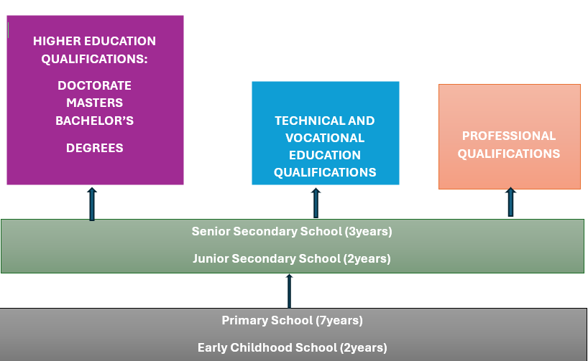
State of Education and Qualifications Systems in Zambia before 2017: Access and learning Pathways and Mobility
In the pre-ZQF period, regulations and policies promoted access to education at all levels of education
Expansion of education and training has resulted in diversity in the number of Institutions at all levels
Foreign tertiary qualifications awarding bodies in the Zambia Market
There were learning pathways from primary and secondary education to various forms of tertiary Education. Therefore, many learners achieved progression from general to tertiary education
No recognition of qualifications from the Vocational and Professional Education by Higher Education Institutions such as Universities. No Recognition of Prior learning.
Vocational and Professional Education graduates were treated at the same level as secondary school leavers in HEIs

Slide 15
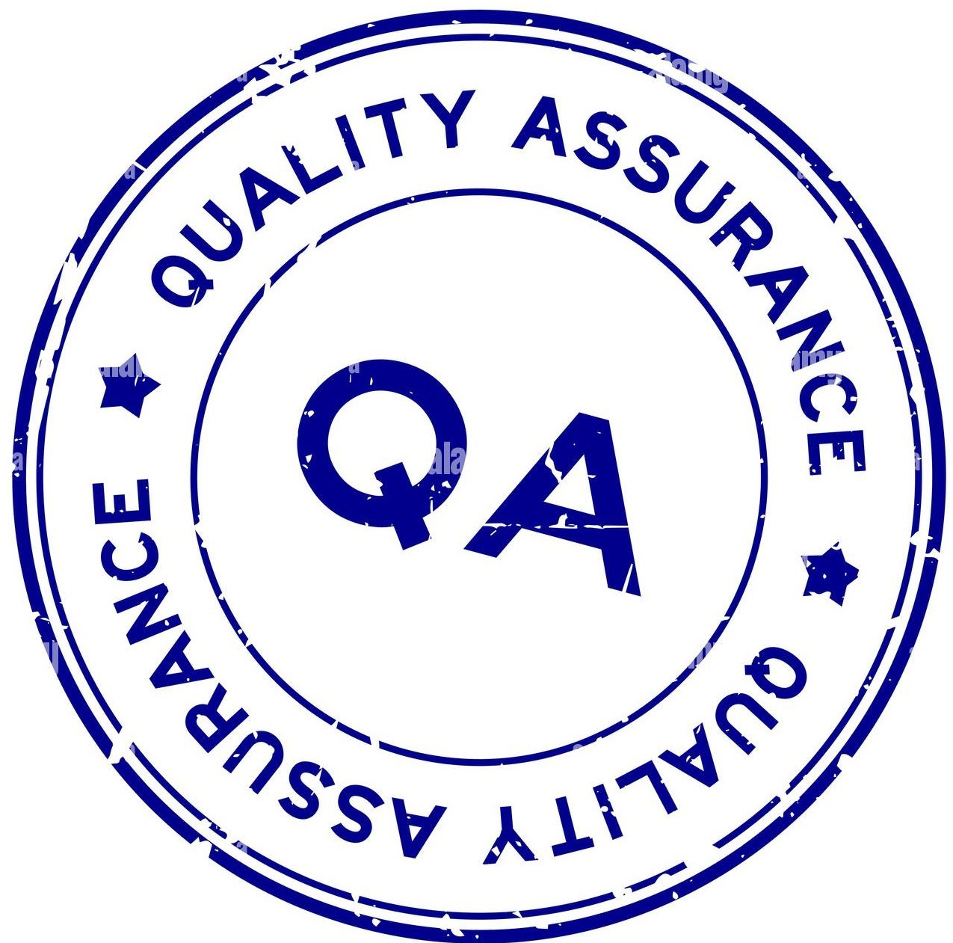
State of Education and Qualifications Systems in Zambia before 2017: Quality Assurance
The regulations established the regulatory and examination bodies for general education examinations, TVET and professional programmes and qualifications.
Universities (Public and Private) were self-regulated through internal standards and quality assurance systems.
Foreign qualifications awarding bodies operating on the Zambian market used standards and quality assurance systems practised in their home country.
Therefore, the Standards of Qualification and Quality Assurance were not uniform due to the lack of a national qualifications system or a body established to provide national standards
Employers and foreign bodies recognised Zambian qualifications from public institutions based on the Trust in government quality assurance systems

Slide 16
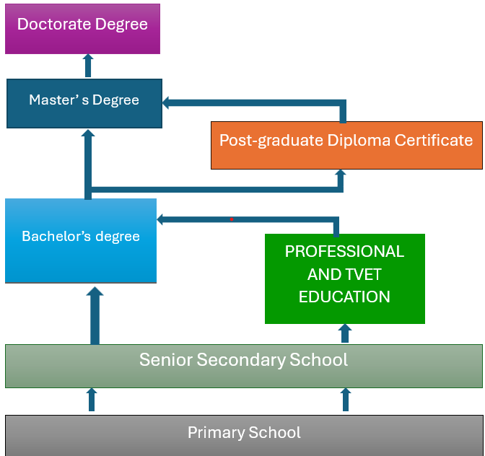
Impact of the NQF on Access, learning Pathways and Mobility
The NQF was established as a transparent and harmonised set of standards to recognise all qualifications awarded in Zambia and those coming into the country from foreign countries.
All qualifications awarding Institutions in Zambia aligned their qualification to the NQF, and this created learning pathways for TVET and Professional qualifications holders into HEIs’ degree qualifications
The NQF enabled fair and transparent recognition of qualifications from Zambian private Institutions (especially universities) by employers and institutions in foreign countries.
The NQF promoted Recognition of Prior Learning and qualifications, and created pathways which enhanced the progression, mobility of learners and lifelong learning.

Slide 17

Impact of the NQF on Quality Assurance
The NQF Harmonised and integrated the Standards and Quality Assurance in the country
It set a transparent set of qualification standards that all educational stakeholders, both local and foreign, were mandated to follow in Zambia
NQF clearly defined the standards and quality assurance parameters that educational regulatory authorities in General Education, TVET and Higher Education to implement and enforce.
Enhanced the integrity of qualifications from institutions (public and private) that met the standards and quality assurance parameters
Non-recognition and discontinuation of learning programmes that do not meet the Standard and Quality Assurance

Slide 18
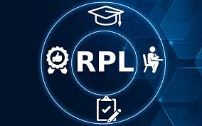
Impact of the NQF on Recognition of Prior Learning and Life long learning
Facilitated development of the National Policy on Recognition of Prior Learning (RPL) and Credit and Accumulation Transfer System (CATS), which promote learner progression, inclusivity and lifelong learning
CATS has enabled the transfer of students from one HEI to another within Zambia due to various reasons

Slide 19

Impact of the NQF on Mobility and Portability Zambian Qualifications
The NQF has facilitated the portability and mobility of Zambia qualifications to the rest of the world
It has created a consistent set of standards through which Zambian qualifications can be measured and recognised internationally
NQF has instilled trust in foreign competent Authorities in the processing of recognising Zambian qualifications that have undergone quality assurance process and are registered on the framework

Slide 20
Stakeholders Understanding of the NQF and their perception of its Impact
Employers indicated that the NQF is useful in the appropriate recognition of foreign qualifications for employment purposes.
Most stakeholders do not comprehensively understand the NQF and its role. They vaguely see as an instrument used to categorise qualifications.
NQF
Students and teaching attested that the NQF has impacted the standards of qualifications as Qualifications in the country are made to align with the NQF
Stakeholders also indicated that the NQF was an instrument used in the verification of qualifications
.
Management of education and training institutions indicated that the NQF impacted enrolment policies through promotion of Recognition of Prior Learning
.

Slide 21
Recommendation from the Study and Way forward
Increase stakeholder engagement to improve understanding of the NQF at individual and corporate level to improve understanding of the framework and its role in Education Training and employment
Engage on national sensitization of the revised NQF
  Revise the NQF to accommodate emerging qualifications and those currently not recognised
Develop a National Policy on Microcredentials.

Slide 22

ZIKOMO, THANK
YOU

